Slide 1
Your Website + Your Goals = A Success Story
Mason Shelby, Director, Digital Content
Lara Fahey, Specialist, Digital Content

Slide 2
Why is a good website important?

Slide 3
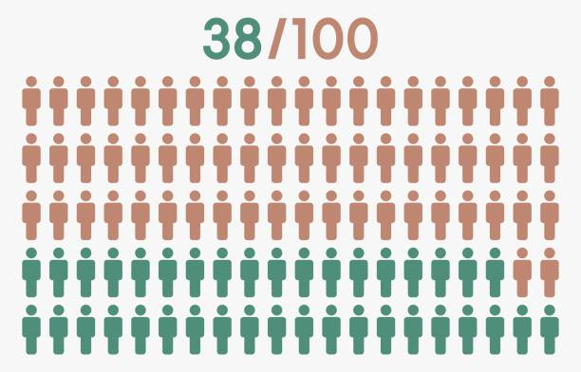
First Impressions
Notes:
According to a recent study conducted by Stanford University….
38% will stop engaging if the content or layout is unattractive
First impressions are 94% design related
75% of website credibility comes from design
https://www.paradigmmarketinganddesign.com/get-it-together-people-why-website-first-impression-statistics-matter/

Slide 4
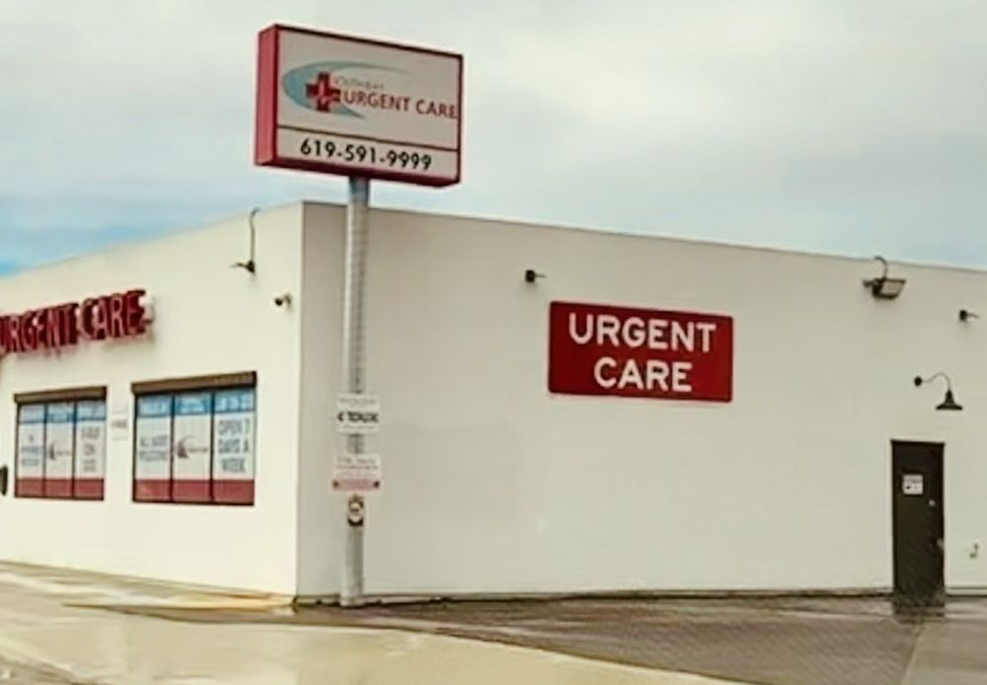
Branding & First Impressions

Slide 5
New This Year… the BRAND GUIDE!
A resource designed to:
Strengthen our identity
Unify our voice
Support consistent, impactful communication across our community
https://brand.exceptionalchildren.org

Slide 6
Optimizing Your Webpage in 3 Steps
Define Your Goals
Design Your Webpage
Assess and Re-design (as Needed)

Slide 7
Define Your Goals
What are the goals of your component?
Who is your audience?
Sample Goals:
Increase awareness of, and attendance at, an event
Increase member (and non-member) engagement
Increase the number of website views/sessions
New member registrations/renewals

Slide 8
Design Your Webpage
Does the layout/hierarchy of your website reflect your goals?
Is the purpose/goal explicitly stated? Why not?
Who is your audience?
How easy is it for users to convert (register, sign up, purchase, etc)?
Which design choices increase engagement/conversion, and which introduce clutter
Identify keywords, hero image, “elevator pitch”

Slide 9
Assess: Webpage Report Card
Clearly defined goal?
Descriptive title?
Overview description/instruction?
Strong hero image?
Using good/relevant keywords appropriately?

Slide 10
1. Clearly defined goal?
What is the goal(s) of your page?
Your goal(s) should be obvious
Your goals should be prioritized
Achieving your goal(s) should be easy/painless for the user
What’s your “elevator pitch” for the purpose of this webpage?

Slide 11
2. Descriptive Title?
Are you using a descriptive title on your page?
Is your title concise?
Is your title direct and un-mysterious?
Does it reflect what a user would enter into a search engine?

Slide 12
3. Overview description/instruction?
Does your page have an overview description or instructions for the user?
In the overview, you can explicitly state:
Who this webpage is for? Call out your audience, they will feel “seen”!
Remind or tell them: what is the goal?
Other background information / context? “Am I in the right place?”

Slide 13
4. Strong hero image?
What is a hero image?
A hero image is a large, attention-grabbing picture shown in the above-the-fold area of the webpage or email.
1 Great Picture > 10 Okay Pictures
Pictures with People > Pictures without People
Repeated, consistent use of hero image across channels (website, email, social media)

Slide 14
5. Using good/relevant keywords?
Are you including keywords in the content of your webpage?
Does it reflect what a user would enter into a search engine?
When to use thesaurus? Finding the right balance between repeating the same words or phrases enough to positively influence search engines without being too redundant

Slide 15
Webpage Report Card: Grading Time!
How did we do?
Wins to celebrate?
Areas to work on / improve?

Slide 16
Thank You!
Mason Shelby, Director, Digital Content
Lara Fahey, Specialist, Digital Content
Email us: websubmit@exceptionalchildren.org
Submit a request: exceptionalchildren.org/webrequest

