Slide 1
Student Chapter Success
Caroline Schwartz, Component Services Manager

Slide 2
Agenda
Introductions
The Importance of Students
CEC Student Chapter Website Overview
Resource Review
So, You Want to Start a Chapter…Chapter Development Process
Share Out and Brainstorm
Q&A

Slide 3
Welcome! About me…
Currently serve CEC members as a Component Services Manager
Primary focus is student chapters, student members, and early career members
Staff liaison to Student and Early Career Committee
Support one of our sub-divisions, MAASE
Been on staff for almost three years

Slide 4
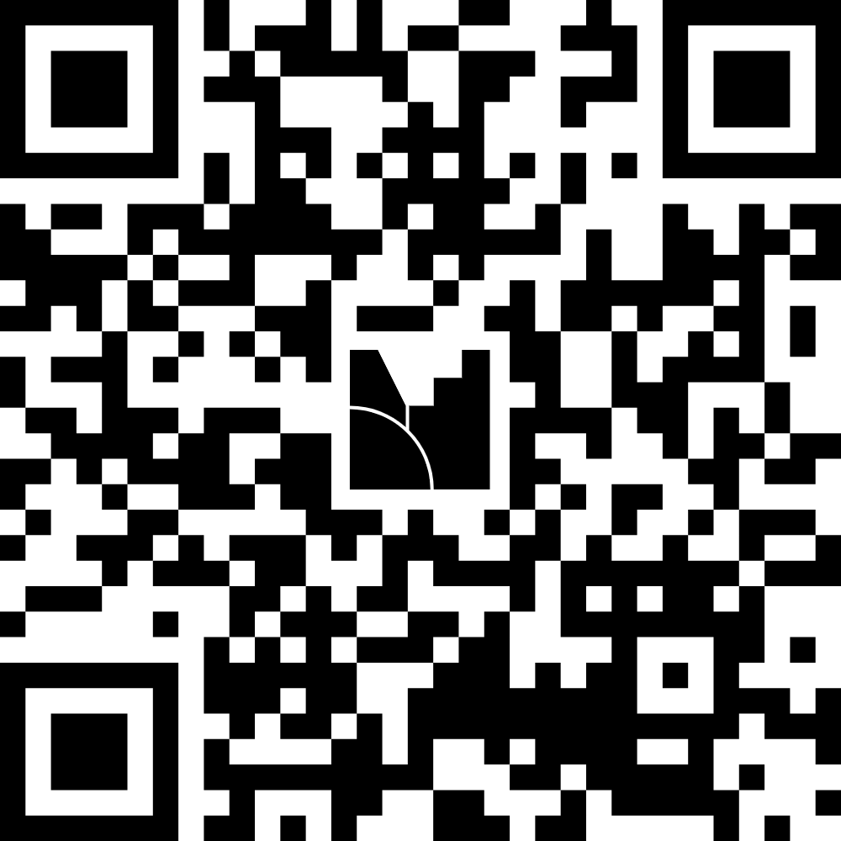
Let’s get to know you!
https://www.menti.com/aluwr5w36rea
Notes:
https://www.menti.com/aluwr5w36rea

Slide 5
Why are students critical?
Notes:
Insert video from SECC here

Slide 6
Notes:
Note: Explain what the first question was before playing the video, the first question is cut off.

Slide 7
Student Membership Data
Active Members
2,526 Pre-Service Members
2,523 Graduate Student Members
Growth from “Access for All” Campaign
589 New Pre-Service Members
851 New Graduate Student Members
Active Chapters
80+ Student Chapters Across the Country

Slide 8
CEC Student Chapter Website
https://exceptionalchildren.org/engage/student-chapters

Slide 9
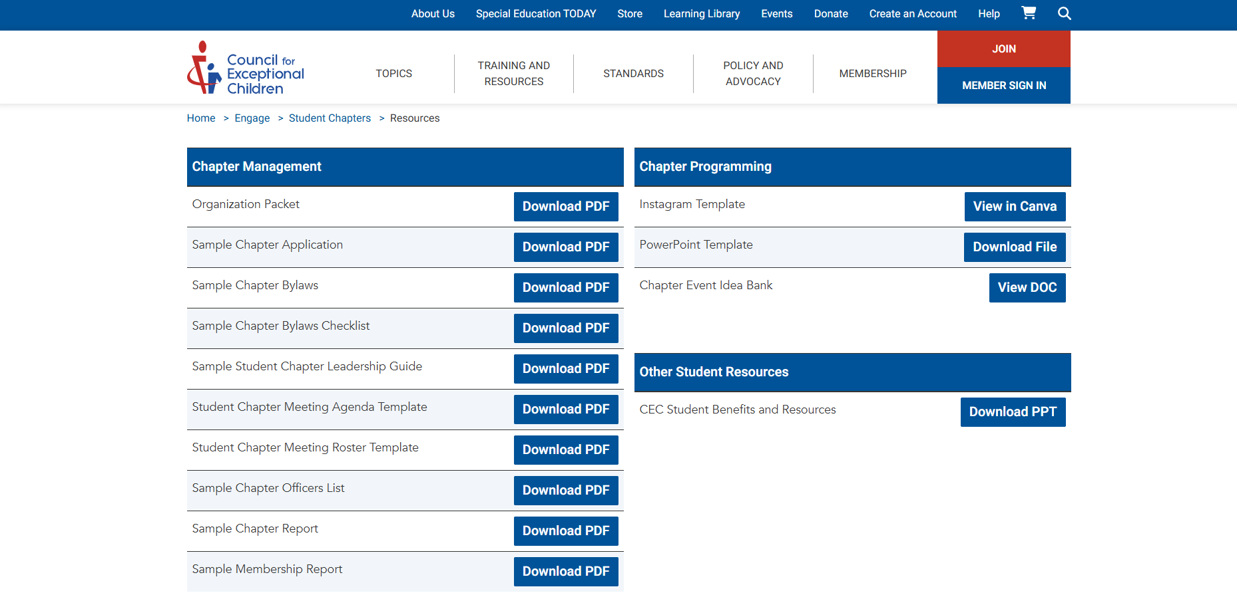
CEC Resources for Student Chapters
CECommunity for Advisors
Sample documents
Ready to use materials

Slide 10
Chat amongst yourselves…
What is your biggest motivation for engaging student members?
What is your component’s biggest challenge when it comes to this?
Feel free to share your thoughts with a neighbor!

Slide 11
So You Want to Start a Chapter…
Interested groups will reach out to either CEC Headquarters or their unit
Student chapters need to abide by campus requirements in addition to unit requirements
The chapter should hold an initial meeting to establish themselves and meet unit requirements
The chapter will submit any required materials to the unit
The chapter will receive a number from CEC headquarters and be added to the database
Student chapters must also report an advisor to CEC headquarters
Notes:
Show hand out at this time and go through it with them

Slide 12
Student Chapter Town Hall Events
Join us or spread the word
Held twice a year (one in the Fall semester and one in the Spring semester)
Target audience is student chapters and early career members
Fall Town Hall will be advocacy related-save the date for September 15th
Notes:
Talk about our new development with the SECC and our town halls.

Slide 13
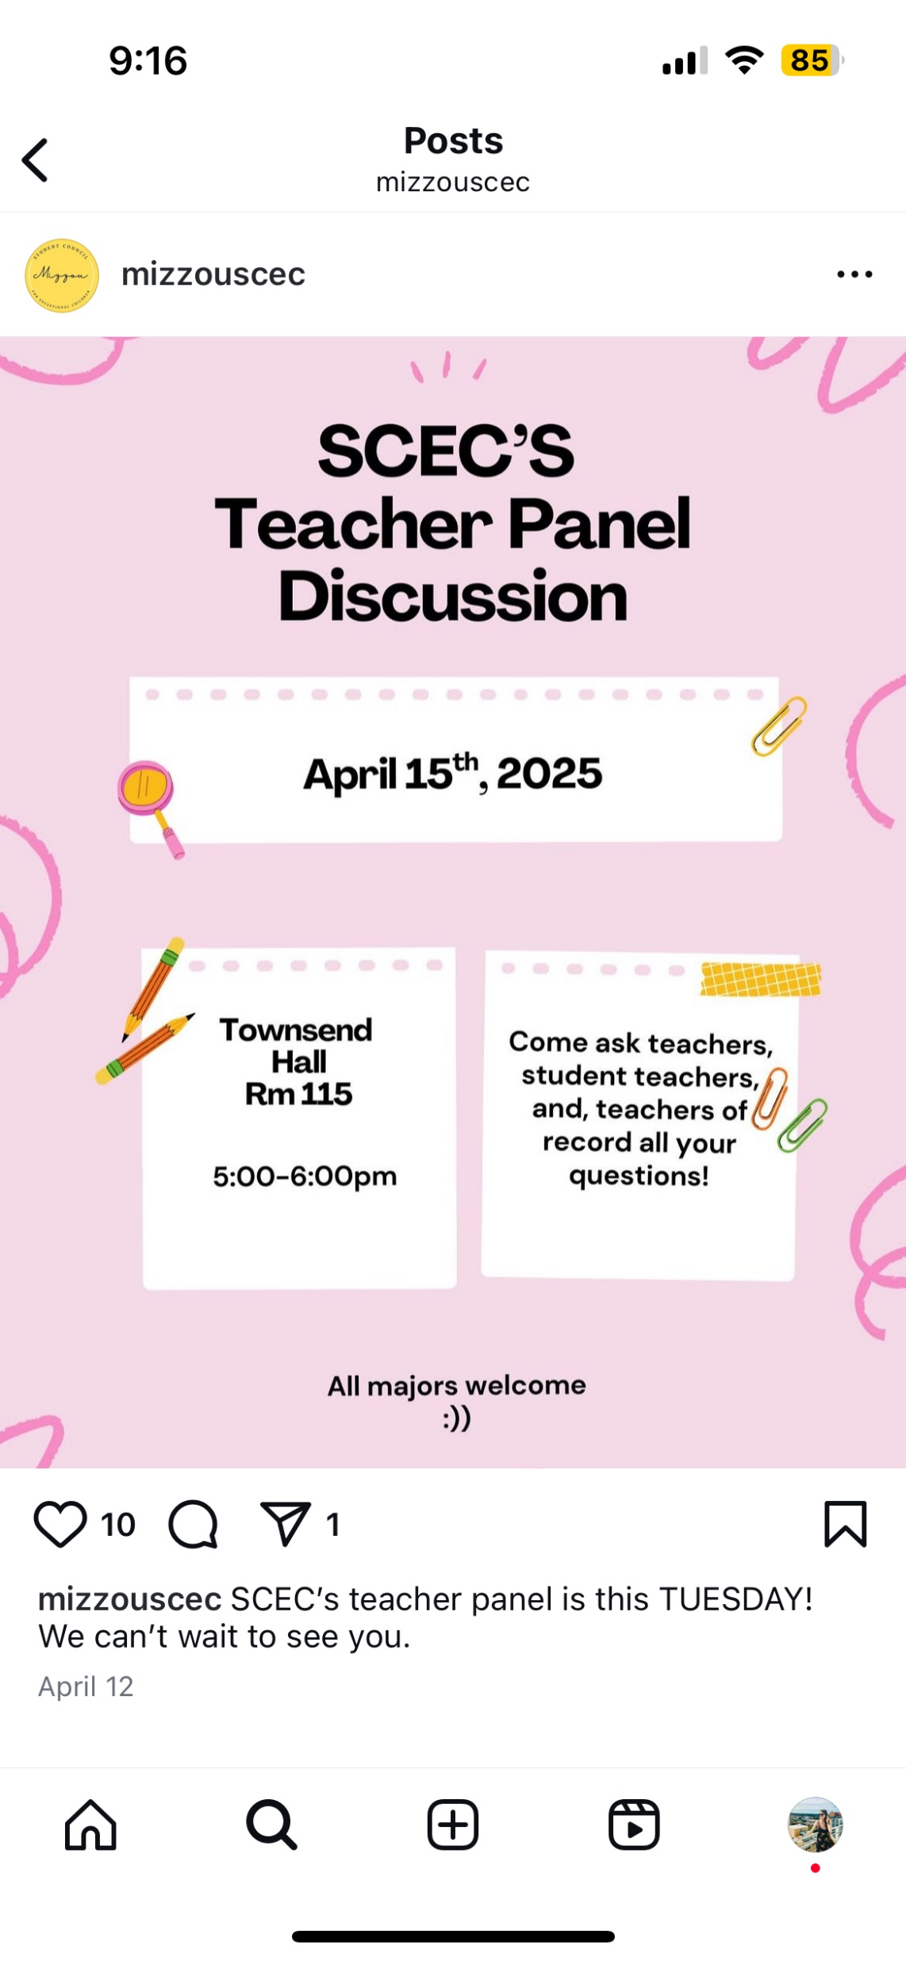
Time to Share!
Notes:
Show examples of student chapter activities from active chapters

Slide 14
More Great Ideas

Slide 15
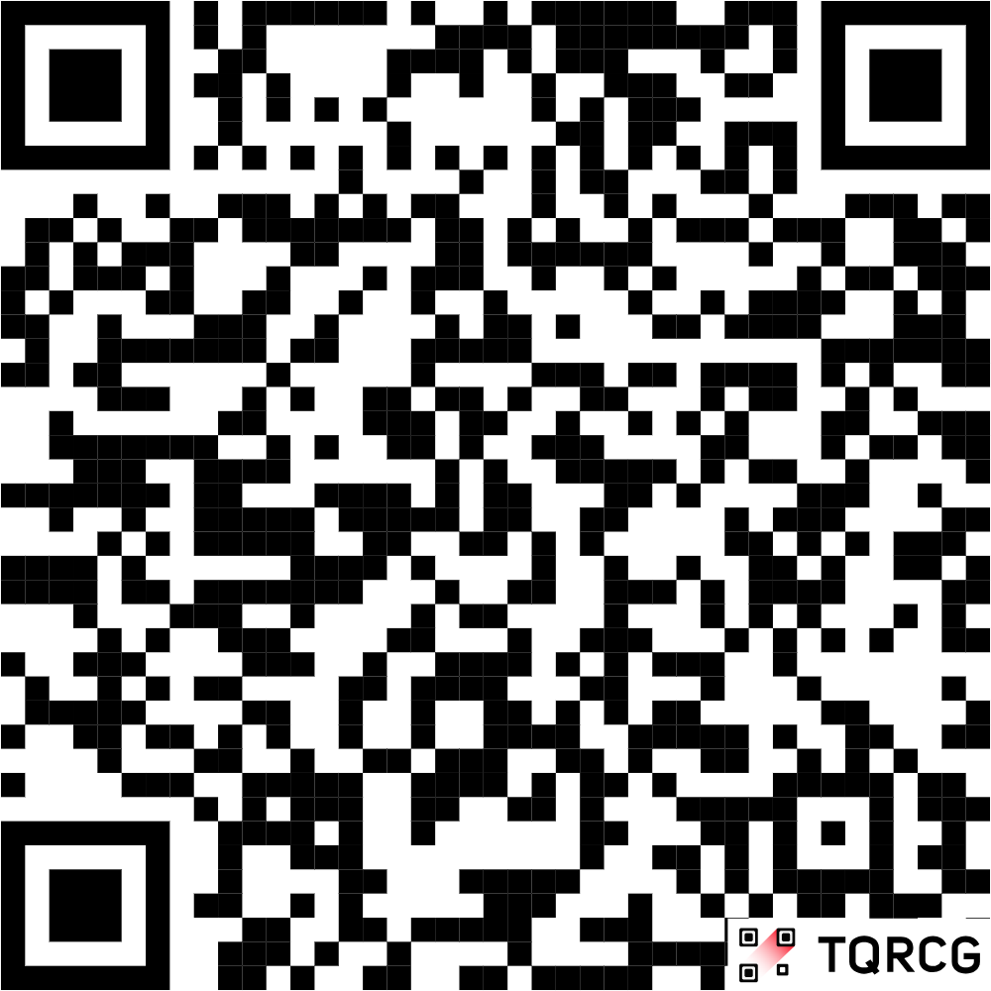
Q&A and Thank You!
Caroline Schwartz cschwartz@exceptionalchildren.org
Student Chapter Webpage:

