Slide 1
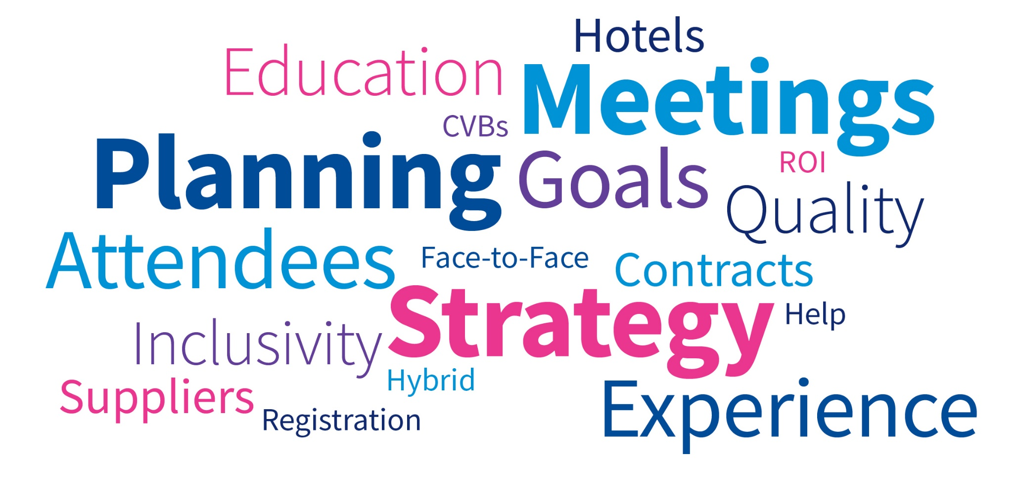

Slide 2
Today’s Goal: Conversation and Collaboration
To provide tips on running an event including:
Current Events
Finding Balance: Revenue vs Relationships
Negotiations
Resources
The “B” word
Education
Create memorable, favorable experiences
Connection and networking opportunities
Details to consider
Sponsorship overview
Notes:
Melissa
tips on running an event including: determine the “why”, setting a budget, picking a location, sponsorship opportunities, and more. We encourage you to ask questions throughout the presentation.

Slide 3
Current Events: How Does This Impact Your Event?
Political Climate
Impact on Travel
Where are your attendees coming from?
What are your contractual obligations?
State funding and grants
Tariff
Rise in cost of goods and services
Impact on potential sponsorship
Marketing and Promotion
Mindful of verbiage
Contracts
Force majeure clause
Performance clauses

Slide 4
Partnerships, Revenue, and AI
Navigating revenue expectations or needs of hotels, convention centers, venues
AI is being used to review/ accept or reject requested changes
AI utilization to write your RFP, design your events
Where do partnerships play in?
Where is the Value Proposition?
Notes:
Ask for audience participation. Sharyn and Melissa will share experience as well. Never assume the 1st offer is the best.

Slide 5
Negotiations
What is your bandwidth to negotiate?
Communicate if best offer will secure the bid
Where are you flexible, if at all?
Timing of decision; ASAP, by “x” date, whenever it gets done is ok
Do you have to be in specific location, date range? If so this “could” limit your negotiation leverage
Who do you know?
Transparency, share your pain points, goals and budget. Looking for a win/win partnership

Slide 6
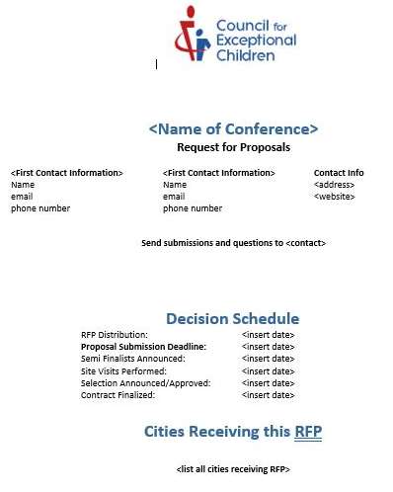
RFP Template
Notes:
Melissa
Example of an RFP template. Make sure to include important information and past history from the event including hotel pickup and F&B history.

Slide 7
Resources
Who should you work with? Who can help?
CEC headquarters
Destination CVBs
A CVB is a Convention and Visitors Bureau or tourism bureau. These organizations provide education and resources to local communities and travelers with the aim of promoting travel to a location, events and conventions in the area, and other hospitality business.
http://www.cvent.com/rfp/convention-visitors-bureau-directory-ee12b9994b424e4f91f7d48ae60d170c.aspx
National Hotel Sales Contacts/Partner
Leverage relationships, big picture opportunities; CEC has Global Representation with Hilton, Hyatt, Omni and Marriott Hotels
Leverage your CEC relationships and be knowledgeable on where other Units and Divisions are holding their events
DMC’s
Local Planning Committee
Local Schools
Notes:
Sharyn Start, Be transparent…with CVB’s & Global Sales Partners they should be client advocates, increase engagement with hotels, connect you with key contacts, advocate for your organization connect your event with the spirit of the location.

Slide 8
Time to Plan Your Event
Establish Goals and Objectives
Type of Meeting
Face-to-Face
Hybrid
Digital/Virtual
Revenue Generating
Educational
Social, Networking, Engagement
Target Audience
Content Delivery
Attendee Experience
What does success look like?
Notes:
Melissa- determine the “why” Goals for organization and attendees,
Sharyn- what type of meeting, will educational credits be offered?, ROI for success

Slide 9
The “B” Word - Budget
Set financial goals for meeting
Profit goal: Revenue exceeds expenses
Break-even goal: Revenue equals expenses
Deficit goal: Expenses exceed revenue
Creating a budget
Incremental budgeting: using previous year’s meeting history
Zero based budgeting: no past history
Budget elements
Revenue: registration fees, exhibitor/sponsorship sales, merchandise
Expenses: Fixed versus variable costs
Fixed: AV, meeting space rental, security
Variable: Food and Beverage, specialty items (swag bags), hotel rooms
Notes:
Melissa- establishing a budget, what are the organizations goals, do you have a past information on total spent or is it a new event/meeting? Do you know what your fixed costs are? How many attendees are you estimating for?

Slide 10
Attendee Experience
You have your goals and objectives – now think about your attendee.
What does that experience look like?
What is the lifecycle of the event
How do we communicate with individuals throughout the year?
Ask Why?
Notes:
Sharyn Start – I included this as we believe that a meeting is no longer space, rates and dates. Same old, same old is not going to work. When I discuss experience – it starts from when the event is announced, when the attendee goes to register, sign up for sessions, marketing the event, communications to the attendee, the know before you go is a good example, to the end of the event, and how far are you taking that event into the future.

Slide 11
Location, Location, Location
Things to consider when choosing an event location:
History of your event (where have you already been)
Survey results
Geographically attractive/desirable/will it sell
Safety first
Politically correct
Perception
Convention Center/multiple hotels/under one roof
Off-site venues
Affordable
Walkable
Attractions
How will the destination support your event?
Notes:
Melissa Start
You understand type of event, goals and objectives, attendee experience – now let’s talk about the details to consider when choosing an event location. Your attendees should be top of mind when considering all of these details.

Slide 12
Hotels
Things to consider when choosing hotels:
How many guest rooms does your event need?
How much meeting space/exhibit space do you require?
Room set up?
Does the hotel contain your event? Overflow?
Big Fish
How far out are you booking your event?
Special accommodations?
VIPs
Sub-blocks
Student blocks
ADA rooms
Suites
Date flexibility?
Concessions & comps
Notes:
Sharyn Start….service, you’ll get a good indication during the RFP, site selection process, meet and or interact with as many people at the locations being considered

Slide 13
Hotel details…details…details…
Set-up
Will all of your meeting rooms stay the same throughout the event? If not, will the venue charge to change the set-up?
Will you need rooms locked (staff offices, expo hall, etc.)?
Wifi
Is Wifi provided in meeting rooms and public areas? If not, what is the cost?
AV
Are you allowed to bring in your own AV, or is there a company you must use?
Electrical
Will you need extension cords, power strips, etc. at tables or at registration? Will there be a charge for those?
Partners
Who are they at the venue, can you bring in outside partners?
Notes:
Melissa Start
Here are some common items when planning and contracting meetings. Many of these items can be noted in the RFP and negotiated during contracting.

Slide 14
It’s all in the details…..
Registration
Sponsor/Exhibitor/Display tables
Staff office/storage
Is storage close enough to wherever you need to move your boxes, or do you have a dolly/cart/someone who needs a workout?
Private rooms
Nursing room
Sensory room
Prayer room
Restroom availability
Will you need family restrooms?
Gender neutral restrooms?
Does your registration team know where the restrooms are (number one question you’ll be asked!)
Notes:
Sharyn Start
When you’re thinking about where to put your various events/sessions/etc., think about the following (if you need them, and where they can go). Think about what makes the most sense from navigating the venue (put registration closer to where people will enter, for example) as well as space limitations (maybe there’s only one room big enough to hold the keynote)

Slide 15
Food & Beverage
Are you providing meals/beverages as part of your event?
If not, where can attendees go for lunch/breakfast/coffee?
If yes, where will it be? Working lunch, unique space options, etc.
Can the hotel or city provide special discounts at restaurants for your attendees
Have you asked for/considered dietary restrictions?
Common restrictions/allergies:
Vegetarian
Vegan
Allergen-free (dairy, nut, gluten, soy, seafood)
Ask the venue to indicate ingredients and/or dietary highlights on displays
Negotiate any requested considerations PRIOR to contracting
Notes:
Melissa Start
Do your research ahead of time on any dietary or food allergies. You can request to work with the chef on special meals and gluten free and vegan options.

Slide 16
Sponsorships
Analyze touch points throughout your event that are sponsorship opportunities.
Where are you branding?
What are you showcasing to your attendees?
Event Announcements
Registration Pages
Educational Sessions/Speaker Introductions
Footprints, Floor decals
Attendee Give-a-ways/Tote Bag/Water bottles/
Food and Beverage/Coffee Breaks/Water Stations
Off Site Events/Venues
Banners/Signage
Hotel key card
Transportation companies/step/escalators/elevators
Collateral – Pre/During/Post
Guest Room Drops
Awards/Entertainment
Exhibitors
Suppliers - Photography/Florists/Destination
Notes:
Sharyn Start

Slide 17
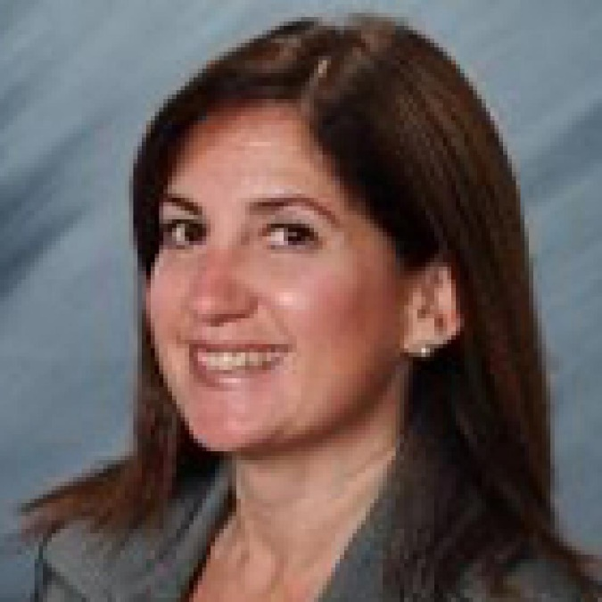
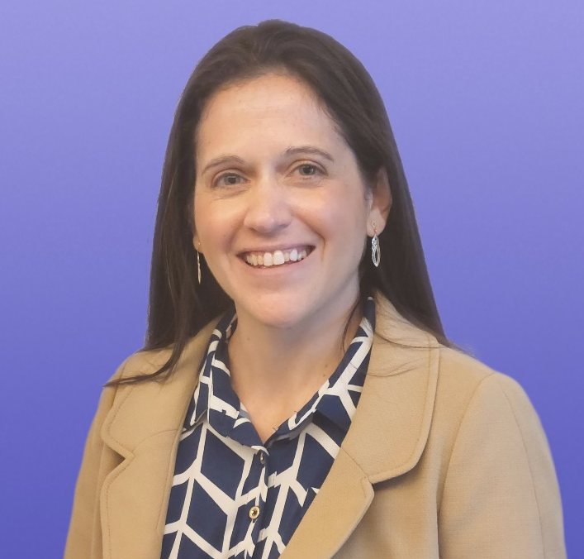
Questions & Answers
Sharyn Weiss
Director, Strategic Partnerships
sweiss@exceptionalchildren.org
Melissa Trout, CMP, DES
Senior Meetings Manager
mtrout@exceptionalchildren.org

