Slide 1
Reaching More, Engaging Better: The MCEC Social Media Refresh
Danya Stump

Slide 2
Introduction
I’m Danya Stump, Vice President of Michigan CEC. I’m excited to share a quick look at how Michigan CEC refreshed our social media presence to better connect with our community, highlight important work in the field of special education, and engage members in meaningful ways.
Alt Text:
Group of adults in blue Michigan CEC shirts outdoors on a grassy area at Michigan State University. Text reads "2024/2025 Board of Directors."

Slide 3
Project/Initiative
In 2022, we decided that we needed a Social Media “refresh”. Our graphics were often copied out of google or some other search engine. They did not convey our mission, or even signify who we were as an organization.
o Wanted to increase member engagement and communication.
o We wanted all social media posts to convey our “brand”, be recognizable by our membership, and encourage engagement.

Slide 4
What is it?
We created a “social media system” that allowed us to create branded, recognizable posts.
o We utilize a social media calendar. It allows the Communication and Membership committee to brainstorm ideas of what we think is important to our membership.
o EA has a Graphic Design degree, but we did consider hiring a Social Media Intern.
o It is an ever-evolving system that changes as we learn new things.
o Also have a social media raffle at our conference.

Slide 5
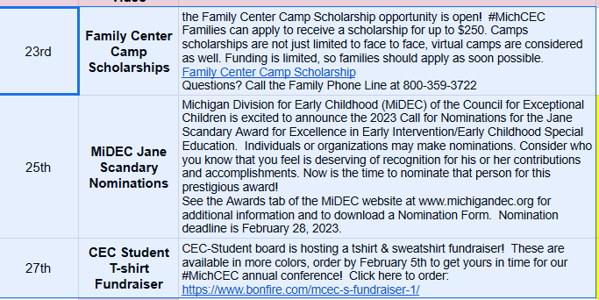
Sample section of Social Media Calendar

Slide 6
Impact
The impact has been two fold. By sharing out through social media, using recognizable branding, we have:
o More than doubled our membership numbers.
o We learned that the posts that are recognizable, get more member engagement. Our Reels, stories, and Facebook lives get more engagement for the under thirty members.
o We have adjusted our types of posts and know that some of our “series” are more popular (parent and sibling spotlights, conference posts, accessible summer posts).

Slide 7
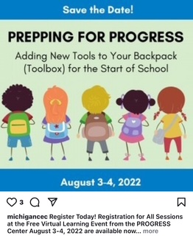
Alt Text:
Illustration of five diverse children with backpacks facing away, under "Prepping for Progress" event details for school preparation on August 3-4, 2022.

Slide 8
Sample of current posts
Alt text: Collage of conference attendees and speakers with event details for the 86th Annual Michigan CEC Conference, "Igniting Change Together 2026," in Grand Rapids, MI, February 25-28, 2026.

Slide 9
Accessibility
Don’t forget to make sure your PowerPoint is accessible:
https://support.microsoft.com/en-us/office/make-your-powerpoint-presentations-accessible-to-people-with-disabilities-6f7772b2-2f33-4bd2-8ca7-dae3b2b3ef25#PickTab=Windows
The “Always Use Subtitles” function has been activated for this PowerPoint presentation. This feature is part of the Microsoft 365 package and may not work on older versions of PowerPoint.

Slide 10
Final Wrap Up
A clear, cohesive brand not only boosts engagement but also helps support membership growth—especially when you're sharing important updates or calls to action.
We’ve created a post template that’s available for you to use and adapt as needed!
We found it to be so useful!
I strongly encourage you to develop a consistent social media brand that makes your component easily recognizable to your members.
Danya Stump: dstump.mcec@gmail.com

