Slide 1
New Teacher Institute: Mentoring to Retain Special Educators in Ohio
Erin Loomis: CEC-Ohio Mentoring and Membership Chair
Laura Sebastian, MAT, M.Ed: CEC-Ohio CAN Coordinator and Professional Development Chair

Slide 2
New Teacher Institute
NTI provides support, resources, and networking for
early career teachers
Beginning cohort 4 in Fall 2025
Offer free CEC membership along with one-on-one mentoring from an experienced educator
Scholarships offered to attend national and state conferences
Special educators and general educators were invited to join

Slide 3
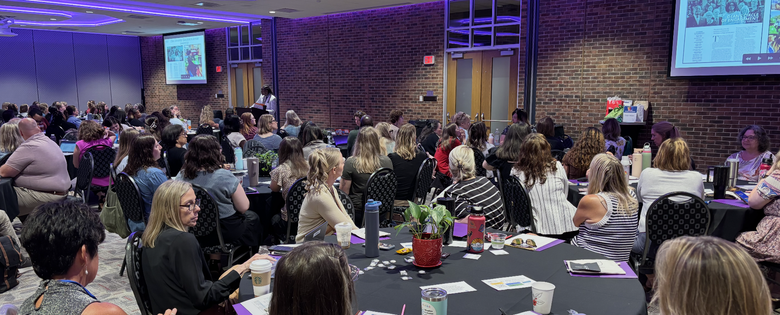
State Partnership
CEC-Ohio partnered with the Ohio Department of Education and Workforce (ODEW): Office of Exceptional Children
ODEW was looking into ways to retain teachers in the state
CEC-Ohio applied for grant funds to pay for memberships and other related expenses
Summer 25: We hosted Communities of Practice with ODEW to share progress and approaches with other organizations including SLPs and School Psychologists

Slide 4
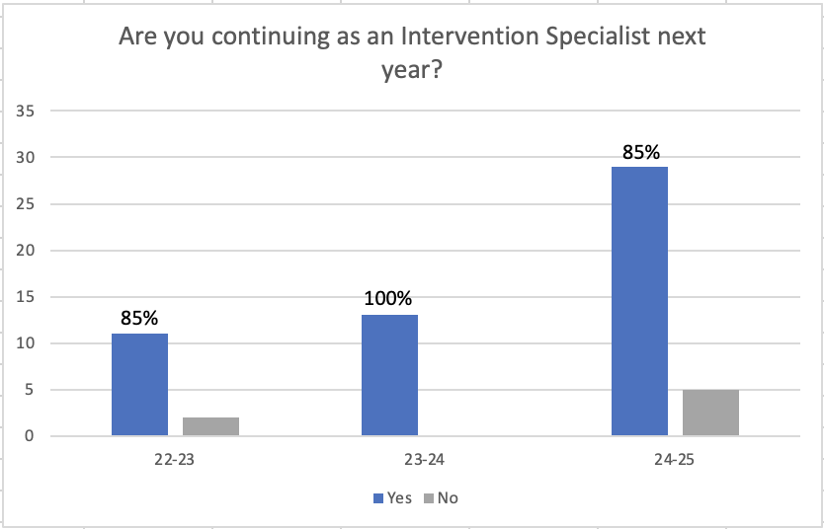
Participation and Retention
2022-23: 100 mentees; 17 mentors; 13 scholarships to Louisville
2023-24: 40 mentees; 21 mentors; 20 scholarships to San Antonio
2024-25: 76 mentees; 48 mentors; 25 scholarships to Baltimore

Slide 5
How can you do it?
Foster partnerships with public entities in your own state
Invite them to unit or division meetings
Ask for updates to be shared with the organization
Consider recording updates to share out with members
Set clear expectations for everyone involved
Collect data and ask questions of participants as you go

Slide 6
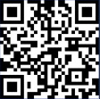
THANK YOU
Scan QR code to see our mentoring website-
https://tinyurl.com/cecnewteacher
Feel free to reach out for more guidance!
Erin Loomis
Membership & Mentoring Committee Chair
eloomis2795@gmail.com
Laura Sebastian, MAT, M.Ed
CEC-Ohio CAN Coordinator
lauramae18@gmail.com

