Slide 1

Mission: Communicate
Crafting a Cohesive Campaign Across Channels
Hannah Hickman & Will Webber, CAE, CVA
Notes:
Today, we’re going to learn how to take your communications from reactive to strategic by building a mission-ready plan that aligns social media, email, and web. Think of it like assembling your toolkit and activating your inner secret agent—but for strategic volunteer communication!

Slide 2
Today’s Mission
Your Mission, Should You Choose to Accept It:
Create a unified communication strategy across social media, email, and web that advances your organization’s goals and connects with your target audience.
Notes:
This is your official mission briefing. You’re here today because you’ve already tackled the basics of communication. Now, it’s time to go undercover and take things up a notch. This mission is all about creating a coordinated communication plan—not just pushing out messages, but making sure they work together and work smart.
HH

Slide 3
Mission Objectives
Understand core components of strategic volunteer-led communication
Identify and segment audiences
Align messaging across social, email, and web
Schedule for strategic delivery
Use tools to plan, track, and measure
Notes:
These are the core objectives of our mission today. By the end of the session, you should be able to understand what goes into a strategic communications plan, how to define and reach your audiences, how to choose the best channels, and how to plan your rollout for impact
WW

Slide 4
Your Communication Arsenal
📧 Email
📱 Social Media
🌐 Website
Notes:
These are your three primary tools. Like any good secret agent, you need to know what’s in your arsenal and when to use each tool. Each has its strengths. Your email is direct and personal, social media is fast and engaging, and your website is your trusted home base. Let’s explore how to use them together
HH

Slide 5
Decode the Mission
Clarify Your Goals:
  Recruitment
  Engagement
  Awareness
  Event Promotion
  Advocacy
Notes:
You can’t hit your target if you don’t know what it is. Start every campaign by defining your goal. Are you trying to recruit volunteers? Raise awareness? Promote an event? Everything you do—from the tone of your message to the channel you choose—should support that goal.
WW

Slide 6
Know Your Targets
Audience Intel:
  Who are you trying to reach?
  What do they care about?
  Where do they get their information?
Segments to Consider:
  Members vs. Non-Members
  New vs. Returning
  Different age groups or locations
Notes:
Like any good mission, knowing your target is critical. Different audiences need different messages. Think about whether you’re speaking to new members, longtime supporters, or the general public. What do they need from you? Where do they spend their time?
HH

Slide 7
Choose Your Channel Wisely
Channel | Best For | Notes
Email | Personal Updates, CTAs | Great for detailed messaging
Social Media | Engagement, quick updates | Visual, short, shareable
Website | Core info, resources, archives | Hub for all communications
Notes:
Here’s a cheat sheet to help you choose the right channel for each part of your campaign. Use email for in-depth updates or personal asks. Social media is great for visibility and interaction. And your website is where everything should live long-term—event details, registration, resources. Match your message to your medium.
WW

Slide 8
Timing is Everything
Create a Comms Timeline:
  Coordinate channel timing
  Avoid flooding followers
  Schedule around key dates
Mission Tip: Use a calendar to visualize your campaign rollout.
Notes:
Timing can make or break your campaign. If you post everything in one week and go silent for three, you lose momentum. Stagger your outreach. Use a calendar to map out what goes where and when. Plan around important dates and give people time to engage.
HH

Slide 9
Assemble Your Toolkit
Planning: Google Sheets, Airtable, Notion
Scheduling: Buffer, Hootsuite, Mailchimp
Tracking: UTM codes, open rates, clicks, shares
Notes:
You don’t need fancy tools to be strategic—but you do need a system. Even a simple spreadsheet can help you stay organized. Use planning tools to map out content, scheduling tools to automate delivery, and tracking tools to measure what’s working.
HH

Slide 10
Sync Your Branding
Bolster your message by utilizing CEC’s brand guide
Adopting a singular brand serves as a unifying force that connects every facet of CEC
Brand.exceptionalchildren.org
Notes:
You don’t need fancy tools to be strategic—but you do need a system. Even a simple spreadsheet can help you stay organized. Use planning tools to map out content, scheduling tools to automate delivery, and tracking tools to measure what’s working.
HH

Slide 11
Operation Alignment
Ask:
  Does this message reflect our values?
  Is the tone consistent?
  Does it support a larger goal?
Notes:
Before you launch any campaign, ask yourself: does this align with our mission? Does it sound like us? Are we telling a consistent story across platforms? Alignment ensures your audience trusts and understands you, no matter where they hear from you.
WW

Slide 12
Case File: Access For All Campaign
Overview: A free membership drive for two weeks in March 2025
Goal: Recruit new members at a time where we have a lot of attention on CEC due to our policy/advocacy work
Campaign: Email (SET, dedicated emails to nonmembers and members), Social Media (several posts on all platforms), Website (dedicated landing page), Toolkits (components, board, partners)
Notes:
HH

Slide 13
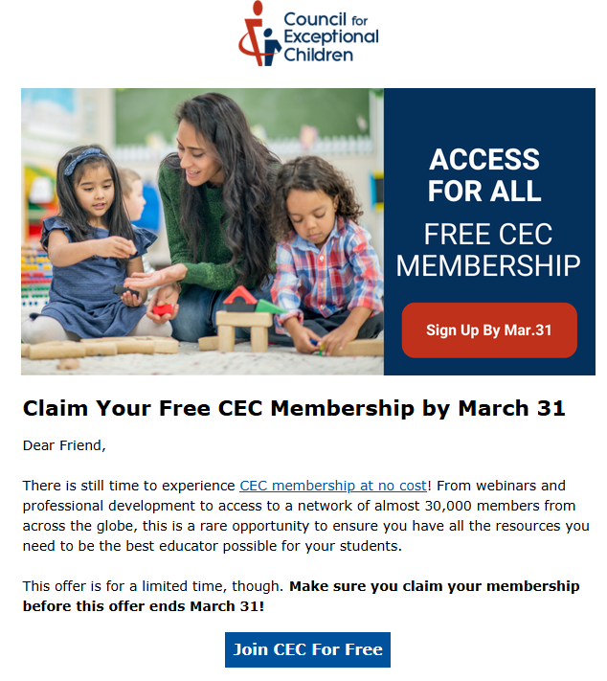
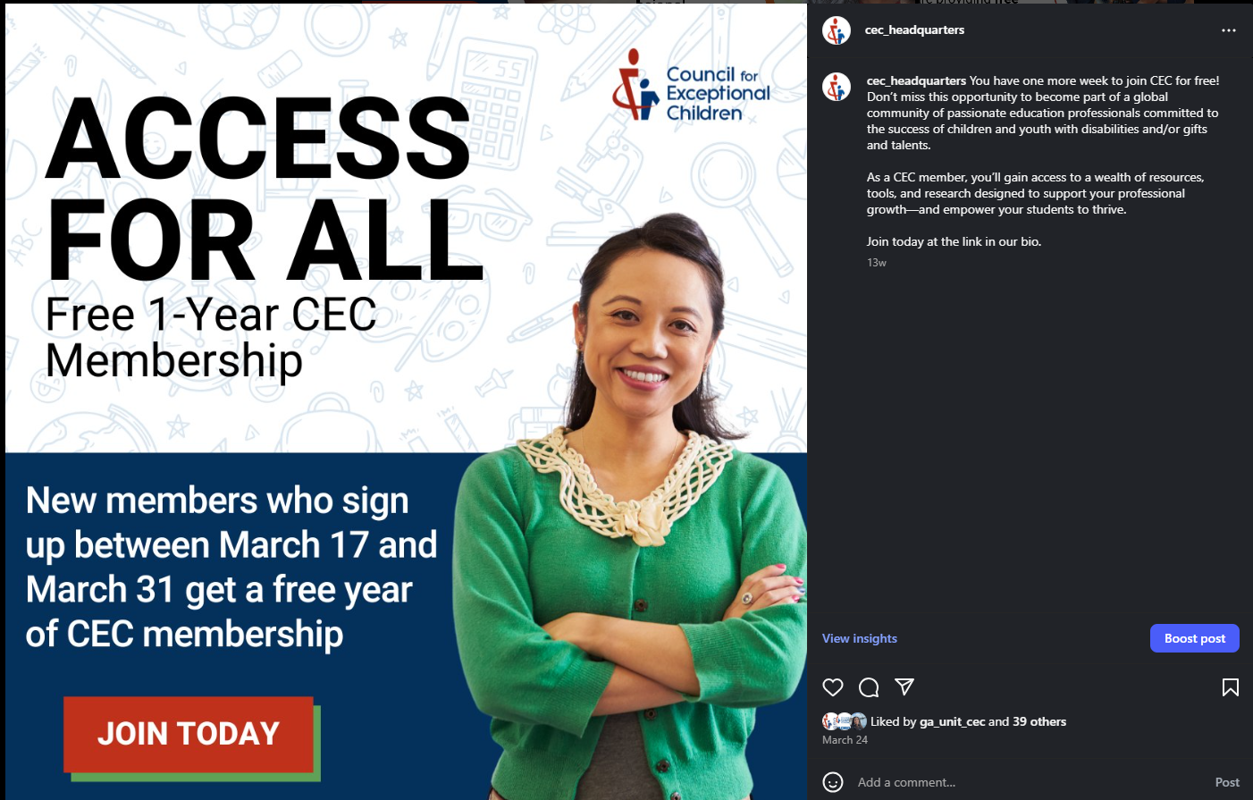
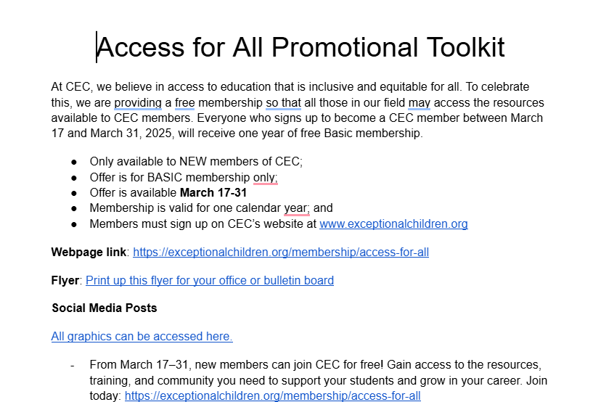
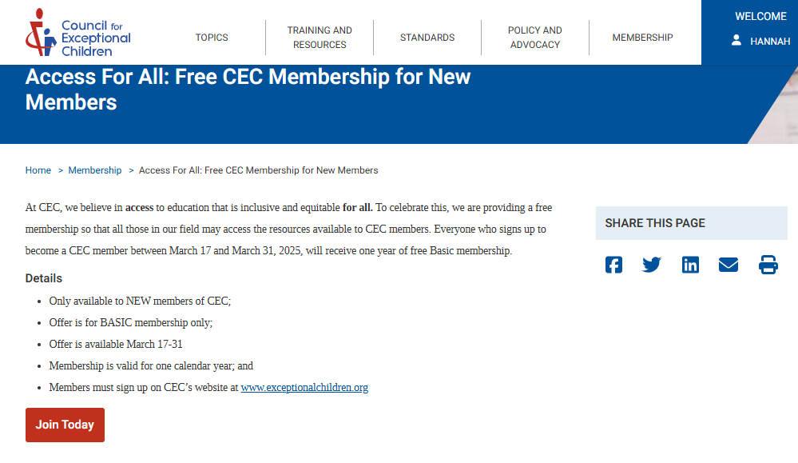

Slide 14
Mission Debrief – Recap
✅ Know your goal
✅ Know your audience
✅ Match message to channel
✅ Schedule intentionally
✅ Track and align everything
Notes:
Let’s debrief. You now know the key elements of a strategic communication plan. Everything comes down to clarity, coordination, and consistency. This is how you move from just communicating to communicating with impact.
WW

Slide 15
Final Mission
Your next steps:
  Choose an upcoming initiative
  Map the message across 2–3 channels
  Test timing, tools, and tone
  Evaluate what works
Notes:
Here’s your next assignment: take an upcoming project and apply what you learned today. Plan out your message, choose your channels, schedule it, and see what works. Treat it like a mission, and adjust as you learn.
HH

Slide 16
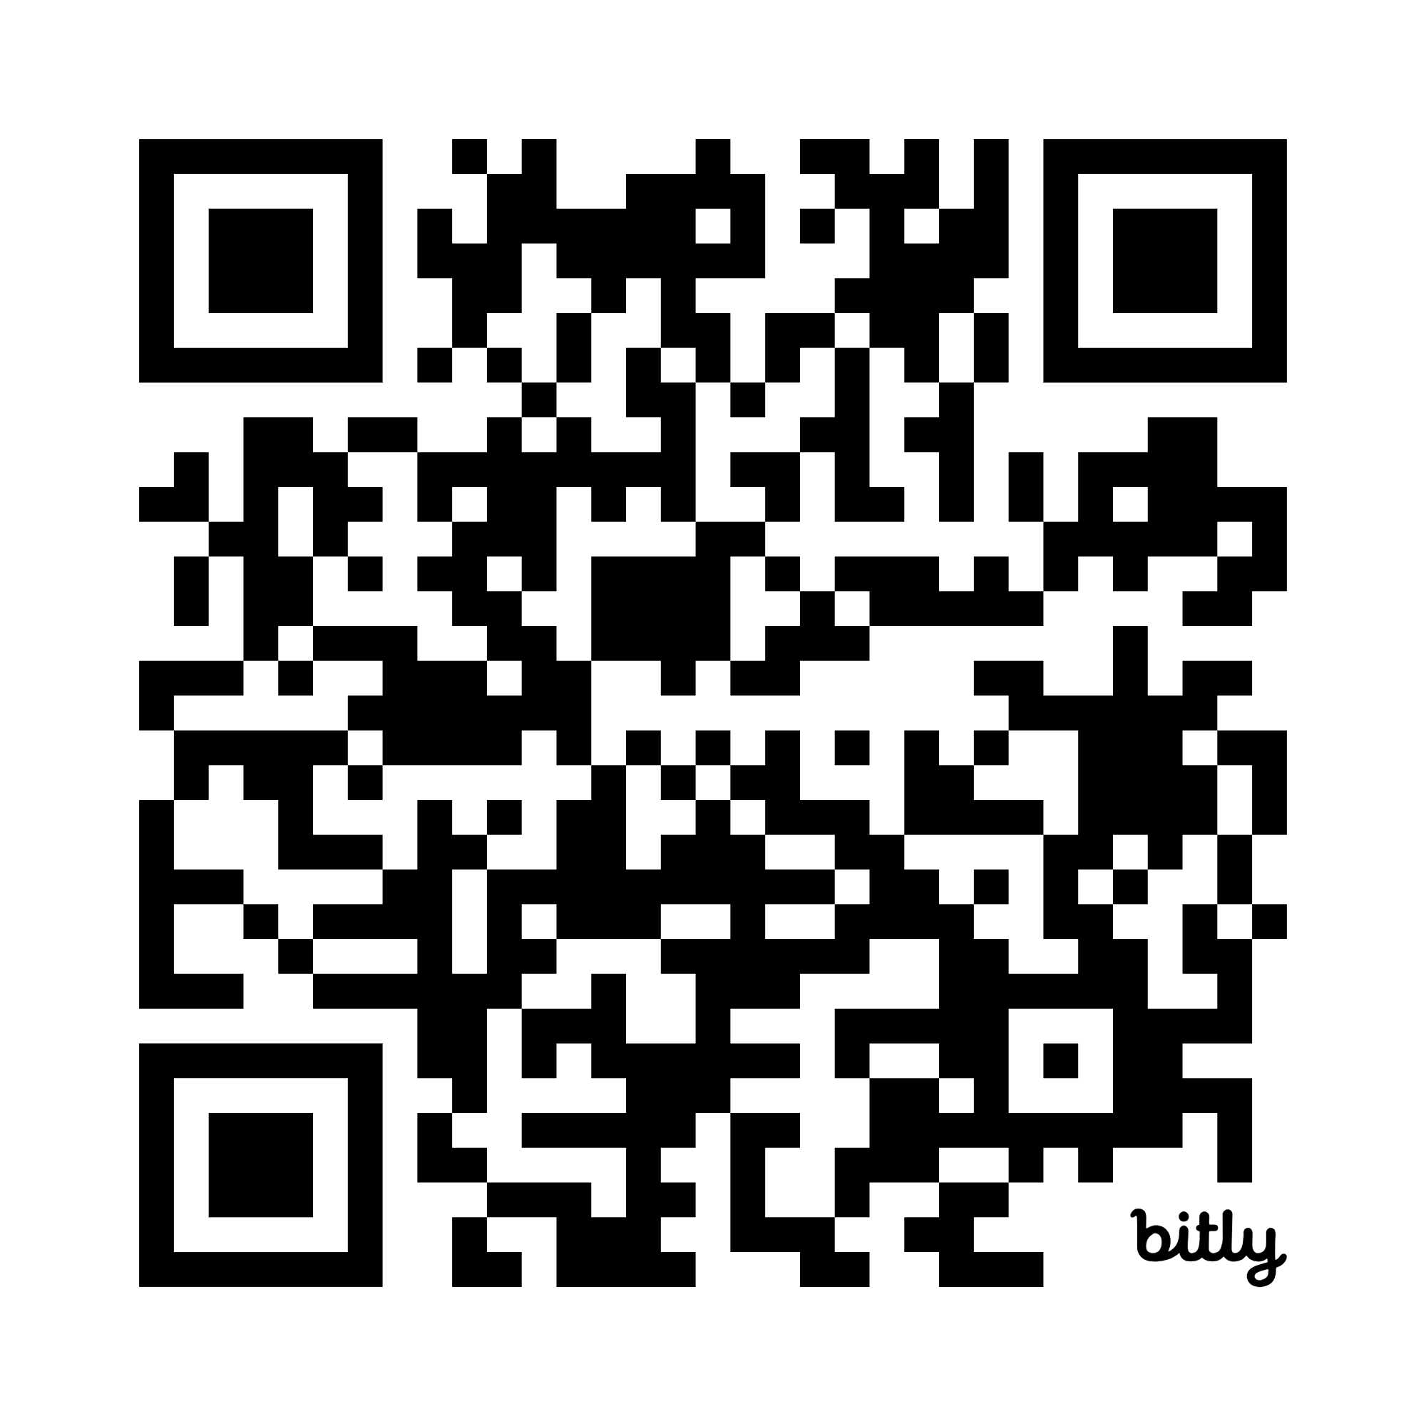
Pull Up Your Mission Resources
Notes:
Here’s your next assignment: take an upcoming project and apply what you learned today. Plan out your message, choose your channels, schedule it, and see what works. Treat it like a mission, and adjust as you learn.
HH

Slide 17
Thank You, Agents
🔐 Mission Complete
Hannah Hickman, Marketing Manager
hhickman@exceptionalchildren.org
Will Webber, CAE, CVA, Senior Manager, Component Services
wwebber@exceptionalchildren.org
Notes:
Thank you for your time and energy today. I hope you feel more equipped to lead your next communication mission. Keep things aligned, intentional, and strategic. And remember: your message matters. Good luck, agents!

