Slide 1
Meeting the Moment: Build and Deliver Member Expectations
Chad Rummel, M.Ed, CAE
Brannan Meyers, CAE

Slide 2
Agenda
Understanding CEC Membership
The Membership Cycle
Branding
Recruiting
Proposition Value
Engaging
Next Steps

Slide 3
Who are we?
CEC
Location
Personal
Specialty
Career

Slide 4
Categories
Pre-service Student (undergraduate or graduate)
Graduate Student
Early Career Professional
Professional
Paraeducator
Retired
Family/Parent Affiliate

Slide 5
Tiers
Basic | Full | Premier
Pre-Service Student Members: Liability Insurance
Resource Library, Quick Takes
SET Today, Store Discounts, Online Journals
Communities, Unit Memb, PD/Insurance Discounts
 | All Recorded Webinars
 | Print Journals
 |  | All Live Webinars
 |  | Free eBook
 |  | Liability Insurance

Slide 6
Group Memberships
Minimum of five in same school, district, or university
About 20% of CEC membership comes through group memberships
“Professional Development Package” – for professionals, includes CEC and a division for each person
Student Group – Designed for university departments or student chapters, includes insurance
University Classroom Package – Provides students a discount code to get reduced membership. Meant for faculty who use CEC resources/journals instead of a textbook.
State Packages – Customized upon request to include membership, PD, books, etc; designed for State Departments, typically created to support Early Career

Slide 7
Group Memberships
Student Group – Designed for university departments or student chapters, includes insurance
University Classroom Package – Provides students a discount code to get reduced membership. Meant for faculty who use CEC resources/journals instead of a textbook.
State Packages – Customized upon request to include membership, PD, books, etc; designed for State Departments, typically created to support Early Career
Minimum of five in same school, district, or university
About 20% of CEC membership comes through group memberships
“Professional Development Package” – for professionals, includes CEC and a division for each person

Slide 8
Understanding Membership
Recruit
Join
Onboard
Engage
Renew

Slide 9
Understanding Membership
?
Join
Renew
Notes:
Dynamics of membership- Everyone thinks join / renew most important but it is what in the middle- that is your brand, what you do for them, how you make them feel and if you get all of that right

Slide 10
Brand vs. Logo
Brand
Brand Identity (Logo)
Feeling about a product/company
Perception of a product/company
Association with a product/ company
Triggers the brand
Visual Logo
Verbal
Notes:
Brand- leads to value- and that leads to engagement
What happens in yellow box in join and renewing when we talk about brand lets clarify we are talking about how we make people feel/perception of CEC not logo/graphic identity, however if I were to show you a graphic identity of any company you would have feelings

Slide 14
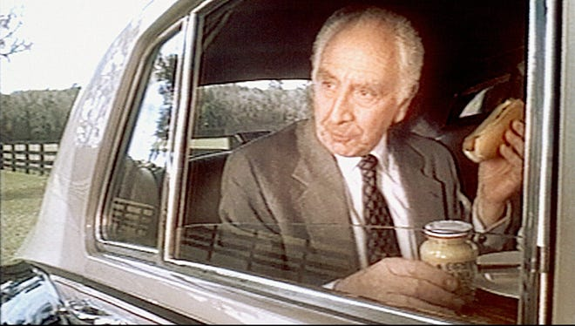

Slide 21
Elevator Speeches
How would you describe CEC to a friend or family member not associated with education?
What would you say to a potential member to convince them to join?

Slide 22
Elevator Speeches
What are the themes we heard through each of those elevator speeches?

Slide 23
Recruit
Notes:
How much do you pay?

Slide 24
Why People Join
Feature
Journals
Webinars/Events
Resources
All Member Forum
Notes:
The basics of what we say
CEC: Here are our features
Phone: Get a phone to make calls.

Slide 25
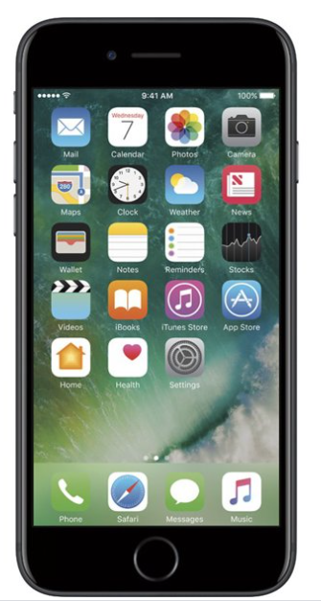
Why People Join
Feature | Perceived Value
Journals | Free access to research
Webinars/Events | Free access to training
Resources | Free access to tools/support
All Member Forum | Free access to networking

Slide 26
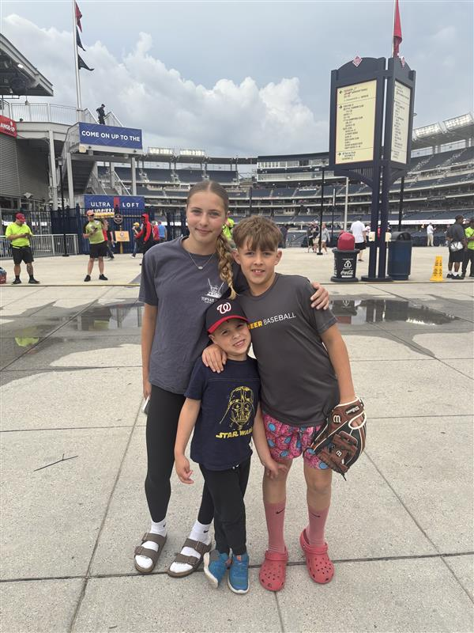
Why People Join
Feature | Perceived Value | Actual Value
Journals | Free access to research | Stay abreast on new research and access to practice strategies
Webinars/Events | Free access to training | Build the skill set you need to be a high performer
Resources | Free access to tools/support | Implement new strategies and tools to enhance your job performance
All Member Forum | Free access to networking | Learn and grow alongside like-minded colleagues and mentors

Slide 27
Proposition Value
By being in CEC, you will:
Stay abreast on new research and access to practice strategies
Build the skill set you need to be a high performer
Implement new strategies and tools to enhance your job performance
Learn and grow alongside like-minded colleagues and mentors
Emotion-Driven
Member-Focused (“You”)

Slide 28
Proposition Value
HOW?
By being in CEC, you will:
Stay abreast on new research and access to practice strategies
Build the skill set you need to be a high performer
Implement new strategies and tools to enhance your job performance
Learn and grow alongside like-minded colleagues and mentors
Emotion-Driven
Member-Focused (“You”)

Slide 29
We don’t have a recruitment problem… we have a retention problem.

Slide 30
Who is Happier with CEC?
Published in Journal
Serves on CEC Committee
Advises Student Chapter
Attends SELS Each year
No Volunteering
Doesn’t Read the Journals
Notes:
Brannan

Slide 31
Engagement
Right People, Right Opportunities
Listening
Year-Round Opportunities
Opportunities at Various Levels of Commitment
Microvolunteering
Committee Leadership
Board Members
Virtual, In-Person
Special Interests (Big Pond, Little Fish)
Role-Specific, not just member type
Utilizing CEC Resources

Slide 32
Let’s Discuss
What are the top 2-3 ways your component engages with members throughout the year?
What are the top 2-3 ways you are helping your members engage with International CEC?
Are you partnering with other components to engage members?

Slide 33
CAUTION:
Is it worth it?
Notes:
Peggy will pay $500 for her phone
She expects everything included
Disney: $200 ticket, but you spend $1000!

Slide 34
Ready to Build and Deliver?

Slide 35
Get our your notepads…
How will you build and deliver differently this year?
What will keep you from doing that?
What do you need?

Slide 36
Let’s do it…
What do you need and how can we help each other?

