Slide 1
MAASE Program Showcase: Advancing our Professional Learning Portfolio
Kirsten Myers, MAASE President
Tina Lawson, MAASE Vice President
Abby Cypher, MAASE Executive Director

Slide 2
Why We Initiated This Work
Issue: Inconsistent professional learning across Michigan’s special education system and a one size fits all approach. SE Admin can no longer have the capacity to train all of their staff.
Need: Statewide, scalable, equity-centered PD solutions for all educator levels. A blend of in-person, regional and asynchronous.
Audience: Special education leaders and aspiring leaders, teachers, paraeducators, building administrators.
Launched: 2024–25 academic year.
Intended Outcomes: Build leadership capacity, address training gaps, integrate inclusion and legal best practices, all while allowing for an individualized path.

Slide 3
What MAASE Built
A comprehensive professional learning system with layered offerings:
Paraeducator Bootcamp (1,200+ trained)
Developing Inclusive Leaders (Cohort-based)
MITTIN virtual modules (1000+ participants)
Sold-out flagship conferences like Summer Institute and Hot Topics in Law
Built by MAASE committees and partners (CEC, MEMSPA, MASSP, MASA, ISDs)
Designed around HLPs, IDEA law, and inclusive practice standards.

Slide 4
Data Driven Learning System
Education Enterprise Scorecard
The Education Enterprise Scorecard is a comprehensive evaluation tool designed to assess the strategic, operational, and instructional health of an organization's education portfolio.
The scorecard serves as both an evaluative and strategic planning resource for education-focused organizations. It breaks down performance into the following domains:
Education Strategy – Assessing alignment with market intelligence, strategic objectives, target audiences, content priorities, pricing, infrastructure, and partnerships.
Portfolio Management – Focusing on business planning, evaluation plans, policies, content calendars, learning environments, and use of education technology.
Learning Design – Examining instructional design, competency development, evaluation methods, design processes, and SME support.

Slide 5
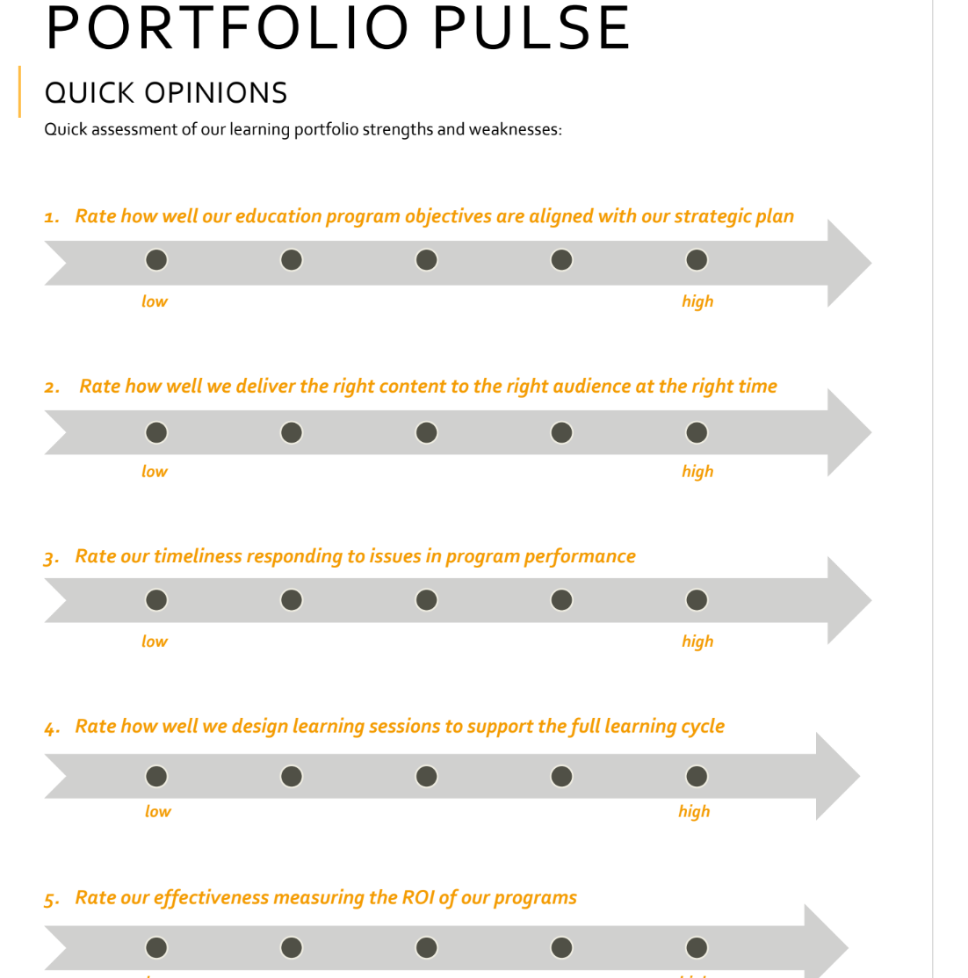
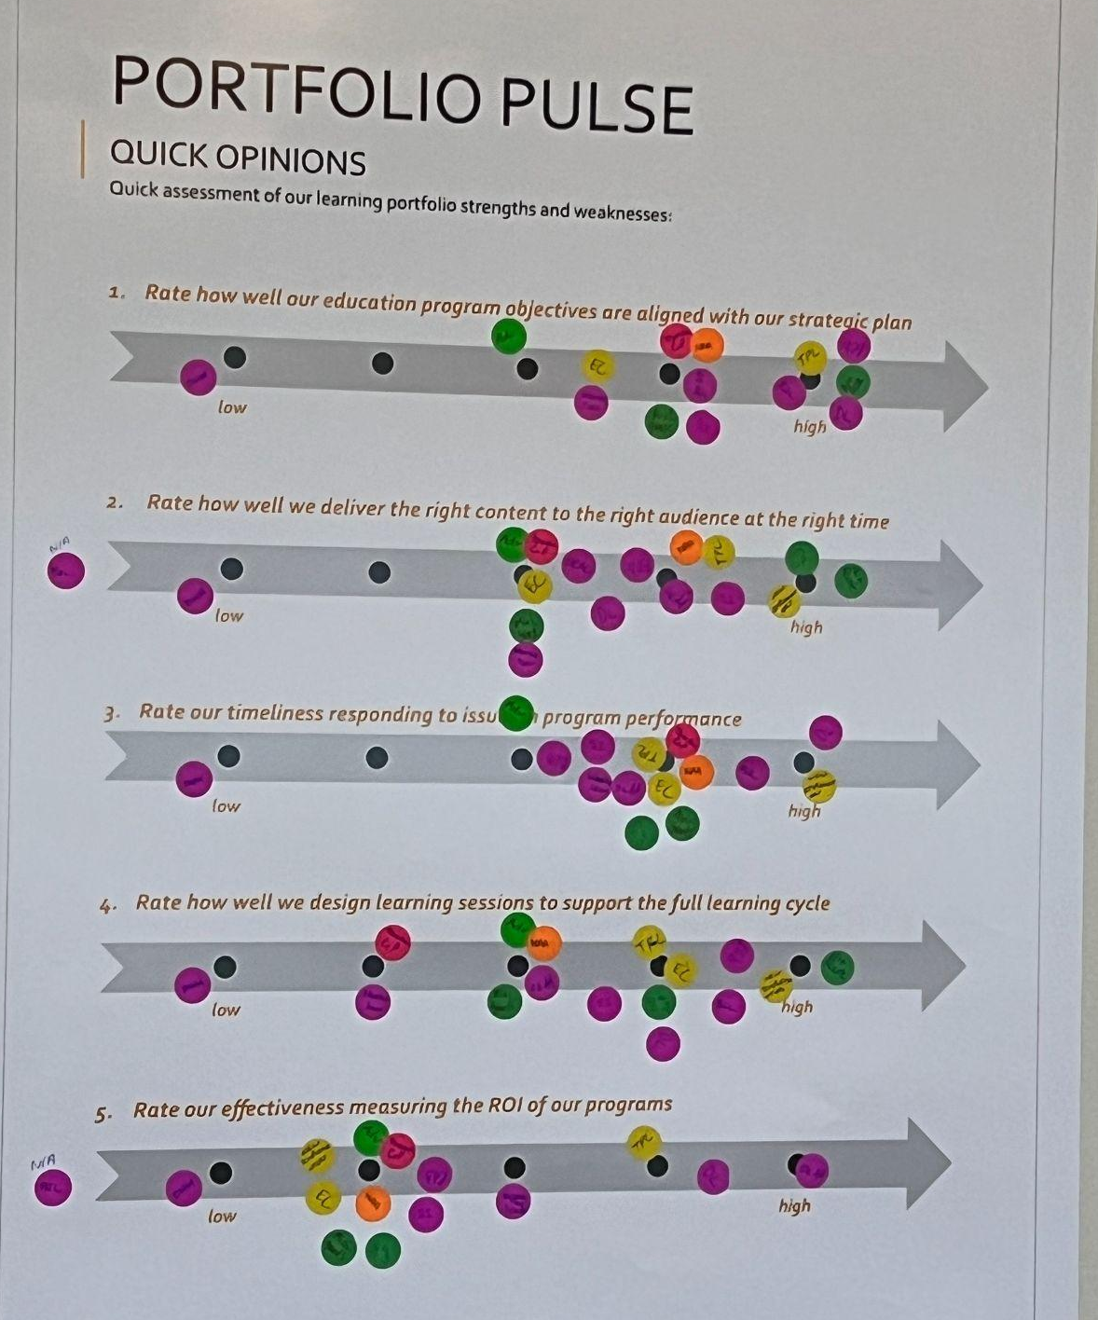

Slide 6
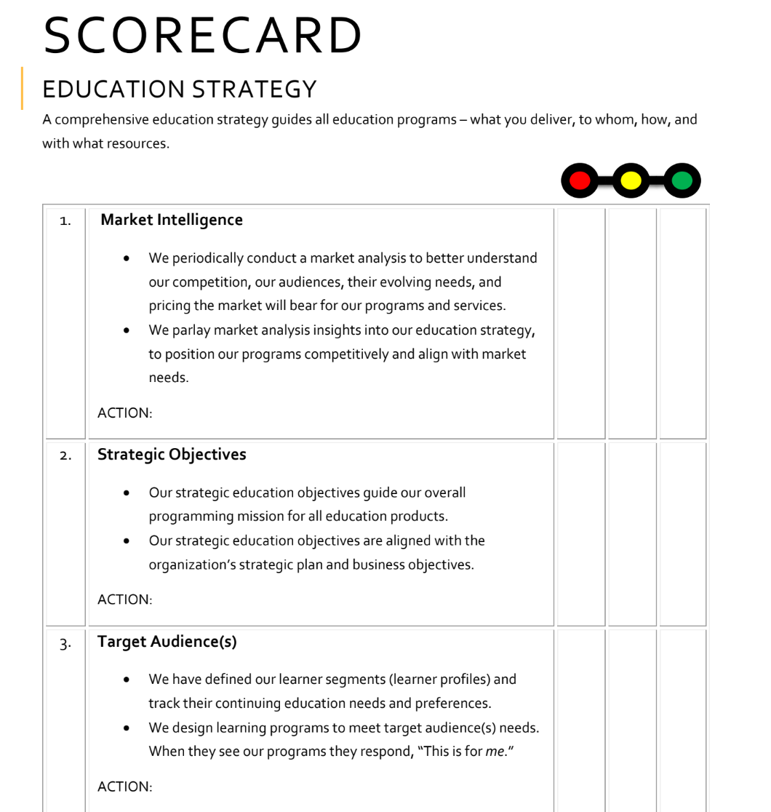

Slide 7
Data Driven Learning System
MAASE’s Content Sandbox
The MAASE Content Sandbox is a strategic planning and alignment tool developed to organize, evaluate, and prioritize professional learning content for special education administrators and other educators. It integrates the Michigan Department of Education (MDE) Standards with MAASE's guiding principles and real-world program offerings to:
Map educational topics to professional standards and learning formats
Identify gaps in content delivery
Guide future content development

Slide 8
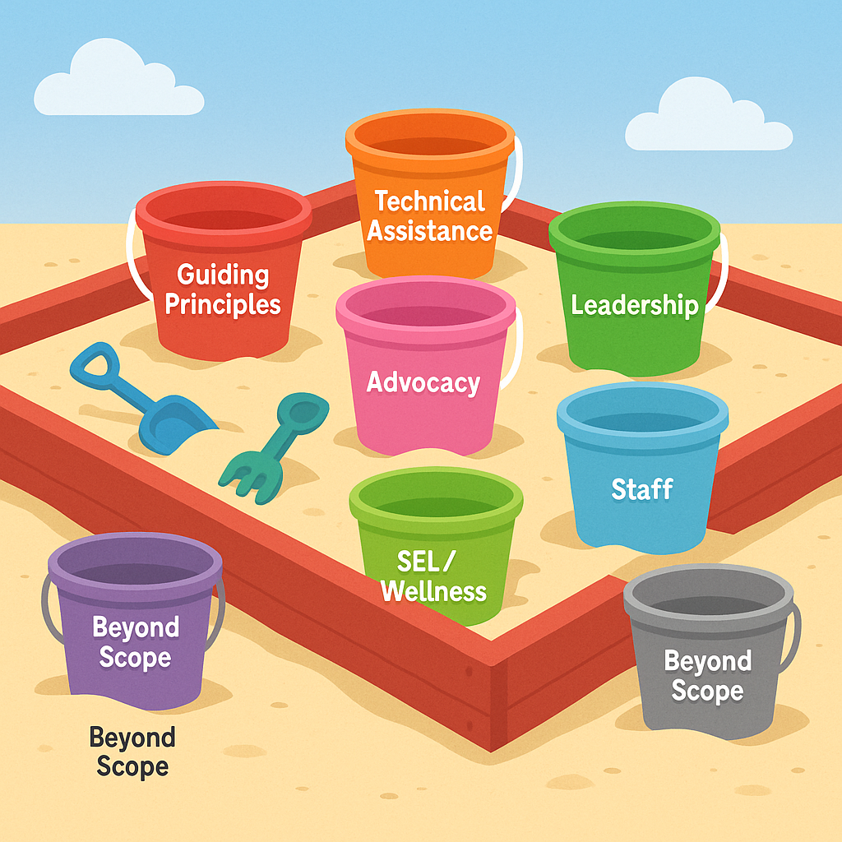
MAASE’s Content Sandbox
TA COP
GMM
Summer Institute
MISELS
Tuesday PL
Full Focus
Alt Route
Notes:
The sandbox functions as a crosswalk between:
MDE standards (knowledge and skill elements),
MAASE’s guiding principles (core leadership competencies),
and actual programmatic offerings (events, academies, and PL formats).

Slide 9
Data Driven Learning System
MAASE’s Content Sandbox
Our Why:
Strategic Alignment: To ensure professional learning topics directly support both state standards and MAASE's mission.
Transparency & Planning: To make clear which standards are being addressed through existing programming and which are not.
Resource Optimization: To coordinate across multiple formats and events (e.g., Summer Institute, New Admin Academy, CoPs).
Member Needs Assessment: To continuously evaluate whether offerings meet the evolving needs of members.

Slide 10
Expanding the MAASE Sandbox
30 years ago:
What we added:
Summer Institute (annually)
Tuesday Professional Learning Conference (every other month)
Developing Leaders (Ed Camp- every other month)
General Membership Meetings (every other month)
Monitors Conference
SLIP Conference
Communities of Practice
Paraeducator Training
Developing Inclusive Leaders
New Administrator Academy
High Leverage Practices
Full Focus- Wellness
Adaptive Schools
AI Webinars
Mentoring
MITTIN PLCs

Slide 11
Impact: Expanding Statewide Engagement
Over 30 high-impact professional learning events from Aug 2024–June 2025
Thousands of participants across Michigan (over 6,000 people)
Sold Out Events:
Summer Institute – 821 registrants
Hot Topics in Special Education Law – 460 registrants
Paraeducator Train the Trainer- 385 trainers, 2200 paraeducators trained
MAASE now has over 1,000 members
Participation in some of our leadership programs provided memberships to MAASE
We provided over 2,000 paraeducators with CEC memberships

Slide 12
Lessons Learned: Things to Adopt
Use tools to collect data on yourself.
People want a personalized experience.
Use internal expertise.
Partnerships are important.
Continuous improvement via NPS, PL evaluations, and strategic retreats.
Iterated content and delivery: from asynchronous to coaching + site-based PD.
Inspired a new MAASE Community platform for ongoing networking and learning.

Slide 13
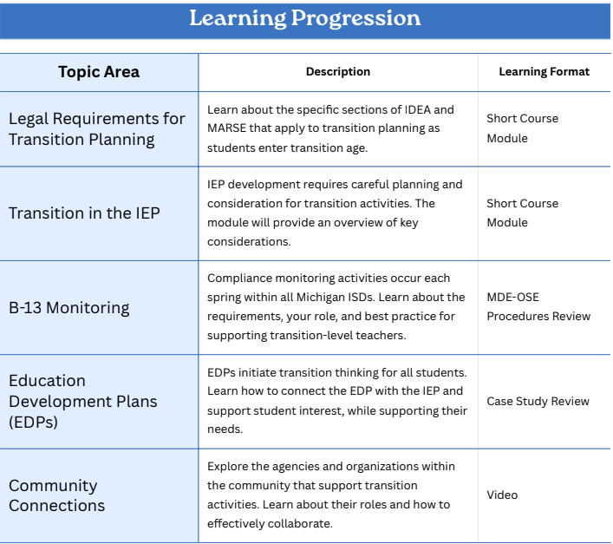
Next Steps: Personalized Pathways -Learner Personas
Personalized, meaningful learning pathways for members in different roles, career stages, and with varying levels of experience.
Example:
Transition Coordinator

Slide 14
Questions:
Abbycypher@maase.org

