Slide 1
Lead On: Succession Planning for CEC's Next Generation of Change-Makers
Building a Legacy of Courageous and Authentic Leadership
Rodneikka Scott, MSc, CAE, CSM

Slide 2
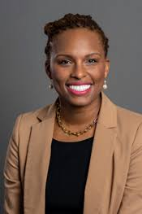
Rodneikka Scott
MSc, CAE, CSM
Vice President of Member & State Engagement for the National Society of Professional Engineers
Founder & Principal of EmpoweR Consulting, LLC
Expertise in strategic planning, fostering engaging member experiences, and developing impactful programs for professional communities.
Leverages qualifications and leadership to enhance member value and create dynamic environments for professional development.
Dedicated to helping professionals thrive and contribute meaningfully to their fields.
Transforming organizations and empowering future leaders.

Slide 3
The Heart of the Matter
Core Challenges in Leadership Succession
Leadership succession requires honesty, courage, and stepping outside comfort zones to nurture authentic leaders aligned with organizational values.
Fostering a Culture for Transformational Leadership
EFFECTIVE SUCCESSION REQUIRES MOVING BEYOND TRANSACTIONAL APPROACHES TO CREATE AN INCLUSIVE CULTURE THAT FOSTERS VULNERABILITY AND BOLD TRUTH-TELLING.

Slide 4
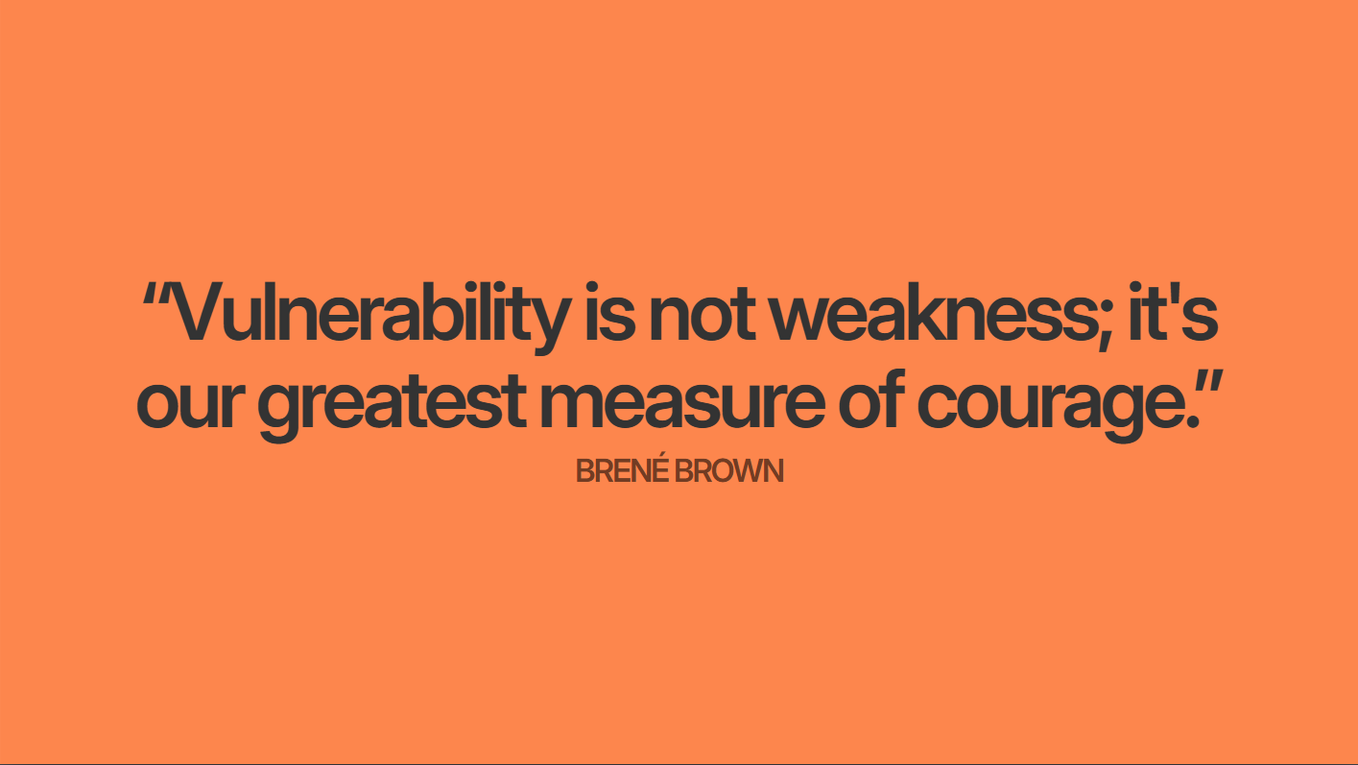

Slide 6
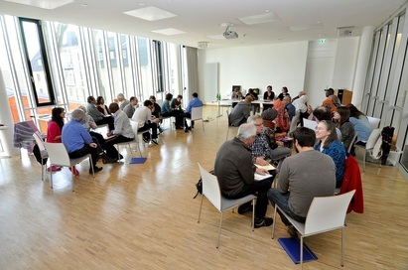
Your Vulnerable Truth (Activity: Think-Pair-Share-Scale Up)
Personal Reflection on Leadership Vulnerability Participants individually reflect on what makes them feel vulnerable about the future of leadership in CEC. | 1
2 | Dynamic Sharing to Build Trust and Collective Insight Join your assigned group of 5–7 people. Take turns sharing; ensure every voice is heard.

Slide 7
Reframing Succession: It’s Not About Filling Seats
1 | 2 | 3
Shifting Mindset from Replacement to Growth | Emphasizing Leadership Development | Creating a Culture of Continuous Leadership
Succession planning should move beyond simply replacing individuals and focus on fostering leadership growth and transformation aligned with the organization's mission. | Effective succession involves continuously developing leadership capabilities and preparing emerging leaders to embrace the organization's vision and legacy authentically. | Succession is a dynamic, ongoing process supported by mentorship and empowerment, cultivating resilient leaders ready to advance the organization's long-term goals

Slide 8
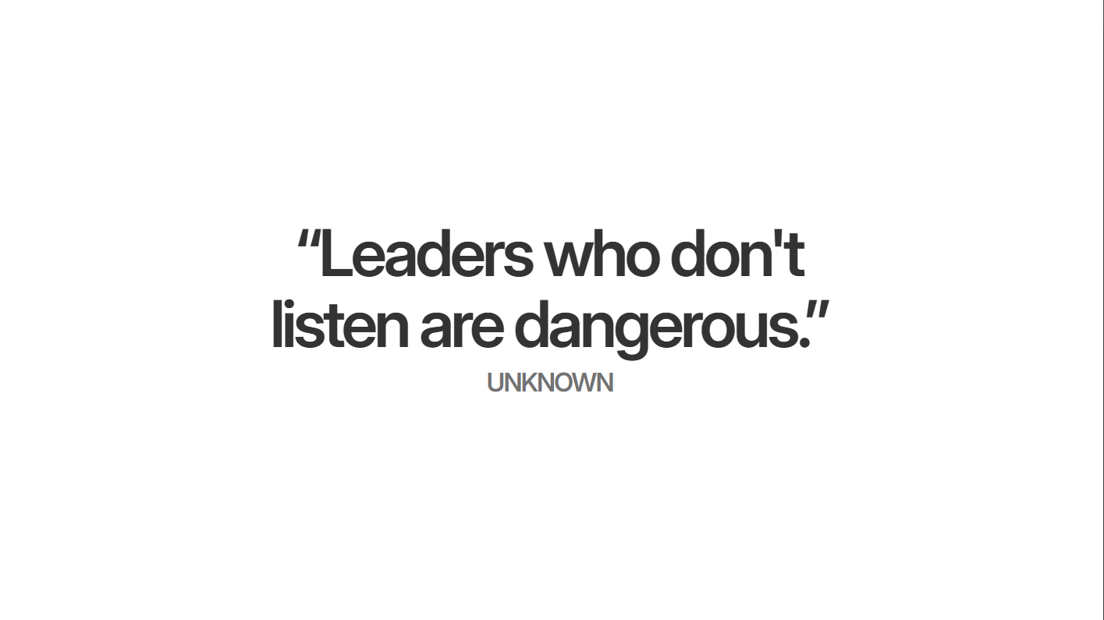

Slide 9
The Importance of Empathy and Connection
Building Authentic Relationships | Enhancing Communication and Cohesion
Empathy is essential for effective leadership, requiring genuine efforts to understand and address team members' experiences, fostering trust and mutual respect. | Empathetic leadership promotes open dialogue and psychological safety, enabling inclusive cultures that improve collaboration, morale, and sustainable team development.

Slide 10
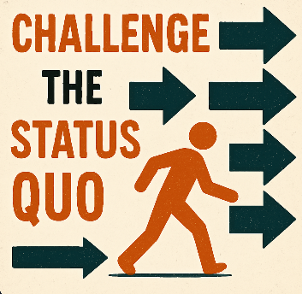
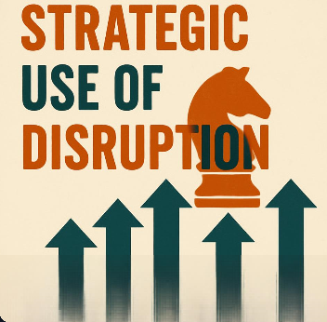
The Power of Truth-Telling and Disruption
Encouraging Honest Conversations | Challenging the Status Quo | Strategic Use of Disruption
Effective leadership requires disrupting norms and speaking truth to power to foster growth and remove barriers. | Boldness and truthfulness in leadership create inclusive cultures where innovation thrives and outdated practices are questioned. | Leaders use disruption to promote equity and inclusion, combining empathy with candidness to enable transformative change.

Slide 11
Activity: Leadership Legacy Brainstorm - Large Group Style
Envisioning Leadership Legacy : Participants collectively explore the desired leadership legacy within CEC, focusing on core values and lasting impact.
Collaborative Brainstorming Process : Small groups use the World Cafe technique with a Legacy Catalyst facilitating dynamic discussions and idea exchange.
Rotational Idea Development : Group members rotate tables to build on previous insights, fostering cross-pollination and diverse perspectives.
Defining Legacy Pillars : Groups identify top three leadership values to guide CEC’s future leaders, enabling collective alignment and actionable goals.

Slide 12
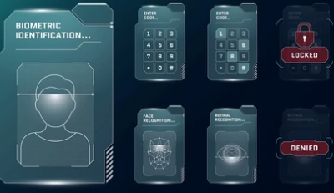
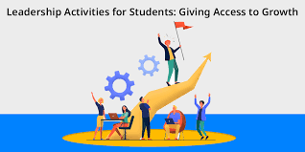
The Importance of Recognizing Potential
Identifying Leadership Potential | Inclusive and Unbiased Identification | Create Access to the Leadership Pipeline
Leadership potential encompasses traits such as curiosity, resilience, and a growth mindset, indicating the capacity for future leadership roles. | Organizations should use tools like 360-degree feedback and behavioral assessments to avoid bias and recognize diverse leadership styles. | Embracing varied backgrounds and creating development pathways for underrepresented groups strengthens innovation and organizational resilience.

Slide 13
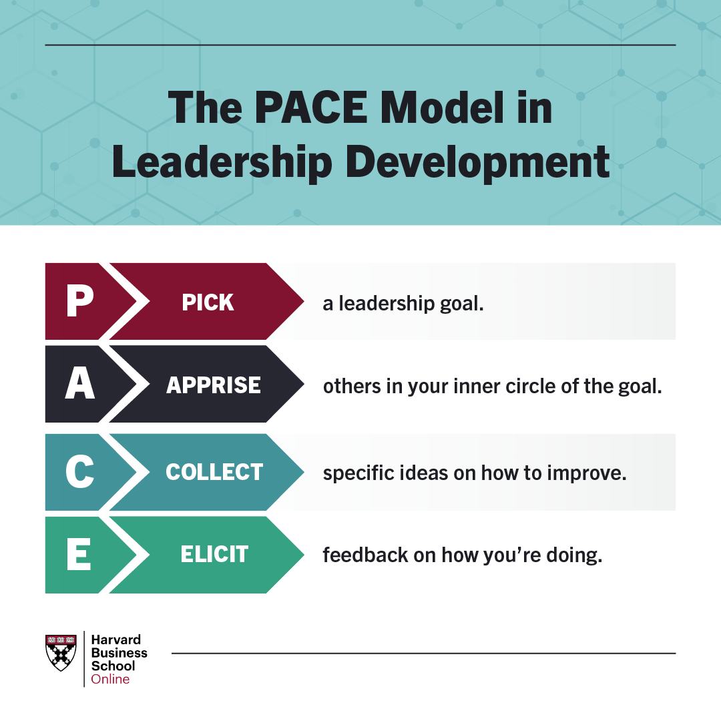
The Power of Taking Action

Slide 14
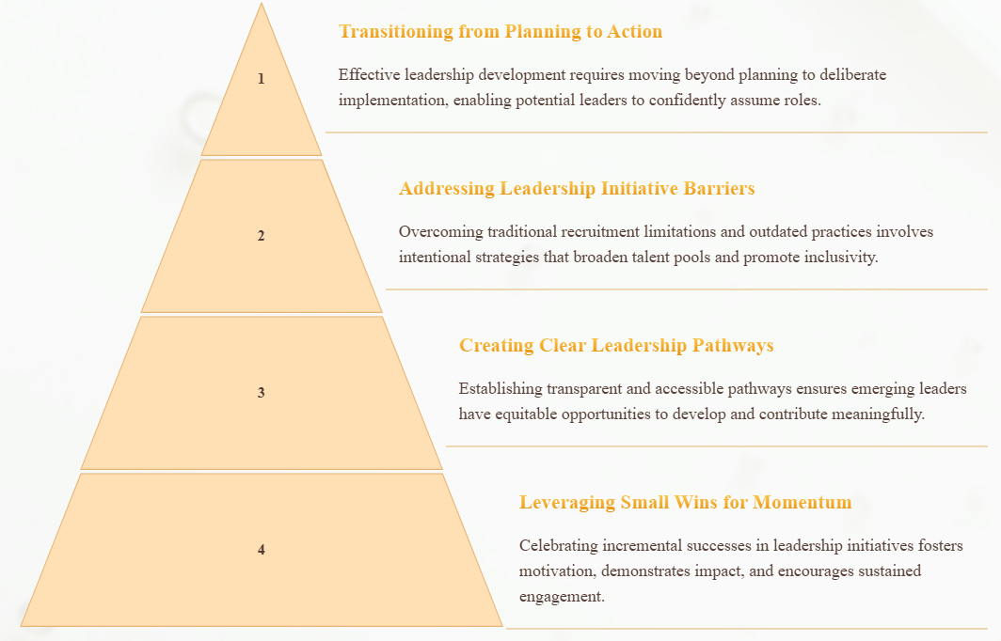
The Power of Taking Action

Slide 15
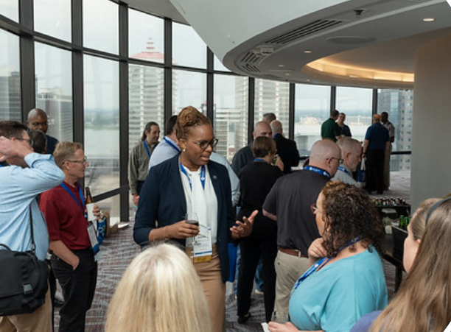
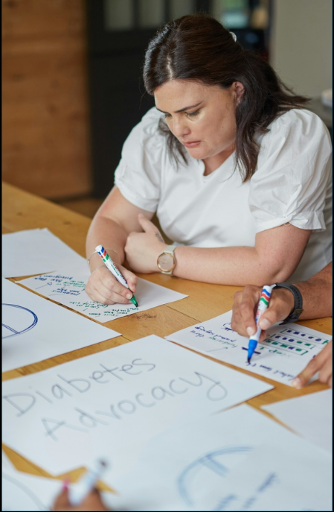
Activity: Leadership Spotting Scenario - Gallery Walk
Interactive Leadership Spotting Exercise
Participants engage in a gallery walk with 2-3 posters depicting leadership scenarios. Groups of 5-7 rotate, discussing leadership potential and strategies to empower individuals using sticky notes.
1 |  | 2
 | Collaborative Insights and Development Strategies
 | Groups share observations to identify leadership qualities and actionable ways to support emerging leaders. A large group discussion synthesizes diverse perspectives and effective nurturing approaches.

Slide 16
Sustainable Leadership Plans: Building a “Forever Thing”
Long-Term Leadership Strategy
Embedding Leadership Development
Sustainable leadership plans focus on mentorship to connect generations of leaders, fostering continuous support and personalized development for emerging leaders.
Leadership growth should be integrated into organizational culture as an ongoing process, ensuring continuous learning and leadership preparedness as a core priority.

Slide 17
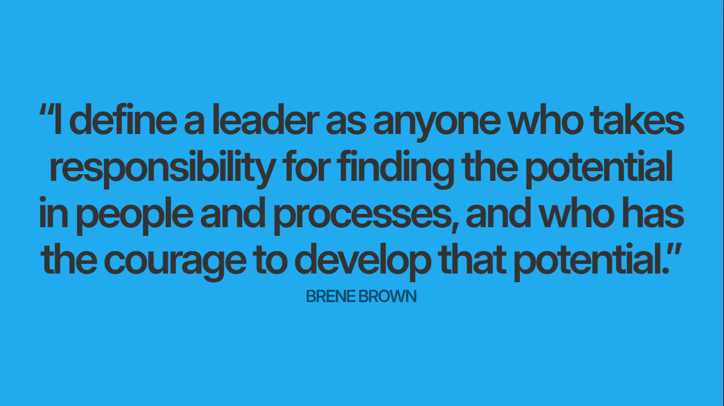

Slide 18
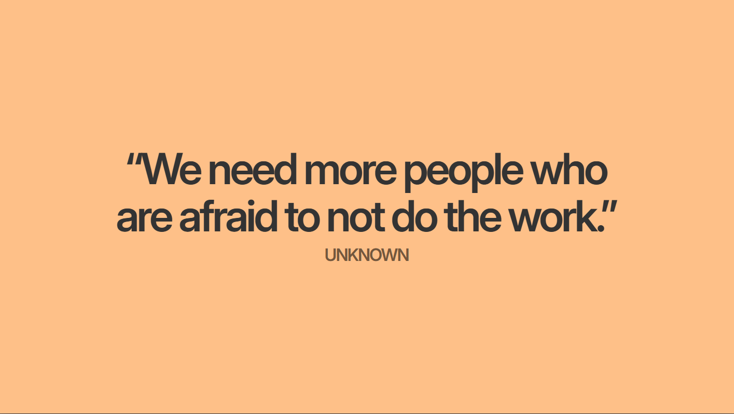

Slide 19
The Gift of Mentorship
Benefits of Mentorship for Leaders and Mentees
Building and Sustaining Mentorship Culture
Mentorship fosters professional growth by enabling leaders to develop others' potential while enhancing their own leadership skills through vulnerability, empathy, and creating a supportive environment.
Effective mentor-mentee relationships rely on authenticity, trust, and active listening, while organizations must embed mentorship as a core value to ensure continuous leadership development and succession planning.

Slide 20
The Responsibility of Leadership
Accountability and Ethical Leadership : Leadership entails a duty to mentor emerging leaders, foster their growth, and uphold ethical standards to ensure smooth transitions.
Visionary Leadership with Integrity : Leaders must embody organizational values and lead with integrity, building trust and guiding others toward a shared ethical future.
Inspiring Through Responsible Actions : True leadership inspires by modeling authenticity, empathy, and commitment to developing others, cultivating a culture of responsibility.

Slide 21
Activity: Mentorship Action Planning – Large-Scale Commitment
Developing Concrete Mentorship Plans | Committing to Mentorship Roles | Creating Support Systems for Sustained Mentorship
Participants identify 1-2 individuals to mentor and reflect on specific small actions they can take within the next month to support their leadership journey. | Participants complete a Commitment Contract, documenting mentees' names, specific action steps, and target dates to ensure accountability and actionable mentorship plans. | Participants post their Commitment Contracts on a Wall of Commitment and may share action steps with a buddy to foster community momentum and sustained follow-through.

Slide 23
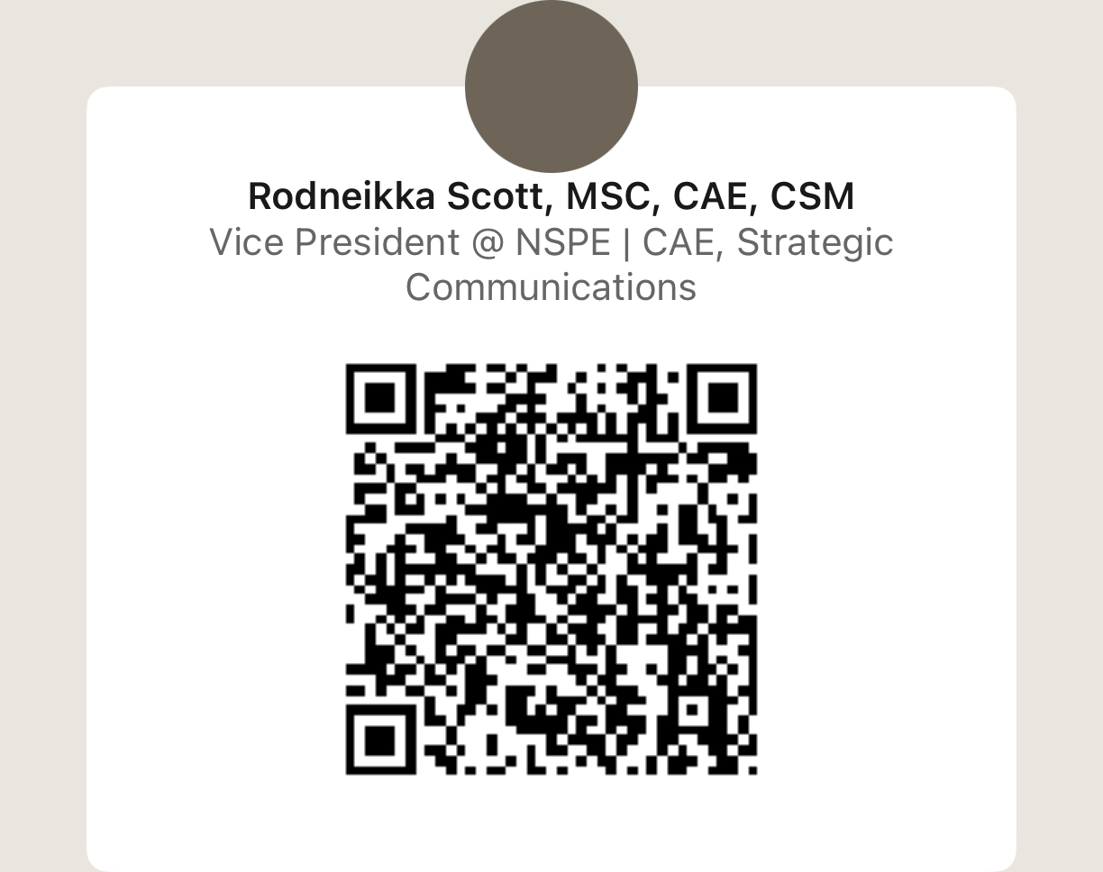
Thank you!

