Slide 1
Fundamental Communication Planning: Aligning Social Media, Email, and Web for Member Impact
Annie Drinkard
Notes:
Hi everyone! I'm so glad you're here. This session is all about helping you feel more confident and comfortable when it comes to communicating with your volunteers. We’re going to talk about how to use basic tools like social media, email, and your website to keep people informed, engaged, and excited about being part of your organization.

Slide 2
Let’s Get to Know You!
Notes:
Poll with hand raise model
Figure out questions later
Who has engaged in PD opportunities with CEC before this conference?
Who is hosting any PD for members?

Slide 3
Why Communication Planning Matters
Helps you connect with your members
Makes your messages clearer and more consistent
Saves time and avoids repeating work
Makes sure the right people get the right information
Notes:
Good communication helps build stronger relationships. When you have a plan, it makes everything easier—you’ll know what to say, when to say it, and how to say it.

Slide 4
What You’ll Learn Today
Know who your audience is and what they need to hear
Share clear and consistent messages across social media, email, and your website
Create a simple communication plan to support member engagement
Check to see what’s working and improve it over time
Use basic tools to help you stay organized
Notes:
You don’t need to be a tech expert or professional marketer to do this. Today, we’re going to break everything down into easy steps and help you get started, no matter your experience level.

Slide 5
Main Ways to Communicate
Social Media (Facebook, Instagram, etc.)
Email (Newsletters, updates)
Website (Info hub, sign-ups, announcements)
Notes:
These are the most common ways to get information out to volunteers and supporters. Each one has a different role to play. You don’t have to use them all—but when you do, it’s helpful if they work together. What topols are you curently using, if any?

Slide 6
Who Are You Talking To?
Ask Yourself:
Who do I want to reach?
What do they care about?
Where do they usually get information
Examples
People who might be interested in joining
Current members/active volunteers
Local community members or partners
Notes:
Before you send a message, think about who it's for. Different groups need different kinds of information. The better you know your audience, the more useful and interesting your message will be to them.

Slide 7
Your Turn
Notes:
Poll with hand raise model
Who are you talking to? share

Slide 8
Keep Your Message Clear and Consistent
Use the same friendly tone across platforms
1
Use simple, easy-to-understand language
2
Make sure the message matches on all channels (even if the wording is a little different)
3
Notes:
People trust you more when they hear the same message in a few different places. You don’t need to say things the exact same way every time—but they should feel connected.

Slide 9
Samples
Emails and Newsletters
Elections | Smore Newsletters for Non-profit
https://www.illinoiscec.net/icec-april-2025-newsletter/
https://cecdr.org/sites/default/files/2024-08/dr_newsletter_august2024_v2.pdf
https://ddel.exceptionalchildren.org/sites/default/files/2024-10/newsletter_october_2024.pdf
Websites
https://dll.exceptionalchildren.org/
https://missouri.exceptionalchildren.org/
https://manitoba.exceptionalchildren.org/

Slide 10
Timing is Important
Plan messages ahead of time
Don’t send too many at once
Don’t go quiet for too long
Use a calendar to keep track
Notes:
It's helpful to space out your messages so people don’t get overwhelmed or confused. A simple calendar or schedule can help you know when to send what.

Slide 11
Simple Tools That Can Help
Planning: Google Sheets, a notebook, or a free calendar app
Scheduling: Facebook tools, Mailchimp (free plan), Buffer (free version)
Notes or reminders to keep you on track
Notes:
You don’t need fancy programs or paid tools. Even a paper planner or Google Doc can work! The key is to get organized in a way that works for you. Add samples here Can we include a visual/screenshot of what that might look like?

Slide 12
Looking Consistent
Use the same logo, colors, and fonts when you can
Add your organization name to graphics and emails
Helps people quickly recognize your messages
Refer to CEC’s Brand Guide: brand.exceptionalchildren.org
Notes:
Visual consistency builds trust. It also makes it easier for people to spot your messages and feel connected to your group.

Slide 13
Is It Working?
Look at what people are clicking, opening, or liking
Ask members what they like or don’t like
Use that info to make future messages even better
Notes:
Add metrics and examples of what's doing well vs what's not doing well. Can we share any guidance on open/click rates? For example what percentage is good?

Slide 14
Your Turn
Notes:
Your turn to try making a quick campaign plan

Slide 15
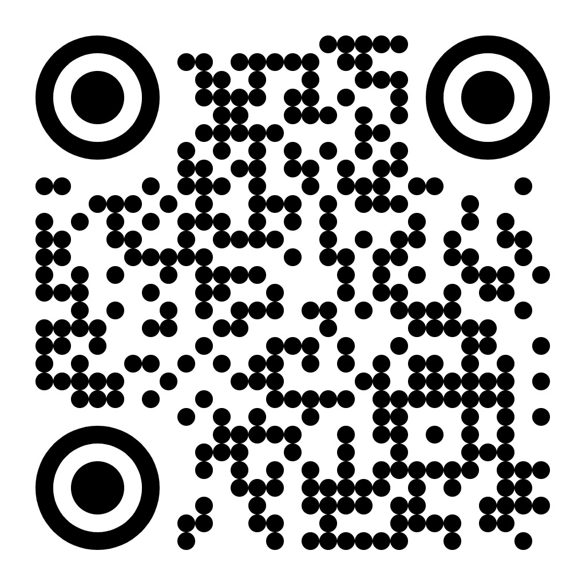
Or use the handout
Notes:
Utlizie the handout our this online form, pair up if needed

Slide 16
A Simple Campaign Example
Goal: Get more attendees for an upcoming online event
Audience: People who’ve attended before + new people
Message: "Join us for our next event"
Channels: Email, social media, link to sign-up page on website
Timeline: Start promoting 2–3 weeks in advance
Notes:
Can we share a visual example of a good flyer/social media post?

Slide 17
What’s one idea or tip you want to try after this session?
Notes:
Poll with hand raise model
Figure out questions later
Who has engaged in PD opportunities with CEC before this conference?
Who is hosting any PD for members?

Slide 18
Quick Recap
Know
Know who you’re talking to
Clear
Keep your messages clear and consistent
Plan
Use a calendar or planner
Try
Try simple tools to stay organized
Learn
Learn from what works (and what doesn’t!)
Notes:
This is your starting point. These basic steps will help you feel more confident when you plan your next communication. You don’t need to do everything—just take one step at a time.

Slide 19
Q & A
Notes:
Poll with hand raise model
Figure out questions later
Who has engaged in PD opportunities with CEC before this conference?
Who is hosting any PD for members?

Slide 20
Thank You!
Annie Drinkard
Director, Publications and Communications
adrinkard@exceptionalchildren.org
Notes:
Thank you!

