Slide 1
Gather & Share
Barb Melnychuk
President Elect
CECDLL.org

Slide 2
Introduction
“Gather & Share” is a versatile concept with many purposes
DLL is currently using the concept to:
Increase engagement/involvement of current members in DLL, including advocacy, leadership and volunteer opportunities
Engage/involve/retain the 4000+ new DLL members resulting from the “Free Membership” initiative
Remind well-intentioned busy members of important information, deadlines and their need to act/respond

Slide 3
Project/Initiative: “Gather & Share”
DLL purposefully gathers information from various sources and then shares it with our members in different ways
Three examples currently in use by DLL:
“Shout outs” since April 2024
“Remembering Education Before PL 94-142” since April 2025
Increased focus on “gathering & re-sharing” in newsletters, etc in 2025

Slide 4
Shout outs
Potential candidates are nominated by other members or can be self-nominated
Communications Committee invites selected members to be highlighted in a “Shout out” via personal contact
Invited members submit information/photos about themselves (professional/personal), which are put into an appealing format and sent to all members
Feature Executive, Board, Committee so members know who we are and may be inspired to volunteer
Recently featuring new members to recognize/welcome them and encourage further involvement

Slide 5
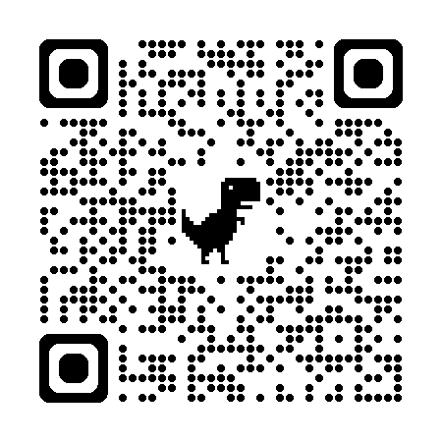

Slide 6
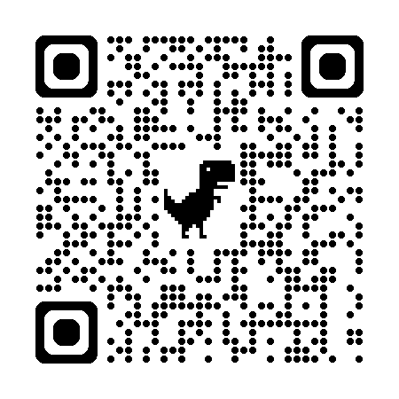

Slide 7
Remember Education Before PL 94-142
“The further backward you look, the further forward you can see.” (Winston Churchill)
Helps members understand the power of advocacy and the impact CEC’s advocacy can have (and has had) on the education of children/youth with special needs
DLL Political Advocacy Committee and Communications Committee invite members and their contacts to submit stories about how PL94-142 impacted their professional or personal lives
Each week, one story is sent out to members with an invitation to submit more stories
Stories/contacts are being collected for future potential purposes

Slide 8
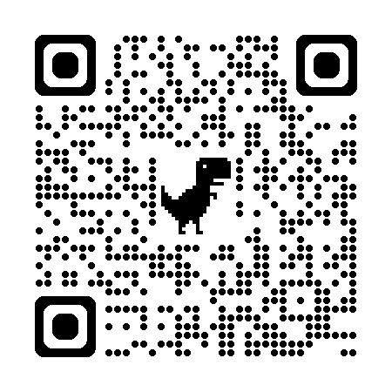

Slide 9
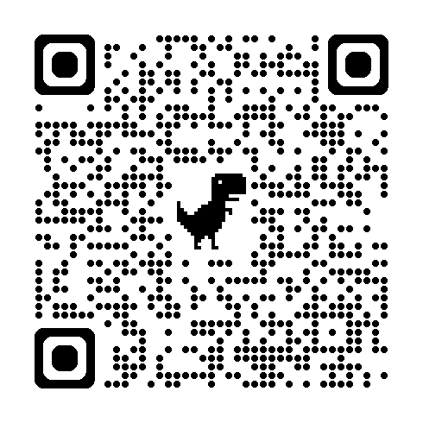

Slide 10
Re-sharing
DLL gathers important or interesting information from other sources
CEC
other Divisions
Re-shares them with our members “as is” or with additions
CEC Advocacy messages with sample letters that members can use or with additional links
Convention 2026 proposal deadlines and link
Inserted into the monthly DLL newsletter
Separate message

Slide 11
Impact of “Gather & Share”
Tracking results show that more recipients open the PL94-142 stories than any other DLL e-mails
Every time a story is shared, 1-2 more are submitted
Currently exploring other possible uses for these inspiring and touching stories

Slide 12
Impact of “Gather & Share”
Shows members that DLL is 'in touch with' and supportive of initiatives/projects/ideas from CEC and/or other components
Well-intentioned, busy members may benefit from a reminder/nudge to take action

Slide 13
Wrap-up
Why might components use the concept of ”Gather & Share”?
Flexibility: can look different depending on component/need/issue
Increases the value of your component to your current and potential members while contributing to CEC and the field

Slide 14
Questions? Looking for samples?
Barb Melnychuk
bmelnychuk@gmail.com
DivisionofLeadersLegacy@cecdll.org
CECDLL.org

