Slide 1
Streamlining Your Division’s Communication: TED’s Story
Monique Pinczynski, Assistant Professor
Boise State University

Slide 2
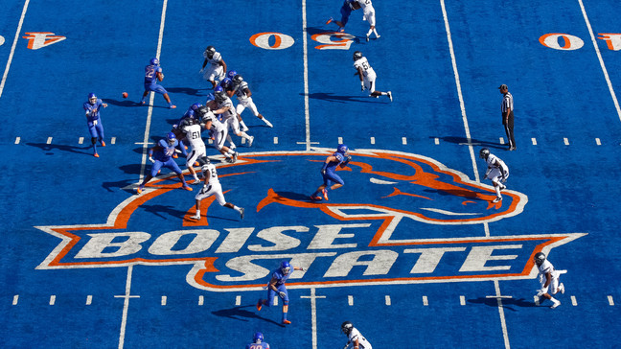
About Me

Slide 3
Communications Initiative
Communication was a common topic in board meetings
No dedicated communications committee or communication structure
Partnered with another board member to propose new committee in November 2024
Ad hoc committee was approved for one year
Work began right after that
7 months in

Slide 4
Our Work
Assessed communication methods and outputs
Wow finding: We have 15 TED affiliated social media accounts
Managed TED social media accounts and increased posts
Created a communication guide for the organization
Recruited committee members
Took inventory of every TED website page
Worked with membership committee to start a quarterly coffee chat
Supported TESE social media

Slide 5
Impact
Board members/committees know how to use different communication tools
Some did not know that many tools existed
Getting closer to consistent branding – hard to reach some SIGs
Increased social media presence and engagement
Slowly moving through website updates with support
Will continue to track engagement on emails, website, social media

Slide 6
Resources at tinyurl.com/TEDCommunication
TED Communications Committee Proposal
TED Communications Guidelines/Resources
TED Website Inventory

