Slide 1
Building the Volunteer Pipeline: From Local Leadership to National Impact
2025 Leadership Institute
July 17
Will Webber, CAE, CVA
Senior Manager, Component Services

Slide 2
Learning Objectives
By the end of this session, you will be able to:
Understand the purpose and value of a volunteer pipeline in supporting leadership at both the component and national levels.
Identify strategies to encourage long-serving volunteers to pursue broader roles within CEC.
Recognize your component’s role in nurturing and preparing future leaders.
Explore opportunities and resources available to support volunteer growth and advancement across the organization.

Slide 3
Getting To Know Each Other
Where did your volunteer journey begin with CEC?
How long have you been a volunteer with CEC?
Have you given thought to your own trajectory, especially if you are a current president?
Notes:
Where did your volunteer journey begin with CEC?
How long have you been a volunteer with CEC?
How familiar are you with managing volunteers, or the overall volunteer pipeline?

Slide 4
Common Acronyms
BOD Board of Directors
CEC Council for Exceptional Children
Cmte Committee
MAL Member-at-Large
U/D Unit/Division
Notes:
Where did your volunteer journey begin with CEC?
How long have you been a volunteer with CEC?
How familiar are you with managing volunteers, or the overall volunteer pipeline?

Slide 5
What is volunteerism? A volunteer?
Merriam-Webster:
“a person who voluntarily undertakes or expresses a willingness to undertake a service”
Someone who gives their time and talent (skills, knowledge, abilities, resources) for the benefit of the greater good without receiving financial compensation

Slide 6
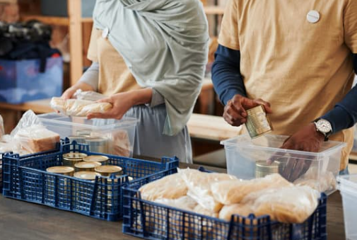
Types of Volunteerism
In-Person
Long-Term
Virtual
Micro
Hospitals
Elderly care
Animal welfare
Food pantries
Picking up trash
-
Content creation
Proofreading
Surveys
Writing letters
Participating in virtual events
Org./Assoc. Committees & Board of Directors
Peace Corps
Habitat for Humanity
Translating documents
Social media & graphic design
Website design
Crisis support
What type(s) of volunteerism have you done from this list? Any other types that may be missing?

Slide 7
Volunteering at the Local U/D Level
1
2
3
Learns about CEC
Becomes a member
Receives value
6
5
4
Serves on U/D Committee
Micro Volunteering
Wants to give back
Has your experience been similar with your U/D?
Notes:
Has your experience been similar with your U/D?

Slide 8
A Typical Volunteer Journey
1
2
3
Learns about CEC
Becomes a member
Receives value
6
5
4
Leadership CEC
Serves on U/D Committee
Wants to give back
Notes:
Think about your own journey. Does it look like this? How different has your experience been?

Slide 9
A Typical Volunteer Journey (cont.)
8
9
Runs for U/D Board Member-at-Large
U/D Exec. Cmte
7
10
11
Leadership CEC
CEC Board Opps
Serves on CEC Board
8
9
National Cmte Opps
National Cmte Service
12
National Cmte or U/D
Think about your own journey. Does it look like this? How different/similar has your experience been?
Notes:
Think about your own journey. Does it look like this? How different has your experience been?

Slide 10
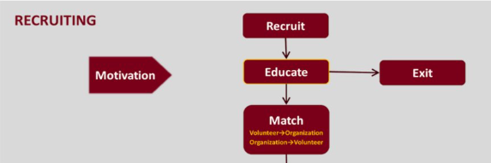
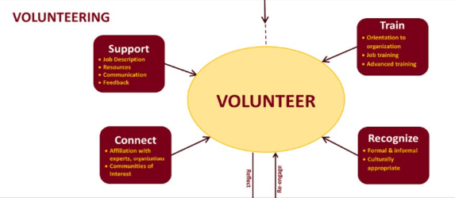
Volunteer Administration Competencies / Pipeline
Takeaway:
Take this pipeline to see where your U/D stacks up, where there could be improvements.
Notes:
This works with all types of volunteers (in-person, long-term, micro-volunteering, and virtual)

Slide 11
Importance of a Strong Volunteer Pipeline
Help CEC to identify individuals with skills and potential to make a greater/broader impact for the organization and the field
Strengthen your Unit/Division

Slide 12
Recruitment
Everyone in volunteer role should help​
Teach how to “ask” and how to “tell your story”​
Identify where you need support
Positions descriptions
KISS: “Kiss It [the process] Simple, Silly”
Happens year round​
Avoid “begging”

Slide 13
Retention
Training​
Provide Materials (job description, files, task list, contacts, etc.)​
Discuss Fiduciary Responsibility​
Who Supports Them?​
Clearly Defined Roles/Descriptions​
Include Outcomes That Aren’t Just “Reports”​
Support System or Check-ins​
CEC Staff are ALWAYS a Support System​
Find Ways to Bring Volunteers Together (Networking)​
Create a Pathway to Leadership to Keep Volunteers Engaged

Slide 14
Rewards
Encourage Leaders to Think About Next Steps​
“Can’t move up until you replace yourself!​”
Give Volunteers a Chance to Shine​
Shout out on social media, newsletter, etc​.
Award System for Volunteers​
“Thank You”​
We serve on our HOA’s because we have to do a thankless job…​
We serve on our Division/Unit because we are appreciated…

Slide 15
Your Role in Nurturing & Preparing Future Leaders
Ensure a smooth and positive experience; most times structure and organization is key
Give your volunteers feedback
Ensure a productive, collaborative, respectful, and ethical environment
Help with networking; introduce these leaders to others in the field, be it locally or nationally

Slide 16
Your Role in Nurturing & Preparing Future Leaders
Share opportunities with upcoming leaders as they may not know about them
Showing them the ropes in your component, making sure that they are well-prepared to take on tasks assigned to them

Slide 17
Encouraging Long-Serving Volunteers to Pursue Broader Roles within CEC
Get to know your volunteers, their goals and aspirations, their skills and talents, their motivations - be a guiding star for them
Ensure that they are aware of the various opportunities to get involved and engaged, whether through participating in professional development opportunities
Give letters of recommendations and mentorship

Slide 18
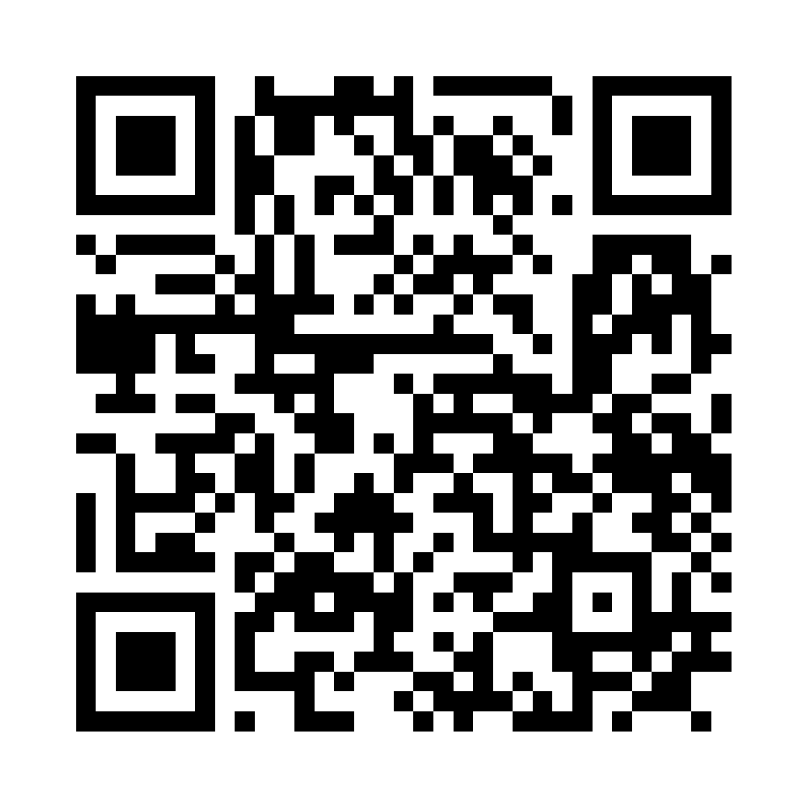
Opportunities & Resources to Support Volunteer Growth & Advancement
Position Descriptions
Leadership CEC
Volunteer Recognition
National Volunteer Week (April)
Notes:
Need to replace QR code

Slide 19
Takeaways & Homework
Identify what positions you have unfilled​
Start with the CEC Required Nine​
Identify other ways to get new volunteers involved at lower levels​
Take care of the volunteers you have​
Easier to retain than to find a new one!​
Host a networking session – train them to find other volunteers​
Talk with good volunteers about the Pathway-- “Where do you want to go?”​
Plan to accomplish ONE goal when it comes to developing volunteers
Notes:
What do we want leaders to do after attending that is tangible and can lead to results?
- assess your U/D’s volunteer pipeline? How do you stack up?
Do you have clear volunteer position descriptions?
Do you have a volunteer experience/satisfaction survey?
How often do you check in with your volunteers?

Slide 20
Learning Objectives Recap
By the end of this session, you will be able to:
Understand the purpose and value of a volunteer pipeline in supporting leadership at both the component and national levels.
Identify strategies to encourage long-serving volunteers to pursue broader roles within CEC.
Recognize your component’s role in nurturing and preparing future leaders.
Explore opportunities and resources available to support volunteer growth and advancement across the organization.

Slide 21
Discussion and Q&A

