Slide 1


SCARED

Slide 2
Avoiding Legal and Financial Pitfalls
Chad Rummel, M.Ed, CAE
2025 Leadership Institute
SCARED

Slide 3

Four Truths and a Lie
X
Notes:
There are three take-aways here. 1) I’m not a lawyer 2) I’ve seen a lot of stuff and 3) I’m clearly bad luck.

Slide 4
Four Truths and a Lie
I worked for a nonprofit that was shuttered by the NY Attorney General in a multi-million dollar lawsuit against the nonprofit, its founders, its vendors AND Board members;
Notes:
There are three take-aways here. 1) I’m not a lawyer 2) I’ve seen a lot of stuff and 3) I’m clearly bad luck.

Slide 5
Four Truths and a Lie
I have testified in a courtroom following an embezzlement at an association where he worked;
Notes:
There are three take-aways here. 1) I’m not a lawyer 2) I’ve seen a lot of stuff and 3) I’m clearly bad luck.

Slide 6
Four Truths and a Lie
I have been a plaintiff on a breach of fiduciary responsibility lawsuit against an association Board, ultimately leading to the termination of the Executive Director and Deputy Director;
Notes:
There are three take-aways here. 1) I’m not a lawyer 2) I’ve seen a lot of stuff and 3) I’m clearly bad luck.

Slide 7
Four Truths and a Lie
While at CEC, I have advised a CEC unit on dealing with an embezzlement, helped a division file Articles of Incorporation, guided a Unit who lost its nonprofit status, and advised a CEC volunteer worried about indemnification and his legal responsibilities;
Notes:
There are three take-aways here. 1) I’m not a lawyer 2) I’ve seen a lot of stuff and 3) I’m clearly bad luck.

Slide 8
Four Truths and a Lie
I am a lawyer.
SCARED
Notes:
There are three take-aways here. 1) I’m not a lawyer 2) I’ve seen a lot of stuff and 3) I’m clearly bad luck.

Slide 9
Four Truths and a Lie - Takeaways
I’m not a lawyer - No legal guidance today, just Chadvice;
I’m clearly bad luck;
Associations are businesses;
Regardless of size of your division or unit, laws apply;
Knowledge is your best safeguard.
Notes:
There are three take-aways here. 1) I’m not a lawyer 2) I’ve seen a lot of stuff and 3) I’m clearly bad luck.

Slide 10
Agenda
Fiduciary Responsibility
Guiding Documents
501c3 and Nonprofits
Governance Nomenclature
Conflict of Interest
Insurance
License, Tax and Audit
Accounting
Contracts

Slide 11
Fiduciary Responsibilities
Applies to:
  Elected Volunteers/Leaders
  Appointed Volunteers/Leaders
  Staff
Everyone has the same fiduciary responsibilities
  i.e. president doesn’t have more fiduciary responsibility than the membership chair
Legal implication for not fulfilling responsibilities
  “Fiduciary Breach”
Notes:
Applies to: Every volunteer who works with you, whether appointed or elected, and every staff member

Slide 12
Fiduciary Responsibilities
Responsibility | Chad-Speak | Examples
Duty of Care | Be Informed | Data, Counsel, History --COME PREPARED
Notes:
Foresight: just as important, sets apart good from great organizations

Slide 13
Fiduciary Responsibilities
Responsibility | Chad-Speak | Examples
Duty of Care | Be Informed | Data, Counsel, History --COME PREPARED
Duty of Loyalty | Put the Organization First | Avoid Conflict, Declare Conflict
Notes:
Foresight: just as important, sets apart good from great organizations

Slide 14
Fiduciary Responsibilities
Responsibility | Chad-Speak | Examples
Duty of Care | Be Informed | Data, Counsel, History --COME PREPARED
Duty of Loyalty | Put the Organization First | Avoid Conflict, Declare Conflict
Duty of Obedience | Follow the Rules | Bylaws, Mission, Policies
Notes:
Foresight: just as important, sets apart good from great organizations

Slide 15
Fiduciary Responsibilities
Responsibility | Chad-Speak | Examples
Duty of Care | Be Informed | Data, Counsel, History --COME PREPARED
Duty of Loyalty | Put the Organization First | Avoid Conflict, Declare Conflict
Duty of Obedience | Follow the Rules | Bylaws, Mission, Policies
Duty of Foresight | Be Proactive | Strategy, Data Mining, Listening
Notes:
Foresight: just as important, sets apart good from great organizations

Slide 16
Avoiding Claims of Fiduciary Breach
Individual volunteers protected somewhat by VPA; not protected from gross negligence
  Avoid negligence by seeking support/counsel
Organization NOT protected from negligence
Remove volunteers members who are negligent; promote volunteers who uphold responsibilities
Onboard/train new volunteers; make governing documents available

Slide 17

Hierarchy of Guiding Documents
“Duty of Obedience”
Follow the laws, policies, and mission of the organization.
Image created using CHatGPT

Slide 18
Hierarchy of Guiding Documents
Document | Created By | Includes
State/ Government Law | Lawmakers | -Who can incorporate -Board responsibilities on voting, quorum, etc

Slide 19
Hierarchy of Guiding Documents
Document | Created By | Includes
State/ Government Law | Lawmakers | -Who can incorporate -Board responsibilities on voting, quorum, etc
Articles of Incorporation | Founders/Board, Filed with Secretary of State | -Mission -Deliverables -Who can belong/support

Slide 20
Hierarchy of Guiding Documents
Document | Created By | Includes
State/ Government Law | Lawmakers | -Who can incorporate -Board responsibilities on voting, quorum, etc
Articles of Incorporation | Founders/Board, Filed with Secretary of State | -Mission -Deliverables -Who can belong/support
Bylaws | Board of Directors (Usually Member Approved) | -Membership; -Officers; terms; “Authority” -Standing Committees; Quorum; voting

Slide 21
Hierarchy of Guiding Documents
Document | Created By | Includes
State/ Government Law | Lawmakers | -Who can incorporate -Board responsibilities on voting, quorum, etc
Articles of Incorporation | Founders/Board, Filed with Secretary of State | -Mission -Deliverables -Who can belong/support
Bylaws | Board of Directors (Usually Member Approved) | -Membership; -Officers; terms; “Authority” -Standing Committees; Quorum; voting
Policy Manual | Board of Directors | -Ad Hoc Committees -Guidelines for Operating Outside of the Board Meeting

Slide 22
Hierarchy of Guiding Documents
Document | Created By | Includes
State/ Government Law | Lawmakers | -Who can incorporate -Board responsibilities on voting, quorum, etc
Articles of Incorporation | Founders/Board, Filed with Secretary of State | -Mission -Deliverables -Who can belong/support
Bylaws | Board of Directors (Usually Member Approved) | -Membership; -Officers; terms; “Authority” -Standing Committees; Quorum; voting
Policy Manual | Board of Directors | -Ad Hoc Committees -Guidelines for Operating Outside of the Board Meeting
Operations Manual | Committees; Staff | -Day to Day Operations -Processes and Procedures -Not Legally Binding

Slide 23

Governance Nomenclature
Board of Directors?
Executive Committee
Notes:
Chad

Slide 24
Governance Nomenclature
Must use naming structure established in Bylaws
Names establish authority
All volunteers have same Fiduciary Responsibility; nomenclature defines different Legal Responsibility

Slide 25
Governance Nomenclature
Board
Executive Committee
President
Past President
President Elect
Treasurer
Boar MAL
Board MAL
Board MAL
Board MAL
Boar MAL
Board MAL
Board MAL
Board MAL
Chapters
SIGS
Committees
Workgroups
Subdivisions
Notes:
Chad

Slide 26
CASE STUDY: SPSP
Notes:
Chad

Slide 27
CASE STUDY: SPSP
Executive Committee
President
Past President
President Elect
Treasurer
Notes:
Chad

Slide 28
CASE STUDY: SPSP
Board
President
Past President
President Elect
Treasurer
Boar MAL
Board MAL
Boar MAL
Board MAL
Boar MAL
Board MAL
Board MAL
Board MAL
Notes:
Chad

Slide 29
CASE STUDY: SPSP
Board
President
Past President
President Elect
Treasurer
Boar MAL
Board MAL
Boar MAL
Board MAL
Boar MAL
Board MAL
Board MAL
Board MAL
Committees
Editors
Task Forces
Foundation
Staff
Notes:
Chad

Slide 30
CASE STUDY: SPSP
Executive Committee
President
Past President
President Elect
Treasurer
Board MAL
Board MAL
Board MAL
Board MAL
Board MAL
Board MAL
Board MAL
Board MAL
Committees
Editors
Task Forces
Foundation
Staff
Notes:
Chad

Slide 31
CASE STUDY: SPSP
Executive Committee
President
Past President
President Elect
Treasurer
Board MAL
Board MAL
Board MAL
Board MAL
Board MAL
Board MAL
Board MAL
Board MAL
Committees
Editors
Task Forces
Foundation
Staff
Notes:
Chad

Slide 32
Insurance
Anyone involved in the nonprofit organization — including directors, officers, employees and volunteers — could be held personally liable for errors or omissions involved in the management of the organization.
Types of lawsuits:
  Employment/Contract Issues (90% of nonprofit lawsuits)
  Fiduciary Duty Breach
  Misuse of nonprofit funds or donor funds

Slide 33
Insurance
Directors and Officers Insurance (CEC Can Recommend)
  Does not cover negligence
General Liability Insurance
Event Cancellation Insurance*

Slide 34
Conflict of Interest
Someone serving in two roles that MAY result in a time when both parties may not be able to be served.
Not Always Financial
  Personal Gain vs. Undue Influence
Should be declared when identified
Many States Require Nonprofits to Have Written Policy, Signed Annually
Usually occurs because someone with power has influence (not necessarily control)—sometimes power can be diluted temporarily

Slide 35
We Can’t Live With It
We Can Live With It

Slide 36

Questions to consider
Does the person with the potential conflict of interest have potential influence that may affect decision-making? Can that power be diluted without a recusal?
Is there a potential that the person might personally benefit from their own influence OR someone with whom they are closely connected benefit?
Is there a potential that the person may influence a decision that would have a negative impact on CEC? (or a positive impact?)

Slide 37
CASE STUDY: T-Shirts
CEC Board Member Jim Millotson owns a T-shirt company;
CEC prints a lot of teachers to sell at its annual convention;
Jim offers to print the T-Shirts for CEC at a discounted rate.
Option A: Not let Jim print the T-Shirts;
Option B: Let Jim print the T-shirts because it will probably save CEC money;
Option C: Have the Board vote and Jim recuses himself from the vote;
Option D: Implement a bid process for printing shirts that doesn’t involve the Board of Directors and let Jim bid on the business.

Slide 38
CASE STUDY: Awardee
CEC Board Member Cindy Gotham is a local administrator and always nominates her students for the Yes I Can program;
Cindy currently serves as the Board liaison to the YIC committee (no voting power, but there to support the work of the group);
While on the Board, Cindy asked the YIC committee if she can nominate a student for the awards program;
Option A: Let Cindy nominate her student—there’s no money involved;
Option B: Do not let Cindy nominate her student;
Option C: Tell Cindy she can nominate her student only if she first switches to be a liaison to another committee.

Slide 39
501c3 Cans and Cannots
29 Different 501c NONPROFIT organizations, all exempt from some federal taxes
  501c3 – Religious, charity, education, science, etc
  501c4 – Civic leagues, social welfare, local employee
    Most Political Action Committees (PAC)
  501c5 –Labor unions, agricultural organizations
  501c6 – Business leagues, chamber of commerce
    Lots of Lobbying

Slide 40
501c3 Cans and Cannots
No tax on operating income, local sales tax
Contributions are tax deductible – NOT membership
  Must register to be ACTIVELY pursue donations
Members cannot engage in activities that utilize nonprofit resources to benefit personally (i.e. book promos)
Cannot engage in electioneering, supporting any candidate for public office OR allow it to happen in forums, listserves, etc.

Slide 41
501c3 Cans and Cannots
Cannot engage or create forums for Antitrust violations (propose boycotts of companies, agree on pricing to pay, exclusionary practices, etc)
CAN do lobbying
  Safe Harbor Law: Cannot spend more than 20% of first $500,000 of revenue

Slide 42
Note for 501c6
Membership collateral MUST state what percent of dues goes to lobbying

Slide 43
CEC Policies
 | Divisions | Units
Bylaws | On File with CEC
Membership | Unified - 1% of CEC (~200) | Unified; 50-Person Minimum
Groups | Oversee Subdivisions | Oversee Chapters
Budget | Should Have One
Public Statements | Must Use Disclaimer Unless Approved by CEC | Must Be in Alignment with CEC (unless state-level)
Reporting | Submit Annual Assurance Form
Elections | May support candidates for CEC Board election (new as of 2021)

Slide 44
Licensure
State
Registration
Federal Registration
Federal Nonprofit Status
Initial Registration Proves Your “License”
Filed Annually
Update Officers
“Local” Contact
Sometimes include Tax Info
Often includes a payment
Initial Registration Provides an EIN
Annually File a 990 (T3010 in Canada)
Done One Time
KEEP YOUR LETTER

Slide 45
IRS 990
Form 990 is an annual reporting return that tax-exempt organizations must file with the IRS. It provides information on the filing organization's mission, programs, and finances.
  All 501c3 organizations must file
  Revenue <$50,000 can file 990-N (Postcard)
  Revenue <$200,00 can file 990-EZ
  May be subject to Unrelated Business Income Tax (UBIT)
  990 Must be made available upon request
CEC will not relinquish dues without proof of filing

Slide 46
Accounting Best Practices
Approve an Annual Budget
  Review Regularly
  Look at TRENDS, Not Just This Year (Foresight)
    Division dues come monthly, Units come annually
  Diversify Revenue
  Management vs. Programs
Multiple “Hands” Involved in Process
  Minimum = Someone Reviewing Bank Statements
Rotate Treasurer Role; Audit periodically
“How Much Should We Have In Reserves?”

Slide 47
Accounting Best Practices
No money, no mission
“Business first; family second”

Slide 48
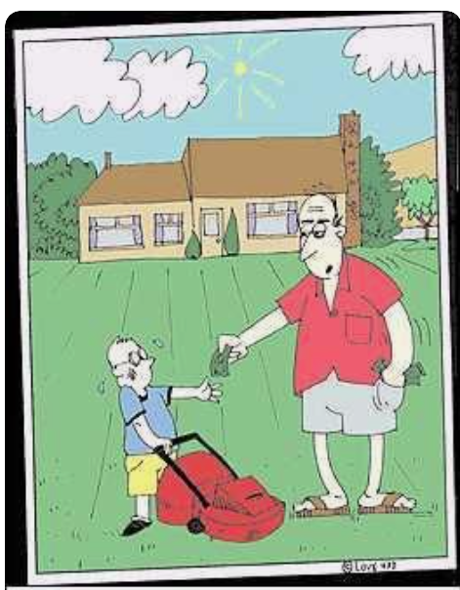
Contracts
GET IT IN WRITING
“No, Jimmy, I distinctly said you could HALVE your allowance by mowing the lawn.”

Slide 49
Contracts
GET IT IN WRITING
Anything involving money, Speaker contracts, Web development, Meeting/Event contracts, Editors/Publishers, etc
CEC will provide free, non-legal review of any contract; Legal review should be handled by an attorney in your state or territory

Slide 50
Meetings/Hotels
Always start with an RFP (CEC can provide sample)
  Ask for what YOU want, not what they want to give
  Discounts on Food/Beverage and A/V (20% minimum)
  Comped Rooms (1:40 Comped at a minimum)
  Free Upgrades

Slide 51
Meetings/Hotels
Chad’s Must-Haves
  Attrition/Slippage of 20%+
  Any revenue minimums and ability to decrease
  Cancellation Clause
  Force Majeure Clause
  Alcohol Responsibility Clause
  Walk Clause
  Rate Integrity Clause
  Resell/Rebook Clause
If not experienced, use a third party (CEC can recommend)

Slide 52
So……

Slide 53
SCARED

Slide 54
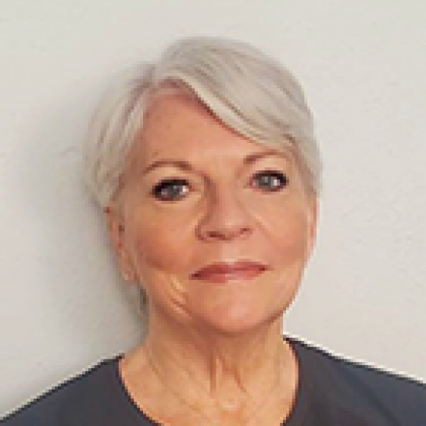
Questions
Feel free to email
Laurie VanderPloeg
  lvanderploeg@exceptionalchildren.org

Slide 55
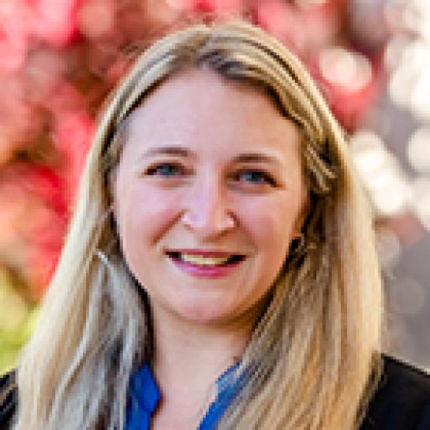

Questions
DIVISIONS
Brannan Meyers, CAE
bmeyers@exceptionalchildren.org
UNITS
Will Webber, CAE
wwebber@exceptionalchildren.org

