Slide 2
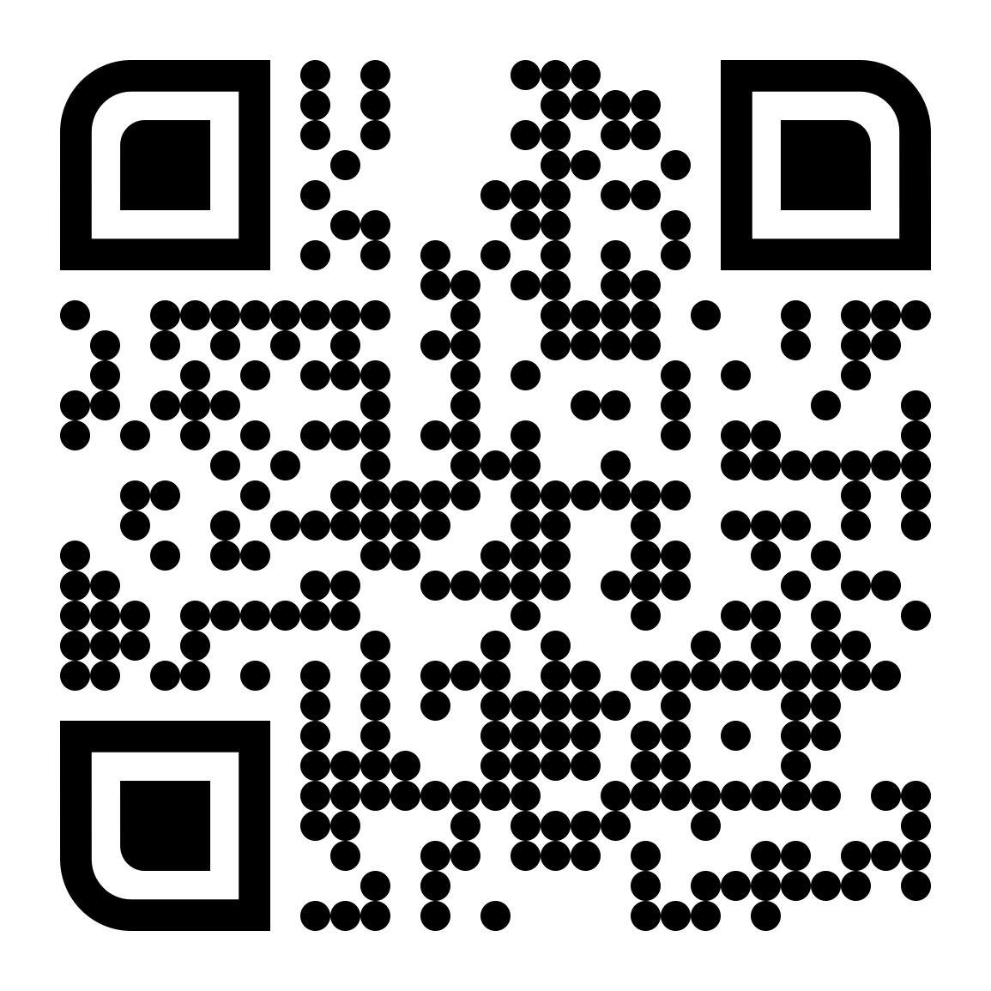
Let’s Start a Conversation!

Slide 3
#1 Online Diagnostic
Assessment & SDI
#2 Teacher Ed Support:
Free account for testing & training
#3 Behavior Framework:
PD & Online Progress Monitoring
Get Started!

Slide 4
Navigating the New Rules & Harsh Realities of MEMBER ENGAGEMENT
Elisa Pratt, MA, CAE, CVF, FSAM

Slide 5
Welcome!
Elisa Pratt, MA, CAE, CVF, FSAM
Association antagonist, nonprofit nerd
25+ years association management
Engagement & Ldr. Development
Certified Association Executive
Fellow Society of Assn. Management
Chapter & affiliate expertise
Member-focused
Mission-driven

Slide 6
What is Engagement [WHAT]
Who are Your Members [WHO]
The New Rules [HOW]
What Do Members Want [WHY]
What Does Engagement Look Like [HOW]
Sustaining Engagement [HOW]
Today’s
Plan

Slide 7
Member Engagement
What people think it looks like
What it really looks like

Slide 8
What Does Engagement Mean?
A word that can mean everything and nothing, how are you defining engagement and what does success look like?

Slide 9
Sincere & Vibrant Engagement
Who
What
How
When

Slide 10
Your Definition of ENGAGEMENT
Participation
Renewals
Member numbers
Dues numbers
Leadership
Attendance
Clicks, views, likes
Impact ? ? ?

Slide 11
The Art & Science of Engagement

Slide 12
Engagement is Sales
Hypercritical consumers
Limited resources
Awareness and communication
Value and return on investment
The “ask” and entry point
The bucket that is never full

Slide 13
Culture of Participation
THE END RESULT OF OUR SUCCESSFUL ENGAGEMENT EFFORTS
Active Committees
Aware & Curious Members
Owning their Member Experience
Giving Testimony
& Recruiting
A culture of participation is not something built overnight and once there is momentum that level of cultivation and engagement must be maintained. Member engagement and the fostering of participation is never done.

Slide 14
Who Are Your Members?
Recruitment, retention, engagement . . .
All of it requires us to understand who members are and are working to become.

Slide 15
Member
Personas
Professional
Early Career
Graduate Student
Pre-Service Student
Paraeducator
Retired Professional
Family/Parent Affiliate

Slide 16
How to Engage Your Member of 2030
The generational environment
Who is your member now?
Tracking Changes
Market awareness
Define your ideal member

Slide 17
The Generational Spectrum
Silent Generation
Baby Boomers
Generation X
Xennials
1928 - 1945
1946 - 1964
1965 - 1979
1975 - 1985
The Silent Generation worked very hard and kept quiet, growing up in a world of war and economic crisis. This period included the Great Depression and McCarthy's anti-communist sentiment, which made it dangerous for people to speak freely about their opinions and beliefs.
This generation was defined by the boom in U.S. births following World War II – are aging and their numbers shrinking in size as the number of deaths among them exceeds the number of older immigrants arriving in the country.
Gen Xers are considered the “middle child” of the generations – caught between two larger generations, the Millennials and the Boomers. Gen X grew up in a world of war and historcial events. They are know to have the highest level of education.
A micro-generation that serves as a bridge between the disaffection of Gen X and the blithe optimism of Millennials. Also known as the "Oregon Trail Generation" who remember a time before the digital age, but barely.

Slide 18
Looking Ahead
Millennials (Gen Y)
Generation
Z
Generation Alpha
Generation Beta
1980 - 1995
1996 - 2010
2011 - mid 2024
2025 - 2039
The Millennial generation is the largest and continues to grow as young immigrants expand its ranks. Marked by elevated usage of and familiarity with the Internet, mobile devices, and social media, Gen Y are considered digital natives. Sometimes called Generation Me and the Peter Pan generation.
Gen Z kids will grow up with a highly sophisticated media and computerenvironment and will be more Internet savvy and expert than their Gen Yforerunners. They are racially and ethnically diverse, progressive and pro-government. They are also digital natives who have little or no memory of the world as it existed before smartphones.
The tech-savvy, highly-educated kids of millennials. This first generation to be born entirely in the 21st century will be the most tech-infused demographic to date.
Gen Beta will be the children of Millennials and the younger siblings of Gen Alphas. They may be even more interconnected and technologically adept, especially with virtual reality and artificial intelligence (AI).

Slide 19
By 2025 Millennials will account for 75 percent of the American workforce.
By 2030, just six years from now, Generation Z will start to occupy senior leadership roles.
Demographic Shifts
Workforce
Education
Healthcare
Technology
Ownership
Membership
In less than 10 years, Generation Alpha will be leaving school and starting their own careers.

Slide 20
Who Are Your Members NOW?
What do you know about your members’ future?
How are they changing?
How is education/the profession/the community changing?
Why the change?
** RETENTION FIRST

Slide 21
Awareness
REQUIRES DATA!!
Through your AMS, CRM or through other methods of tracking member and professional data, you must track and measure changes over time to establish benchmarks and derive trends. Leverage your familiarity with demographic shifts to adapt messaging, benefit offerings and engage new market segments.

Slide 22
Time is everything!
People care more about fewer things!
You aren’t the go-to source!
Customer sophistication!
High expectations!
Use tech to be human!
What
ARE
the New Rules?

Slide 23
The work to engage your members must be an ONGOING commitment.
Member forecasting
must be rooted
in a SINCERE understanding
of motivations, and expectations.

Slide 24
What Do Your Members Want?

Slide 26
The 5 Relationship “Love Languages”
Words of affirmation
Acts of service
Receiving gifts
Quality time
Physical touch
Sample Text

Slide 27
What is Their WHY?
Professional development
Skill enhancement
Knowledge
Professional advancement
Resume building
Networking
Exposure
Thought leadership

Slide 28
What is Your WHY?

Slide 29
CEC Crowd Sourcing

Slide 30
Evolve Your Value Proposition
BASED ON WHAT YOU HEARD HOW DOES YOURS STACK UP?
Education, Events & Training
Communications, Journals & News
Insurance & Discounts
Networking &
Career Advancement
Your "X" Factor

Slide 31
How Do You Know What They Want?
Go to them
Ask sincerely & listen hard
Meet them where they are
Your authentic voice
Understand what impact means to them
Observe, measure, test

Slide 32
What Does Engagement Look Like?
You know who they are. You know what they want. You know what they offer. Now what?

Slide 33
What Does Engagement Look Like?
Listen, watch & understand
Onboard differently
Observe behaviors
Capture & leverage data
Make informed decisions

Slide 34
Ask SINCERELY.
Don't listen to affirm your current path. Listen to what they say and what they don't say. Ask the tough question about future needs and expectations and believe them. Then DO SOMETHING with the information.
This doesn't mean endlessly survey everyone you can find. Talk to a diverse sample of members about what they are looking to achieve. What challenges do they face. Have a conversation. Ask THEM how to get members engaged.
Listen HARD.

Slide 35
Engagement
with Purpose
Once you understand who your members are, what they want, and where they are in their journey, you can better determine how to engage. But do so with purpose, sincerity and consistency.
This is NOT a check-the-box situation!

Slide 36
Points of Entry

Slide 37
Points of Entry
Social, digital, virtual (think in terms of all formats)
Professional networks
Word of mouth
Programs, conferences, and events
Higher level participation:
Committees, Task forces, Leadership

Slide 38
EVERY article, webinar, tweet, event, post, page, seminar, email, speech...
Engagement requires commitment and can’t be assumed.
Your efforts to engage must be adaptive and on-going.

Slide 39
Engagement is a Journey
MEMBERSHIP
Thank
Welcome
Orientate
Communicate
Introduce
Invite
LEADERSHIP
Invite / Expose
Mentor
Recommend
Welcome / Onboard
Thank
Train / Evolve

Slide 40
Sincere & Sustained Engagement
They joined, great! Now what? They renewed, great! Now what?

Slide 41
Sincere & Vibrant Engagement
More than just a welcome kit.
More than just a journal.
More than just an invoice.
More than a menu of benefits.

Slide 42
Invite, Spotlight, Thank
Membership is just the first step. Engagement is a journey. What’s next?
Even after joining, people want, expect and need to be asked.
Recognition in every form. This is your best marketing tool to the not-yet engaged.
Honor Thank
Promote
Celebrate
Award
Reward

Slide 43
How to keep them engaged.
Ask relevant questions
Immediate impact
Integrate and elevate
Give them real value

Slide 44
Often and easy.
Don't relegate them to the
"future leaders council.“ Members aren’t going to wait 10 years to serve in leadership or to have a say regarding the direction of the association. Validate their participation and perspective by providing opportunities for immediate contribution and impact.
The path to engagement starts
with awareness. Members should be given recurrent, redundant, and multiple ways to get involved. EVERY touch should include a “call to action” an invitation and more information on opportunities. Make it hard to miss and easy to do!
Don’t make ‘em wait.

Slide 45
Abandon
"for the good of the order"
Give
them
REAL
value.
Solve their unique problems
Tradition and obligation don't sell. Membership and engagement should be based on meaningful value unique to your organization.
You should know their pain points. How can your org make their lives, careers, and communities better?
Create Community & Belonging
When you understand your members' motivations holistically you can help them achieve the satisfaction and belonging, they seek.

Slide 46
Meet them where THEY ARE!
Your members can be anywhere on the spectrum of personal and professional development.
So where they are and where you will have to go to meet them will change over their membership lifecycle.
They likely have no idea of all the organization has to offer or opportunities to get involved. Their wants and needs will change as well.

Slide 47
Engagement is a relationship not a transaction!
Are you thinking about them?
Are you asking them what they need?
Are you giving them what they need to succeed?
Are you asking for their feedback?

Slide 48
Thank You ! !
If you want to learn more or have any questions, please feel free to reach out to me. Again, thank you so much for your time.
Elisa
Elisa Pratt, CAE, MA, CVF, FSAM Founder & Chief Strategist
Brewer Pratt Solutions, LLC
elisa@brewerprattsolutions.com

Slide 49
BREAK

Slide 51
Legal and financial pitfalls
AVOIDING
2024 Leadership Institute

Slide 52
Four Truths and a Lie
Chad has worked for a nonprofit that was shuttered by the NY Attorney General in a multi-million dollar lawsuit against the nonprofit, its founders, its vendors AND Board members;
Chad has testified in a courtroom following an embezzlement at an association where he worked;
Chad has been a plaintiff on a breach of fiduciary responsibility lawsuit against an association Board;
While at CEC, Chad has advised a CEC unit on dealing with an embezzlement, helped a division file Articles of Incorporation, guided a Unit who lost its nonprofit status, and advised a CEC volunteer worried about indemnification and his legal responsibilities;
Chad is a lawyer.
Notes:
There are three take-aways here. 1) I’m not a lawyer 2) I’ve seen a lot of stuff and 3) I’m clearly bad luck.

Slide 54
Agenda
Fiduciary Responsibility
Guiding Documents
501c3 and Nonprofits
Governance Nomenclature
Insurance
License, Tax and Audit
Accounting
Contracts
Conflict of Interest

Slide 55
Fiduciary Responsibilities
Applies to:
Elected Volunteers/Leaders
Appointed Volunteers/Leaders
Staff
Everyone has the same fiduciary responsibilities
i.e. president doesn’t have more fiduciary responsibility than the membership chair
Legal implication for not fulfilling responsibilities
“Fiduciary Breach”
Notes:
Applies to: Every volunteer who works with you, whether appointed or elected, and every staff member

Slide 56
Fiduciary Responsibilities
Responsibility | Chad-Speak | Examples
Duty of Care | Be Informed | Data, Counsel, History --COME PREPARED
Notes:
Duty of Obedience: Under this duty, board members may not approve an action by the foundation that violates its governing documents or applicable laws. As a new board member, you should have ready access to the foundation’s governing documents and ask questions if these include anything you do not understand.
The biggest challenge that families and donors have is making the transition from an individual to an organizational perspective. You’ve joined the board; that has legal implications; it is not about you as a family member. Just because you are on a private foundation board doesn’t mean that your actions are private – you are accountable.
Hilary Pearson, President and CEO Philanthropic Foundations Canada
25
Copyright © 2013 Council on Foundations
Duty of Care: Care, in this duty, might also be described as the duty to be well in-formed before making a decision. To enable informed choices, board members have a responsibility to review relevant materials, such as minutes, and reports or studies. Board members must also make informed choices by accessing sources of infor-mation like committees, staff, or outside consultants, including legal counsel when needed.
Duty of Loyalty: Board members must act solely in the foundation’s interest, avoiding conflicts of interest and maintaining confidentiality. A best practice for foundations is to ask board members annually to declare any conflicts, in accord-ance with the foundation’s Conflict of Interest Policy, and recuse themselves from voting when a conflict arises. Such policies often include a pledge to maintain the confidentiality of foundation discussions and actions as well. Pay particular atten-tion to any entities with which you have financial or governance relationships, such as sitting on the board of a potential grantee organization or business interests you might have with a vendor to the foundation. These need to be declared, and your declaration recorded in meeting minutes

Slide 57
Fiduciary Responsibilities
Responsibility | Chad-Speak | Examples
Duty of Care | Be Informed | Data, Counsel, History --COME PREPARED
Duty of Loyalty | Put the Organization First | Avoid Conflict, Declare Conflict
Notes:
Duty of Obedience: Under this duty, board members may not approve an action by the foundation that violates its governing documents or applicable laws. As a new board member, you should have ready access to the foundation’s governing documents and ask questions if these include anything you do not understand.
The biggest challenge that families and donors have is making the transition from an individual to an organizational perspective. You’ve joined the board; that has legal implications; it is not about you as a family member. Just because you are on a private foundation board doesn’t mean that your actions are private – you are accountable.
Hilary Pearson, President and CEO Philanthropic Foundations Canada
25
Copyright © 2013 Council on Foundations
Duty of Care: Care, in this duty, might also be described as the duty to be well in-formed before making a decision. To enable informed choices, board members have a responsibility to review relevant materials, such as minutes, and reports or studies. Board members must also make informed choices by accessing sources of infor-mation like committees, staff, or outside consultants, including legal counsel when needed.
Duty of Loyalty: Board members must act solely in the foundation’s interest, avoiding conflicts of interest and maintaining confidentiality. A best practice for foundations is to ask board members annually to declare any conflicts, in accord-ance with the foundation’s Conflict of Interest Policy, and recuse themselves from voting when a conflict arises. Such policies often include a pledge to maintain the confidentiality of foundation discussions and actions as well. Pay particular atten-tion to any entities with which you have financial or governance relationships, such as sitting on the board of a potential grantee organization or business interests you might have with a vendor to the foundation. These need to be declared, and your declaration recorded in meeting minutes

Slide 58
Fiduciary Responsibilities
Responsibility | Chad-Speak | Examples
Duty of Care | Be Informed | Data, Counsel, History --COME PREPARED
Duty of Loyalty | Put the Organization First | Avoid Conflict, Declare Conflict
Duty of Obedience | Follow the Rules | Bylaws, Mission, Policies
Notes:
Duty of Obedience: Under this duty, board members may not approve an action by the foundation that violates its governing documents or applicable laws. As a new board member, you should have ready access to the foundation’s governing documents and ask questions if these include anything you do not understand.
The biggest challenge that families and donors have is making the transition from an individual to an organizational perspective. You’ve joined the board; that has legal implications; it is not about you as a family member. Just because you are on a private foundation board doesn’t mean that your actions are private – you are accountable.
Hilary Pearson, President and CEO Philanthropic Foundations Canada
25
Copyright © 2013 Council on Foundations
Duty of Care: Care, in this duty, might also be described as the duty to be well in-formed before making a decision. To enable informed choices, board members have a responsibility to review relevant materials, such as minutes, and reports or studies. Board members must also make informed choices by accessing sources of infor-mation like committees, staff, or outside consultants, including legal counsel when needed.
Duty of Loyalty: Board members must act solely in the foundation’s interest, avoiding conflicts of interest and maintaining confidentiality. A best practice for foundations is to ask board members annually to declare any conflicts, in accord-ance with the foundation’s Conflict of Interest Policy, and recuse themselves from voting when a conflict arises. Such policies often include a pledge to maintain the confidentiality of foundation discussions and actions as well. Pay particular atten-tion to any entities with which you have financial or governance relationships, such as sitting on the board of a potential grantee organization or business interests you might have with a vendor to the foundation. These need to be declared, and your declaration recorded in meeting minutes

Slide 59
Fiduciary Responsibilities
Responsibility | Chad-Speak | Examples
Duty of Care | Be Informed | Data, Counsel, History --COME PREPARED
Duty of Loyalty | Put the Organization First | Avoid Conflict, Declare Conflict
Duty of Obedience | Follow the Rules | Bylaws, Mission, Policies
Duty of Foresight | Be Proactive | Strategy, Data Mining, Listening
Notes:
Foresight: just as important, sets apart good from great organizations

Slide 60
Avoiding Claims of Fiduciary Breach
Individual volunteers protected somewhat by VPA; not protected from gross negligence
Avoid negligence by seeking support/counsel
Organization NOT protected from negligence
Remove volunteers members who are negligent; promote volunteers who uphold responsibilities
Onboard/train new volunteers; make governing documents available

Slide 61
Hierarchy of Guiding Documents
“Duty of Obedience”
Follow the laws, policies, and mission of the organization.

Slide 62
Hierarchy of Guiding Documents
Document | Created By | Includes
State/Government Law | Lawmakers | -Who can incorporate -Board responsibilities on voting, quorum, etc

Slide 63
Hierarchy of Guiding Documents
Document | Created By | Includes
State/Government Law | Lawmakers | -Who can incorporate -Board responsibilities on voting, quorum, etc
Articles of Incorporation | Founders/Board, Filed with Secretary of State | -Mission -Deliverables -Who can belong/support

Slide 64
Hierarchy of Guiding Documents
Document | Created By | Includes
State/Government Law | Lawmakers | -Who can incorporate -Board responsibilities on voting, quorum, etc
Articles of Incorporation | Founders/Board, Filed with Secretary of State | -Mission -Deliverables -Who can belong/support
Bylaws | Board of Directors (Usually Member Approved) | -Membership -Officers; terms; “Authority” -Standing Committees -Quorum; voting

Slide 65
Hierarchy of Guiding Documents
Document | Created By | Includes
State/Government Law | Lawmakers | -Who can incorporate -Board responsibilities on voting, quorum, etc
Articles of Incorporation | Founders/Board, Filed with Secretary of State | -Mission -Deliverables -Who can belong/support
Bylaws | Board of Directors (Usually Member Approved) | -Membership -Officers; terms; “Authority” -Standing Committees -Quorum; voting
Policy Manual | Board of Directors | -Ad Hoc Committees -Guidelines for operating outside of the Board meeting

Slide 66
Hierarchy of Guiding Documents
Document | Created By | Includes
State/Government Law | Lawmakers | -Who can incorporate -Board responsibilities on voting, quorum, etc
Articles of Incorporation | Founders/Board, Filed with Secretary of State | -Mission -Deliverables -Who can belong/support
Bylaws | Board of Directors (Usually Member Approved) | -Membership -Officers; terms; “Authority” -Standing Committees; Quorum; voting
Policy Manual | Board of Directors | -Ad Hoc Committees -Guidelines for Operating Outside of the Board Meeting
Operations Manual | Committees; Staff | -Day to Day Operations -Processes and Procedures -Not Legally Binding

Slide 67
Governance Nomenclature
Notes:
Chad

Slide 68
Governance Nomenclature
Must use nomenclature established in Bylaws
Names establish authority
All volunteers have same Fiduciary Responsibility; nomenclature defines different Legal Responsibility

Slide 69
Governance Nomenclature
Board
Executive Committee
President
Past President
President Elect
Treasurer
Boar MAL
Board MAL
Board MAL
Board MAL
Boar MAL
Board MAL
Board MAL
Board MAL
Chapters
SIGS
Committees
Workgroups
Subdivisions
Notes:
Chad

Slide 70
CASE STUDY: SPSP
Notes:
Chad

Slide 71
CASE STUDY: SPSP
Executive Committee
President
Past President
President Elect
Treasurer
Notes:
Chad

Slide 72
CASE STUDY: SPSP
Board
President
Past President
President Elect
Treasurer
Boar MAL
Board MAL
Boar MAL
Board MAL
Boar MAL
Board MAL
Board MAL
Board MAL
Notes:
Chad

Slide 73
CASE STUDY: SPSP
Board
President
Past President
President Elect
Treasurer
Boar MAL
Board MAL
Boar MAL
Board MAL
Boar MAL
Board MAL
Board MAL
Board MAL
Committees
Editors
Task Forces
Foundation
Staff
Notes:
Chad

Slide 74
CASE STUDY: SPSP
Executive Committee
President
Past President
President Elect
Treasurer
Board MAL
Board MAL
Board MAL
Board MAL
Board MAL
Board MAL
Board MAL
Board MAL
Committees
Editors
Task Forces
Foundation
Staff
Notes:
Chad

Slide 75
501c3 Cans and Cannots
29 Different 501c NONPROFIT organizations, all exempt from some federal taxes
501c3 – Religious, charity, education, science, etc
501c4 – Civic leagues, social welfare, local employees
Most Political Action Committees (PAC)
501c5 –Labor unions, agricultural organizations
501c6 – Business leagues, chamber of commerce
Lots of Lobbying

Slide 76
501c3 Cans and Cannots
No tax on operating income, local sales tax
Contributions are tax deductible – NOT membership
Must register to be ACTIVELY pursue donations
Members cannot engage in activities that utilize nonprofit resources to benefit personally (i.e. book promos)
Cannot engage in electioneering, supporting any candidate for public office OR allow it to happen in forums, listserves, etc.

Slide 77
501c3 Cans and Cannots
Cannot engage or create forums for Antitrust violations (propose boycotts of companies, agree on pricing to pay, exclusionary practices, etc)
CAN do lobbying
Safe Harbor Law: Cannot spend more than 20% of first $500,000 of revenue

Slide 78
Note for 501c6
Membership collateral MUST state what percent of dues goes to lobbying
Work with CEC staff on it

Slide 79
CEC Policies
 | Divisions | Units
Bylaws | On File with CEC
Membership | Unified - 1% of CEC (~200) | Unified; 50-Person Minimum
Groups | Oversee Subdivisions | Oversee Chapters
Budget | Should Have One
Public Statements | Must Use Disclaimer Unless Approved by CEC | Must Be in Alignment with CEC (unless state-level)
Reporting | Submit Annual Assurance Form
Elections | May support candidates for CEC Board election (new as of 2021)

Slide 80
Insurance
Anyone involved in the management of a nonprofit organization — including directors, officers, employees and volunteers — could be held personally liable for errors or omissions involved in the management of the organization.
Types of lawsuits:
Employment/Contract Issues (90% of nonprofit lawsuits)
Fiduciary Duty Breach
Misuse of nonprofit funds or donor funds
Directors and Officers Insurance (CEC Can Recommend)
General Liability Insurance
Event Cancellation Insurance*

Slide 81
Licensure
State
Registration
Federal Registration
Federal Nonprofit Status
Initial Registration Proves Your “License”
Filed Annually
Update Officers
“Local” Contact
Sometimes include Tax Info
Often includes a payment
Initial Registration Provides an EIN
Annually File a 990
Done One Time
KEEP YOUR LETTER

Slide 82
IRS 990
Form 990 is an annual reporting return that tax-exempt organizations must file with the IRS. It provides information on the filing organization's mission, programs, and finances.
All 501c3 organizations must file
Revenue <$50,000 can file 990-N (Postcard)
Revenue <$200,00 can file 990-EZ
May be subject to 990-T (UBIT)
990 Must be made available upon request
CEC will not relinquish dues without proof of filing

Slide 83
Accounting Best Practices
Approve an Annual Budget
Review Regularly
Look at TRENDS, Not Just This Year (Foresight)
Division dues come monthly, Units come annually
Diversify Revenue
Management vs. Programs
Multiple “Hands” Involved in Process
Minimum = Someone Reviewing Bank Statements
Rotate Treasurer Role; Audit periodically
“How Much Should We Have In Reserves?”
No Money, No Mission

Slide 84
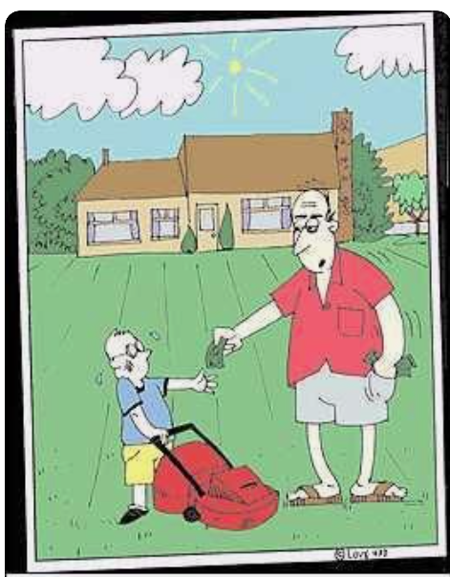
Contracts
GET IT IN WRITING
“No, Jimmy, I distinctly said you could HALVE your allowance by mowing the lawn.”

Slide 85
Contracts
GET IT IN WRITING
Anything involving money, Speaker contracts, Web development, Meeting/Event contracts, Editors/Publishers, etc
CEC will provide free, non-legal review of any contract; Legal review should be handled by an attorney in your state or territory

Slide 86
Meetings/Hotels
Always start with an RFP (CEC can provide sample)
Ask for what YOU want, not what they want to give
Discounts on Food/Beverage and A/V (20% minimum)
Comped Rooms (1:40 Comped at a minimum)
Free Upgrades

Slide 87
Meetings/Hotels
Chad’s Must-Haves
Attrition/Slippage of 20%+
Any revenue minimums and ability to decrease
Cancellation Clause
Force Majeure Clause
Alcohol Responsibility Clause
Walk Clause
Rate Integrity Clause
Resell/Rebook Clause
If not experienced, use a third party (CEC can recommend)

Slide 88
Conflict of Interest
Should be declared when identified
Interest of Two Parties Cannot Be Served
Many States Require Nonprofits to Have Written Policy, Signed Annually
Not Always Financial
Personal Gain vs. Undue Influence
Conflicts Should Be Avoided—particularly if it is a duality of loyalty; when they cannot, volunteer should recuse and minutes should reflect

Slide 89
So……

Slide 90
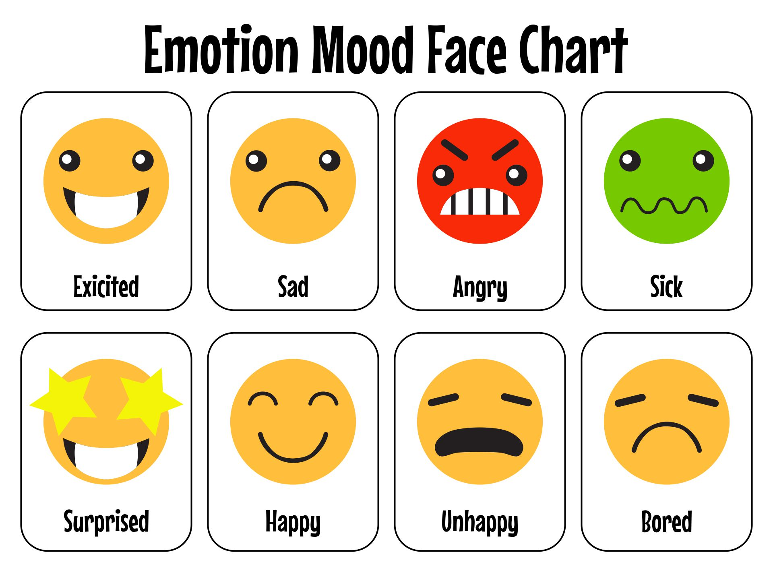

Slide 91
Questions
Feel free to email
Laurie VanderPloeg
lvanderploeg@exceptionalchildren.org

Slide 93
Lunch Breakouts Begin at 1:40pm

Slide 94
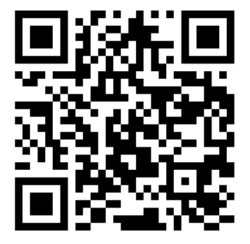
IDC Grants
In July 2023, the board approved a proposal from the Division Relations Committee (DRC) for $20,000 in funding to support a minimum of two grants (up to $10,000 each) for the 2024 fiscal year. This program is intended to:
foster collaboration among, and engagement within, divisions to enhance their viability.
potentially attract and retain members.
create resources for CEC to share with the entire community to strengthen CEC’s ability to support members.
Each funded project must support at least one of CEC’s Strategic Plan Goals and Objectives:
Develop and support an effective and diverse workforce of special education professionals.
Intentionally embed diversity, equity, inclusivity, and accessibility within CEC.
Increase the impact of CEC’s policy agenda for education professionals and for individuals with disabilities and/or gifts and talents.
Establish CEC as a globally recognized leader in the field of special education.
Open August 1- October 1
https://shorturl.at/0LfAj

Slide 95
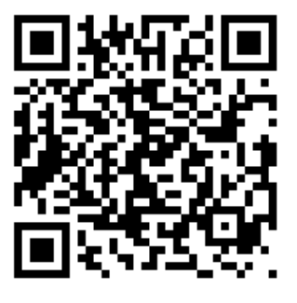
Component Strategic Plan Survey
https://www.surveymonkey.com/r/HDQGHZF

Slide 97
Table Talks
Brannan Meyers, CAE

Slide 98
Goals
Receiving Support ( Hack-A-Thon)
Discussion with other colleagues who have similar needs
Making Connections!

Slide 99
Table Talks
Everyone sitting at TWO tables
25 Minutes at each table
Everyone has a role at each table:
One table you will be leveraging your strength as the “expert”
The other table you will learn from the experts
Expert vs. Learner determined by your OWN registration selections
Each table has a list for you to reference for your role AND topics

Slide 100
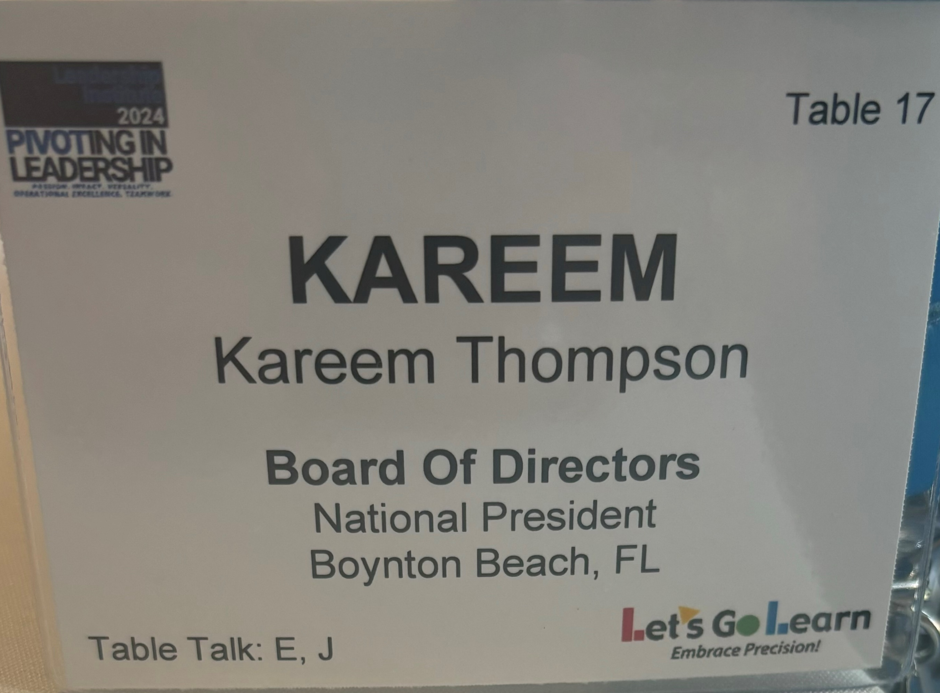
First table= First letter
Second table = Second letter

Slide 101
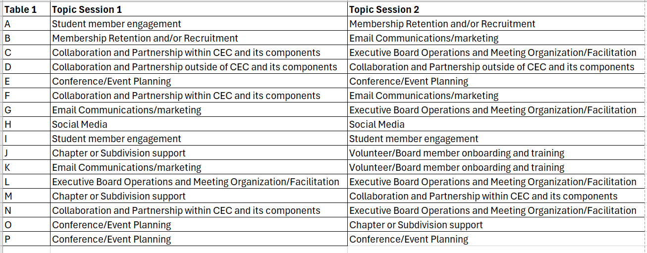

Slide 103
Component Strategic Plan

Slide 104
Goals
CEC is developing a strategic plan to help support and grow components over the next five years.
At Your Table Please lead a discussion revolving around the next three questions.
We have a scribe at your table that will be taking notes, so feel free to talk freely and they will bring the feedback , back to us!

Slide 105
1. What are your Components 5-year goals? How do they plan to improve in the next five years
2. What is keeping you from getting there?
3. How can CEC help?

Slide 106
Networking Reception 5:00 -6:00 PM

