Slide 1
Pass It On: The Art and Heart of Volunteer Succession Planning
Irving Washington

Slide 2
Two Word Check In!
Right now, I’m feeling __BLANK__ (insert conjunction) ___BLANK____.
●And
●But
●Yet

Slide 3
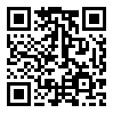
Live Poll: Getting to know the team
Join at
slido.com
#3388 072

Slide 4
Who’s Irving?
Enjoys facilitating and speaking to volunteer leaders
Current healthcare philanthropy exec
Former CEO of media association
Active in American Society of Association Executives
Diversity Executive Leadership Program
Certified Association Executive
ASAE Fellow
ASAE Board Member
Aspiring Cook
Part-Time Explorer: I love traveling.
I like to lift very heavy things
Self-identified Introvert (although some don’t believe it!)
Self proclaimed nerd to studies on happiness

Slide 5
Ground Rules for Today
Embrace all experiences.
Respectful engagement. Attention is a gift.
Give each other the benefit of the doubt
When in doubt, ask rather than assume
Stay committed to developing a shared understanding of the issues
Listen to learn rather than to plan a response or rebuttal
Speak to the heart of the matter and share why something is important to you and not just the what
Slow down the conversation
Step up; Step Back

Slide 6
Exploration for Today
Recognize and leverage the unique strengths of each volunteer leader
Build a sustainable leadership development pipeline
Foster a culture of appreciation, recognition, and continuous learning

Slide 8
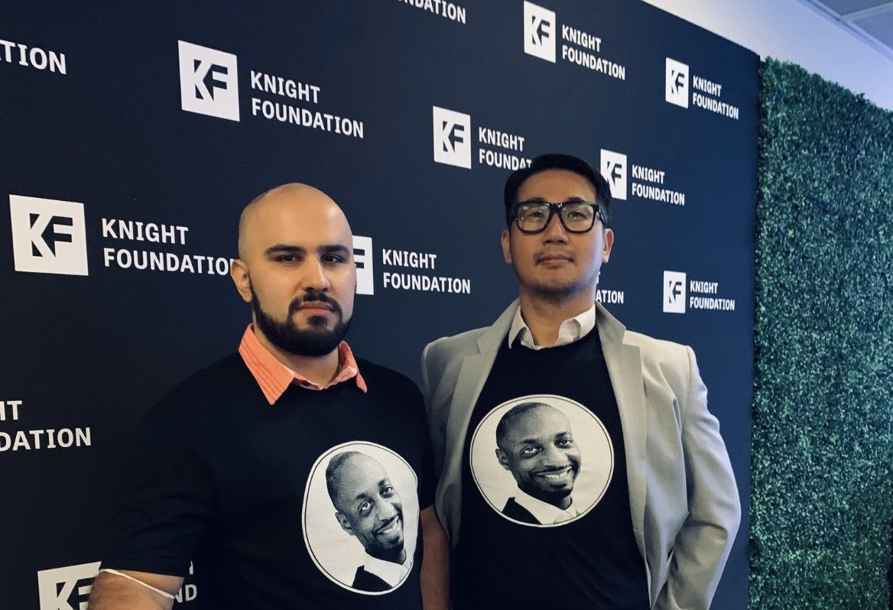
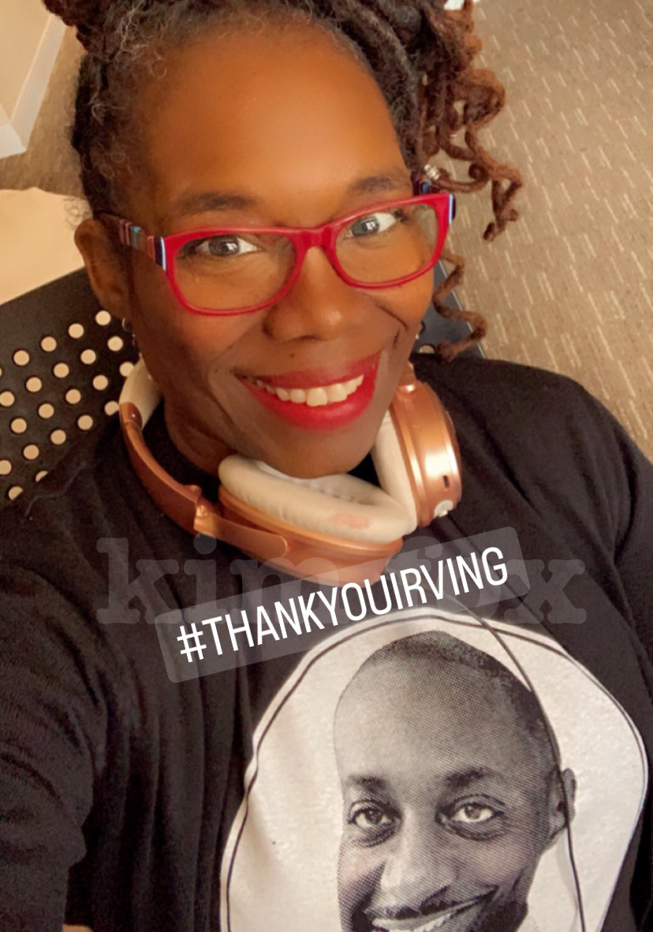
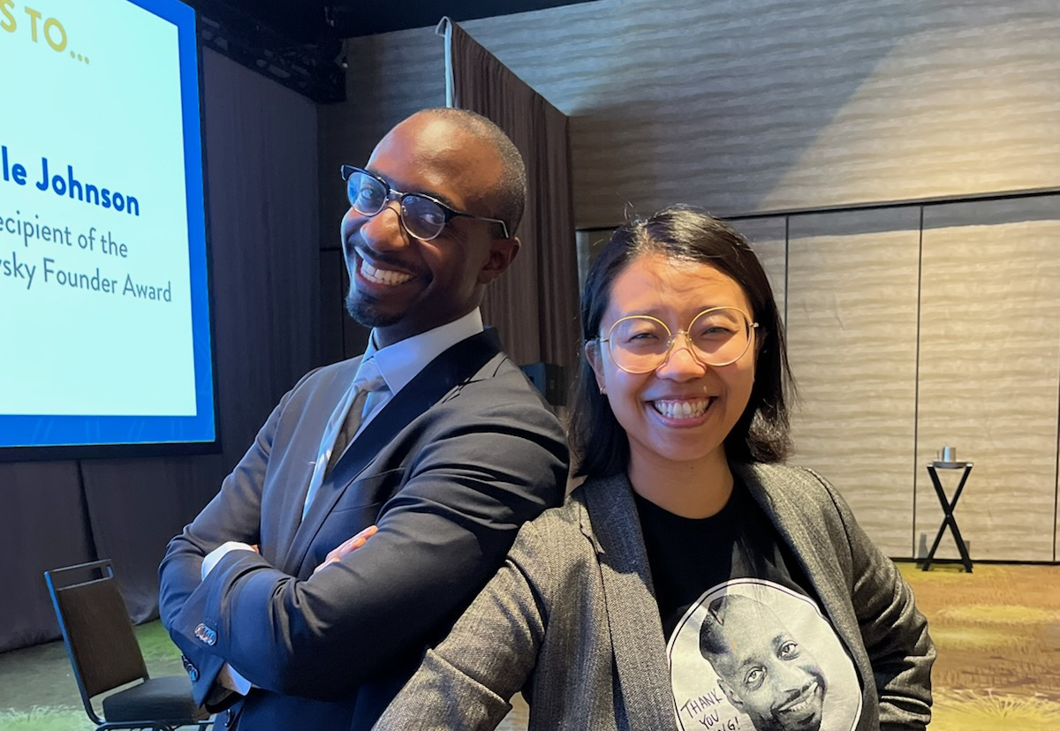

Slide 9
Michelle Johnson

Slide 10
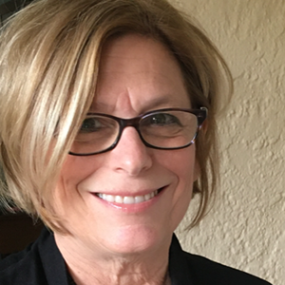
Amy Eisman

Slide 11
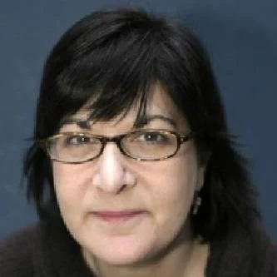
Mary Jane “MJ Bear
“To promote the voices of young professionals working in or training to work in the field of Online news by presenting programs at the Association's annual meeting, or in other venues. The programs will be designed to explore and showcase innovations, developments and new ideas in the field by sponsoring panel presentations, keynote talks or other appropriate formats.”

Slide 12
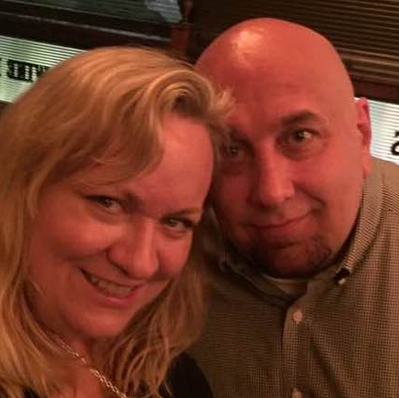
Tiffany Shackelford Matt Mansfield

Slide 14
What is succession?
“the order in which or the conditions under which one person after another succeeds to a property, dignity, title, or throne.”
A succession plan is a document that outlines how your organization will fill key volunteer leadership positions when they become vacant.

Slide 15
But really, what is succession?
The mission that I care about matters more than the moment
When it’s time for me to leave, how do I want to leave things for the next person?
Do I want to leave a foundation or a footnote?
Planting trees you'll never sit under.

Slide 16
Three Things In Common (People)
Find and Grow Leaders: Actively seek out and identify future leaders within your team through ongoing evaluation.
Build Leaders: Invest in leadership development through training, mentorship, and increased responsibilities.
Transition and Pass the Baton to New Leaders: Ensure smooth transitions by having detailed plans in place for leadership handovers.

Slide 17
Know Thyself
"Define yourself. Don't be an imitation of something or someone else."
— Viola Davis

Slide 18
Find and Grow Leaders:
"Nobody feels better than a volunteer who has been personally approached.”
"You can't just call your friends. Have a wider circle, give people titles, give them appreciation, give them tasks.”
"I didn’t necessarily go out looking for these opportunities. Most of the time, they just sort of came to me.”
We looked for people who identified with the values of the organization.

Slide 19
Build Leaders:
"The best thing you can ever say to anybody is these four words: what do you think?”
"Give people titles, give them appreciation, give them tasks, and given timelines.”
"People don't necessarily want to be led the way you would want to be managed. They want to be managed the way they want to be managed.”
”Help people realize they can do it. It isn’t as hard as it may look.”
“Give people a sense of ownership.”

Slide 20
Transition and Pass the Baton to New Leaders:
"I wasn't really thinking much about succession at that point, because I sort of, I was loved, loved what I was doing, and I couldn't imagine stopping, I just couldn't imagine it.”
“Ask new leaders if it’s too overwhelming or if it feel about right.”
"You have to recognize you have to step away at some point.”
"If you're managing volunteers, find their special sauce too you know, what do they want to learn?”
“It’s always good to have a sounding board as volunteer leaders.”

Slide 21
Why Members Don’t Accept Leadership Roles
Fear of commitment
Doesn’t sound exciting
Insecure about skills
‘Old guard’ unfriendly to newcomers
New ideas are not fostered and supported
Lack of understanding of programs
Unclear goals
They have watched others burn-out

Slide 22
Remove Barriers to Leadership
Create clearly defined responsibilities
Set expectations
Explain time commitments
Clarify what success looks like
Make new volunteers comfortable
Model supporting new ideas

Slide 23
Be Tactical: Define Specific Tasks
Have a plan.
Don’t let someone slip away because at the time they offered to help, you did not have something for them to do. Keep a list of things that people can always do.
Keep it simple at first. And provide opportunities with varying levels of responsibility.
People are more likely to say “yes” when they understand the potential rewards.
Create volunteer leader job descriptions.

Slide 24
Delegate & Invest Time
Invite a volunteer to something.
Set up a support system for mentoring new leaders.
Consider taking an item from your to-do list today and finding a capable volunteer to take it over.
Provide recognition and feedback. Do this meaningfully— recognize that it’s the person’s first time helping out.
Aside from a formal thank you, volunteers feel appreciated when folks pull them aside and thank them personally.

Slide 25
G. R. O. W.
Gather potential leaders
Recognize leadership qualities
Offer development opportunities
Widen responsibilities

Slide 26
B. U. I . L. D.
Benchmark current leadership capacity
Uplift potential leaders
Invest in leadership development
Link current and future leaders
Deploy emerging leaders

Slide 27
B. A. T. O. N.
Build your plan
Assess your current leadership
Time your leadership transitions
Onboard new leaders effectively
Navigate the transition process

Slide 28
What's one action we could take this year to advance succession planning or leadership development in our volunteer groups?

Slide 29
If you’re stuck on a problem, try solving it at a different level.

Slide 30
If you ask, “What can we do to create a more unified country?” then you end up with vague answers that are difficult to implement.

Slide 31
The problem is mostly unimaginable at that level.

Slide 32
But if you ask, “What can I do to create a more unified neighborhood?” then you can likely think of many small things that you can do to connect your friends and neighbors.

Slide 33
Zoom in or Zoom out. Problems that seem impossible at one level are often quite accessible from a different one.
James Clear

Slide 34
Let’s Begin!

Slide 35
Transitions
Remember our elementary school transitions!

Slide 36
Step 1: Getting Started
1. Index card
2. Writing pen or marker
3. Curiosity!

Slide 37
Step 2: Write on your index card
What's one action we could take this year to advance succession planning or leadership development in our volunteer groups?

Slide 38
Step 2: continued What's one action we could take this year to advance succession planning or leadership development in our volunteer groups?
One Idea, One Card: Stick to a single thought or idea.
Brevity is Key: Concisely capture your idea in a sentence or two.
Top of Mind: What’s most pivotal?
Think Widely: Think big and small across the profession.
Attribution: No attribution needed, however remember your idea!

Slide 39
Step 3: Let’s swap cards
1. Stand up
2. Pass your card to a peer.
3. You’ll get theirs, but don’t read it yet!

Slide 40
Step 3: continued
Now walk around the room. Repeat passing cards until you hear stop!
Don’t read the cards yet!

Slide 41
Step 4: Read
Stop and read the card in your hand. If it happens to be your card, switch with more people on your own.

Slide 42
Step 5: Reflect on the idea
On a scale of 1-5, how important does this idea feel to discuss right now, in your opinion?
(5 = Very important / 1 = Not as important)

Slide 43
Step 6: Write the number
On a scale of 1-5, write the number in the top left corner on the back of the card.
(5 = Very important / 1 = Not as important)

Slide 44
Step 7: Let’s swap cards…
…again and repeat!
Pass your numbered card to a peer.
You’ll get theirs.
Repeat passing cards until I say stop!
When you hear ‘stop’, give your card a number and we’ll repeat again.

Slide 45
Step 8: Time for math
Add the total numbers on the back of the index card.

Slide 46
Let’s Discuss
Which themes emerged?

Slide 47
Which cards scored a 25?

Slide 48
Which cards scored a 24?

Slide 49
Which cards scored a 23?

Slide 50
Which cards scored a 22?

Slide 51
Which cards scored a 21?

Slide 52
Pass It On: The Art and Heart of Volunteer Succession Planning
Irving Washington

Slide 53
Presentation Title Goes Here (Please provide full title of your presentation)
Presenter Names

Slide 54
How to Use This Template Pt. 2
You can either insert new slides or duplicate these guidance slides to add your own content.
Be sure to delete these guidance slides before saving your presentation in its final form!

Slide 55
Accessibility
Don’t forget to make sure your PowerPoint is accessible:
https://support.microsoft.com/en-us/office/make-your-powerpoint-presentations-accessible-to-people-with-disabilities-6f7772b2-2f33-4bd2-8ca7-dae3b2b3ef25#PickTab=Windows
The “Always Use Subtitles” function has been activated for this PowerPoint presentation. This feature is part of the Microsoft 365 package and may not work on older versions of PowerPoint.

Slide 56
Slides as Handouts
If you make your slides available as a handout that will be uploaded to the app, be sure to save them as a PDF with two slides per page.

Slide 57
Sample Header
Sample text

Slide 58
Sample Header
Sample text

Slide 59
Sample Header
Sample text

Slide 60
Sample Header
Sample Text

Slide 61
Sample Header
Sample Text

Slide 63
Sample Title
Sample Text

Slide 64
Sample Title
Sample Text

Slide 65
CONTENT BREAK
Sample Sub-Header
Sample Sub-Header
Sample Text
Sample Text

Slide 66
Sample Header
Sample Text
Sample Text

Slide 67
Sample Header
Sample Sub-Header
Sample Sub-Header
Sample Text
Sample Text

Slide 68
Sample Header
Sample Sub-Header
Sample Sub-Header
Sample Text
Sample Text

