Slide 1
Leadership Institute:
Unit/Division-Level Policy and Advocacy
Kuna Tavalin
Senior Policy and Advocacy Advisor
Council for Exceptional Children

Slide 2
Agenda
Overview: Role of CAN Coordinator
CEC’s Policy and Advocacy Resources
Strategies for Unit/Division Work
Q&A/Discussion

Slide 3
CAN Coordinator Job Description
Summary: Children and Youth Action Network (CAN) Coordinators are CEC members selected by their respective units or divisions. CAN Coordinators must be committed to advancing CEC’s policies through effective grassroots advocacy.
Estimated Time Commitment: 1-2 hours per month

Slide 4
CAN Coordinator Responsibilities
Development of an effective network of advocates from w/in unit/division
Regular communication with the network, including circulation of CEC’s weekly policy newsletter Policy Insider
Activation of the network for CEC calls to action; for unit/division-related issues
Attendance of CEC policy and advocacy webinars and events
Attendance at CAN trainings offered virtually and at the annual convention, if in attendance

Slide 5
CAN Coordinator Qualifications
Qualifications:
Must be a member of CEC
Knowledge of or desire to learn about policy and advocacy
Commitment to the policy priorities of CEC
A willingness to devote time to this position
Advocacy in Washington, DC:
CEC encourages CAN Coordinators to attend/lead state teams at the Special Education Legislative Summit, an annual advocacy event for special educators which includes a two-day training, culminating with meetings with lawmakers on Capitol Hill.

Slide 6
CEC Policy/Advocacy Resources
Legislative Action Center
Policy Insider
Policy/advocacy webinars
Special Education Legislative Summit
Policy/advocacy landing page on website
CAN Community
Me! ktavalin@exceptionalchildren.org

Slide 7
Example: Kentucky CEC
KY ballot initiative to change State Constitution to allow public funds allocated outside the public school system (vouchers)
KYCEC Can Coordinator reached out seeking advice/resources
CEC Position Statement on vouchers
Resources from National Coalition for Public Education
CAN Coordinator used resources to craft advocacy materials
CEC reviewed and provided feedback
Campaign launched!

Slide 8

Sample Social Media Image
Kentucky CEC campaign, Vote NO on Amendment 2

Slide 9
Example: Division for Career Development and Transition (DCDT)
New CAN Coordinator eager to increase DCDT’s national presence
Conducted DCDT policy town hall and three months of preparation work
Developed official position in support of the Transformation to Competitive Integrated Employment Act
Met with 6 key offices on Capitol Hill that have critical influence over the bill
Opportunity to discuss bill and discuss DCDT’s work and priorities

Slide 10
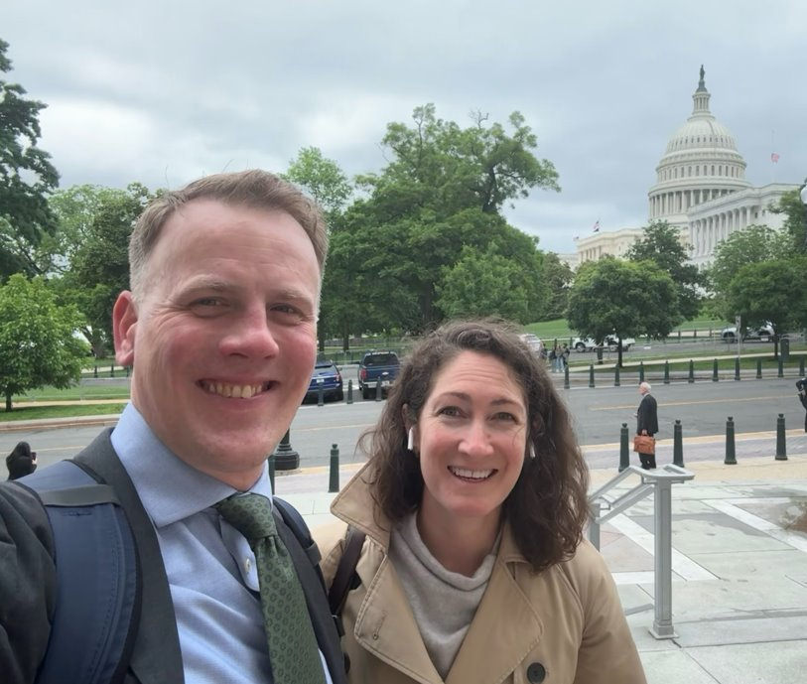
DCDT Hill Visits
“It was great meeting you, I really enjoyed the conversation and appreciate the opportunity to have you and DCDT as a resource!”
-Disability Policy Advisor
“The Capitol Hill visit represented the culmination of several months of intensive activity and preparation from members on the topic of transitioning from subminimum wages to CIE.”
-DCDT CAN Coordinator Dr. Joshua Taylor

Slide 11
Example: Private Action Alert: Arizona State Legislature
Arizona legislature had opportunity to improve state financing of special education
Arizona CAN Coordinator requested call to discuss strategy
Co-wrote letter and uploaded to Action Alert platform
Target: Arizona lawmakers
Only recipients of link could go to alert
Arizona CAN Coordinator shared with robust network
354 contacts made
Outcome: adoption of legislative effort

Slide 12
Excerpt of Private Action Alert: Arizona State Legislature
As an educator dedicated to supporting the needs of all students, I graciously ask that you include $50 million to increase the Group B weight funding for our most prevalent and lowest funded special education categories and a $5 million appropriation for the Extraordinary Special Education Needs Fund.
Group B weight funding received unanimous support in the past and is in critical need of your support again. The current model generates less than $20 for many special education categories although providing an appropriate education to eligible students cost districts tens of thousands of dollars. The Extraordinary Special Education Needs Fund was established for districts and charter schools to recuperate the uniquely high and unexpected costs associated with serving certain special education students, costs which can be particularly devastating to the budgets of small and rural districts and charter schools. Unfortunately, the Fund has never received an appropriation…

Slide 13
Strategies for Unit/Division Advocacy
Present at your annual conference to inform and engage your peers
Work with peers to strategize approaches that respond to the unique circumstances of your State
Work with your board: present policy updates; engage your board in policy; strategize on how to mobilize
Plan engagement events: calling legislators, writing letters, etc.
Plan a state-level advocacy event
Discussion: What have you done!?

Slide 14
Questions? Thoughts?
Please feel free to contact me!
ktavalin@exceptionalchildren.org

