Slide 2
Crafting Social Media Magic: Advancing Your Strategies
Hannah Hickman
Marketing Manager, CEC

Slide 3
Social Media – Why and Where?
Why do you use social media?
Platforms
Meta – Facebook + Instagram
Twitter/X
LinkedIn
TikTok
YouTube
Notes:
One of the first things you should do when thinking about your social media strategy is figure out why. Why are you on social media? Why are you using it? These reasons can be anything from wanting to share information with your members, wanting to educate your audiences, wanting to increase your membership, and more. These reasons should guide your strategy. And if you are struggling to find your why, take a step back. If you are on social media just for the sake of being on social media, it might not be the best move for you. But there is a way to make it work and ensure that you are getting the best value for your time and effort.
There are a lot of platforms out there to utilize for social media. The goal is not to be on every platform. The goal is to be effective on the platform you are on. If you can dedicate the time to each platform, that’s great. But if you are feeling spread thin, we can evaluate where you find the most value. For example, say you are on Facebook and Instagram. Your Facebook audience is engaged, and really likes your content. You struggle a lot with Instagram, as you already need to find an image. Take a look at where your audiences are. It’s okay to get off of a platform. I’d rather see you thrive on one social media platform, then struggle with multiple.

Slide 4
The Magic Wand: Understanding Your Audience
Who is your audience?
Who do you want your audience to be?
What does your audience want?
Notes:
When crafting your social media strategy, you need to understand who you are talking with. While your social media will likely primarily consist of your members, the world of social media is vast and far-reaching, meaning that you are likely capturing people interested in the content you are sharing without CEC affiliation. Let’s make some inferences about who will be following us:
CEC Members
Special educators/general education teachers
Support staff (SLPs, paras)
Families
Who else?
We should also consider who we want our audience to be? Think of your ideal page follower. Who are they? Where do they work? What do they know? And might they want to know? Being aspirational can help you guide your content in a way that will allow you to appeal to your ideal audience and bring them into the fold.
A lot of our social media platforms offer analytics, including some audience insights. The following slide will dive what we can tell about your audiences.

Slide 5
Audience - Gender
Women – 91%
Men – 9%
Notes:
This is the current makeup of CEC’s digital audience, pulled from our FB, IG, and website analytics. Much like the special education field, we are a supermajority women. Now this can help us guide some of our content in two ways: 1. We can make sure we are posting content that is inclusive of women, aimed at women in the profession, and so forth. And 2. we can also make sure that our male audience isn’t forgotten and talk about the dearth of men in the field as a whole.

Slide 6
Audience – Age (FB)
18-24 - .5%
25-34 – 9.7%
34-44 – 27.2%
45-54 – 31.8%
55-64 – 15%
65+ - 6.9%
Notes:
This is a snapshot of the ages of CEC’s Facebook audience. You can see a lot of Millenials and Gen-Xers. Using this information, we can probably deduce that our audiences are mid-career professionals. What do people in these age groups and career points want? How can we make content to appeal to them? We can also see that we are not capturing a younger Gen-Z audience. We can also cater content for them, such as more information about getting into the field and establishing themselves. We can also generate some content for our older audiences on communicating with younger colleagues.

Slide 7
Audience – Age (IG)
18-24 - 6%
25-34 – 26%
34-44 – 33%
45-54 – 23%
55-64 – 9%
65+ - 3%
Notes:
Now Instagram on the other hand skews much younger. We can appeal to Gen-Z and Millenial audiences. This means that we are hitting two different audiences on Facebook and Instagram. We can tailor our content for each platform with this insight. For example, we can post about opportunities for mid-career professionals and admins on our Facebook page and information about student-teaching and finding the right job on Instagram. Differentiating your content per platform does take more work but you get a better ROI and your audience feels seen and heard.

Slide 8
Content Conjuring: Finding the Perfect Material
What is content?
Don’t repeat yourself everywhere
Social media is a home for content that doesn’t fit elsewhere
Where to find content?
Notes:
Great! You have a social media page that looks great and has some followers. Now what? Time to fill those feeds up with content. I’m sure you’ve all heard the word content over and over again. Let’s step back to basic for a second: content is any information shared on social media platforms, such as text, images, videos, audio, and links. It’s what we post. When you are operating a page for an organization, you need to ensure that you are sharing high-quality information consistently in order to engage with and provide value for your followers.
Social media is great to add to your toolkit in order to share information broadly with your members and beyond. But you need to be careful not to repeat the same things over and over again. If you are emailing your members about a program, and posting it on your website, you probably don’t need to be posting about it repeatedly on social media. Social media is a great opportunity to share content that might not fit on your website or in your emails, and to show some of your thought leadership.
There is a truly overwhelming amount of information available online. While you may have things that you can share from your own website, from CEC headquarters, and so on, it’s important to vary it up. There is news to sha

Slide 9
Content Conjuring: Finding the Perfect Material
Resources People Resharing News Holidays
Notes:
There are a lot of different things you can share on your social platforms
Resources for your members and those in the profession will keep your audiences coming back for more. Educators are time-strapped and if you can help them save time and improve their practice, they will continue to come back, engage, and maybe contribute.
People love talking about people. Introduce your members on social media, spotlighting who they are and their accomplishments. If one of your members is interviewed by their school, share that. People love community, and highlighting that on social not only builds goodwill with your members but also humanizes you and your mission/messaging.
Resharing is a great way to fill up your newsfeed without having to create content. Many social media platforms allow you to directly share and credit people by resharing their content. This helps to build community, and increase your reach
With a 24/7 news cycle, there is ALWAYS something to post. Share news articles about what’s happening in your geographic area, your field, or in special education as a whole. Just ensure that you are sharing news from a trustworthy source and that your organization agrees with what is being shared.
There is a holiday every. Single. Day. Today, (Friday, August 2nd) is International Beer Day, National Ice Cream Sandwich Day, National coloring Book Day, National Water Balloon Day, among several others. Look at what holidays are coming and up and plan some social media content around that. There are a ton of awareness days that tie in our missions that will not only allow you to put a spotlight on issues that matter to you and your audiences, but allow you to showcase what you know.

Slide 10
Spellbinding Content: Creating Captivating Posts
What does your audience want to see?
Go back to your why
Stand out, but be appropriate
Notes:
Great! You have a social media page that looks great, you have some followers, and you have gathered up links, images, and videos to share. Now what? Time to create some posts! While you can share those links and images without saying anything, so can anyone else. Adding your own commentary or context differentiates you from everyone else who might share the same thing. Think about what your audience wants to see. If you are sharing a news article, give some information on why that news article is important and relevant to your audience. If you are sharing a picture for an awareness day, talk about .how that relates to your work and mission, and even link to a resource.

Slide 11
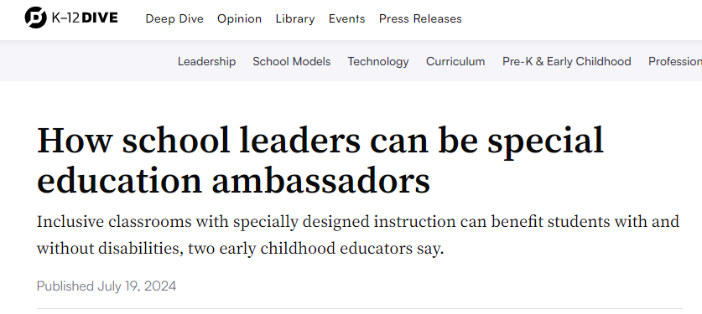
Notes:
Let’s give an example. I found this great article from K-12 Dive that relates to CEC’s work and mission, and is something that I think our audiences would really like.

Slide 12
Notes:
Now, I can share this link without anything else and it will appear on our followers’ newsfeeds just like this. While they might appreciate us sharing it, they are not getting the full value of this post. Why did we decide to share it? Is there something that we want to draw peoples’ attention to? Why is this relevant?
Let’s add some more elements to make this more appealing and impactful.

Slide 13
Notes:
By adding a quote from the article, the post is giving our followers more information about what we are sharing. It gives our followers some more information and might encourage them to click into the article, share, comment, like, or engage in some way. When you are sharing articles and picking quotes, try to find one that relates to the overall message of the article and that contains some key words that you know your audience will recognize. This post calls out SDI, which is something that special educators know about and want to get more information on.
What else can we do to make this more appealing?

Slide 14
Divination: Looking Forward and Planning
Social media takes time
Plan out the year ahead
Evergreen
Utilize tools like content calendars and schedulers
Notes:
There is a reason that there are full-time social media managers. It takes a lot of time to get content, write up the copy, check the analytics, and so forth. We are not expecting anyone to be putting in 40 hours a week toward social media. But there are steps you can take to reduce the amount of time you are spending on social media overall. Take some time at the beginning of the year (the actual year or school year) and pull out a calendar. What’s happening in the next year? Put your holidays on the calendar, any events that you are participating in or think your audience might be interested in, any deadlines or important dates. You have a ton on your calendar already!
There is content we refer to as evergreen, which is appropriate to post at any time. These can include resources, blog posts, guides, and more. Create a document that has this information, whether it’s just a link to a site or the already created social media posts and images. You can plop those into your calendar ahead of time, or as you go if you have a gap. And don’t forget about resharing! CEC Headquarters posts very often and you can always reshare those posts or even take the links/images/resources and share them from your own page. Don’t forget about the social aspect of social media.
Make sure to leave some room to post about timely events. And it’s okay to not post every day. At the very least, try once per week per platform. The top goal should be 5x/week on every platform but again, that takes a lot of time and effort.
There are a lot of tools that I will include the resources to help you plan out your content. These include content calendars that you can use to plan and draft your content, and content scheduling tools that allow you create posts and schedule them to appear on your platforms in the future. There are paid and free options to help you knock out a week’s worth of posting within moments. Some platforms even offer their own posting tools, like Facebook and Instagram.

Slide 15
Mystical Metrics: Measuring Your Success
How do we measure success?
What do these analytics mean?
What do I do with them?
Notes:
We have put the work in. Now what? Let’s take a look at your metrics and analytics. In our digital age, we can track everything we do. But what are our goals, our why? Think back to why you are on social media and from there, we can figure out what metrics to look at. If you are trying to get people to read a blog post, you can take a look at link clicks or engagement rate (which is the total amount of engagement divided by the amount of impressions/views on a post). If you are trying to spread the word on an action alert, take a look at those share numbers.
These analytics give you insight into your audience and how they behave, and what they like. You can use these figures to measure success and progress. You can also use them to guide your path forward. If you share news articles on a variety of topics, look at the topics that get the highest amount of engagement. These are the topics your audience likes, and you can shift your content to cater more to that aspect.
Now that you have decided to track your analytics, what do you do with them? It’s a good thing to keep in mind to adjust your strategy going forward. I would also be careful to not tie performance too closely to certain metrics. Social media is finicky and the algorithm changes without warning. For example, Twitter, now X, has seen a massive departure of their users, and as a result, many accounts have seen drops in engagement and followers.

Slide 16
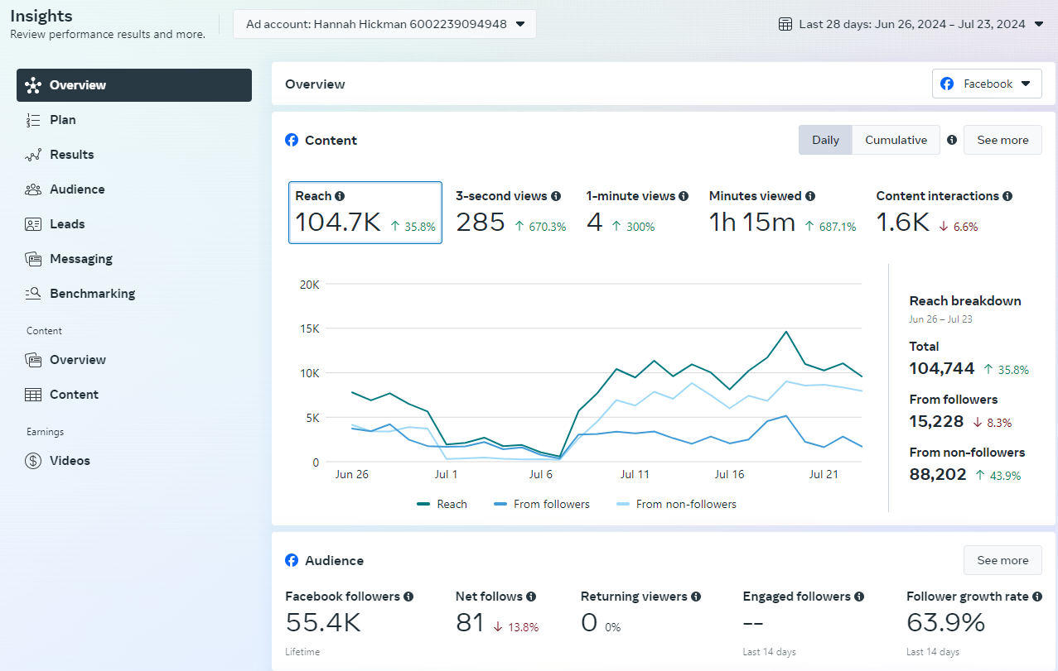
Notes:
This is what Facebooks’ insights, or analytics look like. Let’s walk through this live and figure out what we should be looking at and what we can learn.

Slide 17
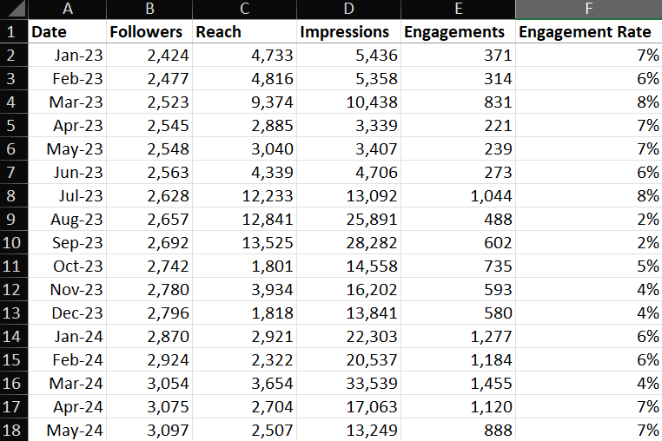
Notes:
This is what we use to track our monthly Facebook metrics. As you can see, it’s pretty simple and it does the job. It’s an easy way to quickly reference performance and find patterns. In the resources accompanying this presentation, we included a copy of how we used our 2023 metrics.

Slide 18
THANK YOU
Hannah Hickman, Marketing Manager
Hhickman@excpetionalchildren.org

