Slide 1
Help your members succeed with CEC's professional development, resources, and Standards and Accreditation
Laurie VanderPloeg | Associate Executive Director, Professional Affairs
Brad Duncan | Director of Standards and Accreditation
Brooke Massey | Senior Manager, eLearning
Notes:
Shortened title. This PPT template has to be revised.

Slide 2
Who are we?
CEC’s professional affairs department
Notes:
At the Council for Exceptional Children (CEC), professional development is what we do.
We offer a wide variety of professional development opportunities through webinars, online courses, in-person trainings, conferences, and more.
From our earliest days, we've recognized the critical role of standards in defining special education as a profession.
As the recognized leader for special education professional standards, we develop standards, ethics, practices, and guidelines to ensure that special educators are better prepared for successful, long-term careers.

Slide 3
PROFESSIONAL AFFAIRS
Team
Areas of Oversight
Laurie VanderPloeg
Brad Duncan
Brooke Massey
Megan Shea
Renee Glasby
Aimee Roberge
Melissa Trout
Online PD Programs
Webinars
Contract Training Programs
Conventions
Fall PD Fair
Standards and Accreditation
Repository/Professional Resources
Notes:
Quick overview – 30 seconds

Slide 4
CEC Professional Affairs Department

Slide 5
PD Agenda
Know what is available to all CEC members
Doing the leg work for your members
Creative ways to repurpose content so your members see the value of their membership
Targeted content curation
Targeted marketing & communications
Consistent recruitment for member involvement/engagement
Notes:
Change the name of this? Maybe we move to the end after we present what is available?

Slide 6
So what do we have?
Let’s review the PD that CEC has to offer your members!

Slide 7
Come hang out with us online!
Notes:
Talk about benefits to Divisions and come talk to me if they want to participate and have not shown interest yet
Invite Units to attend/spread the word

Slide 8
Convention
Share important registration dates with members
Filter highly relevant content for your members (or at least the quantity!)
Schedule meet-ups through the mobile event app
Start a discussion thread during the convention
San Antonio
Difference between in-person/virtual
PAC: each division gets to choose some content - highlight that content for your division
PAC will make decisions in August
Why convention is a good opportunity for your members
Idea sharing between states
Great addition to state and Division conferences
Notes:
Last bullet = compare to state/local government and federal level government

Slide 9
CEC Learning Library
Filter content by relevance to your members
Highlight timely PD options for members in newsletters
Get on-demand information and CEUs
Notes:
Over 175 on-demand courses/webinars and new additions every month. Quick Takes, webinars, workshops, resources

Slide 10
On-Demand Programs
Webinars - FREE for CEC members!
Everything Else – Special member pricing
Individual Webinars
Collections
We can assist with collection curation
HLPs for Paraeducators (FREE)
Supporting Paraeducators Series
JumpStart for New/Early Career Special Educators (starting soon)
Educator Shortage Webinar Series (FREE)
Coming Soon
Notes:
Use these to highlight content that is relevant/important to your members.

Slide 11
Collaboration Opportunities
Partner with CEC to offer a FREE webinar for your members
You identify the content & presenter (what do your members need right now?)
CEC does the rest!
Offer free registration to your members as a member recruitment or retention effort
Your members could get it for free, but we charge everyone else (convert these folks to members)
Notes:
Great member recruitment and/or engagement opportunity!

Slide 12
Paraeducator Resources
Paraeducator Competencies
New Paraeducator Assessment Toolkit
New member category for paras
PD and resources
How to work with a paraeducator
Support for paraeducators

Slide 13
Resource Repository
Database of resources for teachers
Peer-reviewed for relevance & utility
FREE for CEC members
Notes:
Pitch to fill it up
Resume Building
Encourage members to submit to help other teachers

Slide 14
Curating Resources for Members | ETRR
Filter content from resource repository by relevance to members
Share or highlight resources applicable to members and celebrate contributors from your Division or Unit
Encourage submissions from your members to increase resources and elevate awareness of your members

Slide 15
Targeted Member Benefits
Highlight & communicate targeted resources to your members
Curate relevant content for them
Celebrate your members’ contributions
Encourage engagement & reinforce value

Slide 16
How do we choose what to offer?
We asked!

Slide 17
PD Needs Assessment
Completed end of 2022/beginning of 2023
Initial step for CEC to inform the implementation of part of the 2022 strategic plan
Collected information from members on:
Current areas of challenge
Critical topics for PD
Determine preferences in the types of professional supports available

Slide 18
PD Needs | Teacher Feedback Trends
Top 3 Areas of Challenge from Teachers
Social/Emotional & Behavioral Health
Assessment & Progress Monitoring
Curriculum Access (SDI, UDL, co-teaching, etc.)

Slide 19
PD Needs | Administrator Feedback - greatest challenges for special education staff?
Top 3 areas of challenge for educators on their teams
Social/Emotional & Behavior Health
Curriculum Access
Instructional/Intervention Practices

Slide 20
PD Needs | Administrator Feedback - greatest areas of challenge for themselves
Top 3 areas of challenge for Administrators
Educator supports & wellness
Social/Emotional & Behavioral Health
Legal, ethical and compliance issues

Slide 21
Feedback Trends | Resource Types
What type of “resources or professional development” would be most helpful to you?
Teachers:
Books/Articles/Case Studies
Online/Virtual Training/Webinars
Manuals/Guidance Materials/Templates
Administrators:
Books/Articles/Case Studies
In-person Training/Seminars
Coaching/Mentoring

Slide 22
Who are you?
Division leaders
Unit leaders
Who else?
Notes:
While they are Division/Unit leaders, they are also CEC MEMBERS and division/unit MEMBERS

Slide 23
The Value of Division Membership
Get deeply involved in your profession
Focused groups of CEC members based on their professional interests, role, practice setting, or focus on a specific exceptionality
Expand your professional network, exchange knowledge, and advance your career
Create the pathways you need to grow your career through conferences, workshops, journals, and more
Gather in-person with folks who share interests with you (convention, conferences)
Notes:
What would division leaders add to this list?

Slide 24
The Value of Unit Membership
It’s FREE with your CEC membership!!
Connect with colleagues nearby
Access local resources
Engage in public policy efforts that impact your practice and your students directly
Attend local meet-ups and professional development events
Notes:
What would unit leaders add to this list?

Slide 25
Standards & Accreditation
CEC Standards
HLPs
Program Review
Accreditation
Resources

Slide 26
Professional Preparation Standards
What are they?
Set the expectations for what completers of professional preparation programs should know and be able to do
They provide a common framework for how high-quality educators are prepared
Audiences: Preparation Programs, policy makers, credentialing agencies, administrators

Slide 27
Initial & Advanced Levels
Standards are organized into two categories of initial and advanced​
Does not indicate graduate or undergraduate​
Initial programs is designed to result in a first special educator licensure/credential​
Advanced Programs are designed to result in an additional special educator licensure/credential

Slide 28
CEC's Standards (Initial-Level)
Initial Practice-Based Professional Preparation Standards for Special Educators (K12)​
Initial Gifted Educator Preparation Standards*​
Initial Practice-Based Professional Preparation Standards for Early Interventionists/Early Childhood Special Educators (EI/ECSE)

Slide 29
CEC's Standards (Advanced-Level)
Advanced Gifted Educator Preparation Standards​
Advanced Administrator of Special Education Professional Leadership Standards​
Advanced Special Education Preparation*
Notes:
*The initial special educator standards are newly revised and required for use by all programs conducting program review or accreditation beginning in Fall 2022. The 2012 version of these standards has been phased out.
**The initial gifted educator standards are currently under revision.
Different audiences for the standards

Slide 30
High-Leverage Practices (HLPs)
Address the most critical practices that every K12 special educator should master and be able to demonstrate
The HLPs are used frequently in classrooms and have been show to improve student outcomes if successfully implemented
22 HLPs organized into four aspects of practices
Collaboration
Assessment
Social/emotional/behavioral
Instruction

Slide 31
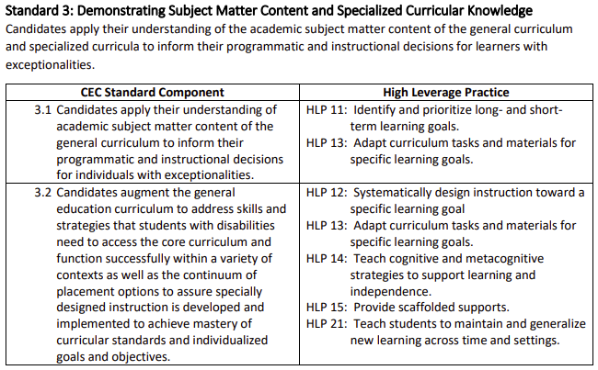
HLPs and the Standards
The standards drive training pre-service teachers on how to enact the HLPs
PD plan in development for faculty on HLP and Standards

Slide 32
Program Review with National Recognition
Partnership with CAEP (Council for the Accreditation of Educator Preparation)
Only programs pursuing Accreditation through CAEP are eligible
AKA SPA Review (Specialized Professional Association)
Not equivalent to Accreditation
CEC issues National Recognition Decision; CAEP issues Accreditation Decision
Notes:
Only programs that are part of an institution actively engaged in CAEP Accreditation may participate in the program review program review process

Slide 33
Why CEC Created Accreditation
CAEP was the only mechanism CEC had to evaluate programs using our Standards through national recognition
CEC Accreditation provides an exclusive opportunity for special educator programs to seek accreditation independently from or in addition to their unit/EPP
An avenue for CEC to influence and directly impact the preparation of special education professionals through our standards

Slide 34
Accreditation Overview
Fully virtual process
Reduces financial and staffing resources
Increases flexibility
Cost are tiered based on program size (based on enrollment) and discounts for multiple programs from the same parent organization
Streamlined and supportive process

Slide 35
Why become CEC accredited
Relevance: CEC Standards represent consensus from the field
Commitment: Demonstrates your program’s commitment to operating a high-quality special educator preparation program
Impact: Assures the public, the profession, and graduates of accredited programs that educators are prepared
A Statement of Excellence: CEC upholds the national standards for special educator preparation programs while encouraging innovative practices and instructional strategies.

Slide 36
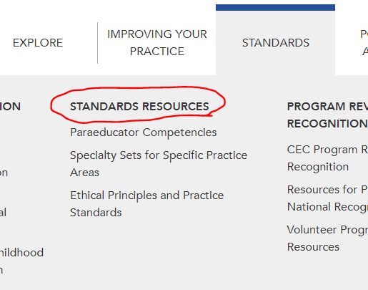
Resources
CEC Website​
HLP alignments​
Standards alignments​
Accreditation​
National Recognition​
Division Websites​
"Purple Book"
HLP Faculty Guides (Coming Soon!)

Slide 37
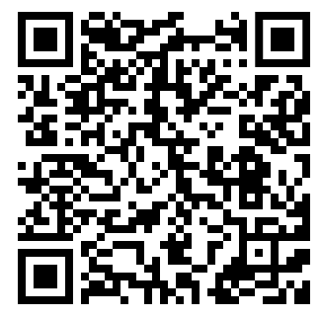
Q&A
Contact us!
Bmassey@exceptionalchildren.org
Bduncan@exceptionalchildren.org
LVanderPloeg@exceptionalchildren.org
Scan this QR code to access digital resources

