Slide 1
Quarterly Regional Support Townhall

Slide 2
Welcome
Brannan Meyers, Component Services Director
Luann Purcell, Unit Resource Advisor

Slide 3
Welcome
Danielle Wieczorek
CEC Component Services Manager
dwieczorek@exceptionalchildren.org

Slide 4
Welcome
Danielle M. Kovach, Ed.D.,
CEC President

Slide 5
Please enter the information below in the chat box :
Who is here?
Unit
Name
Office with Unit
How long have you been in leadership with this unit

Slide 6
First Things First
Open email to bmeyers@exceptionalchildren.org and luannpurcell@gmail.com
take notes there, send when done so we can keep the dialogue going!

Slide 7
Why are we here?
Goal: We want you to leave with knowledge and support and we want to learn how we can we assist

Slide 8
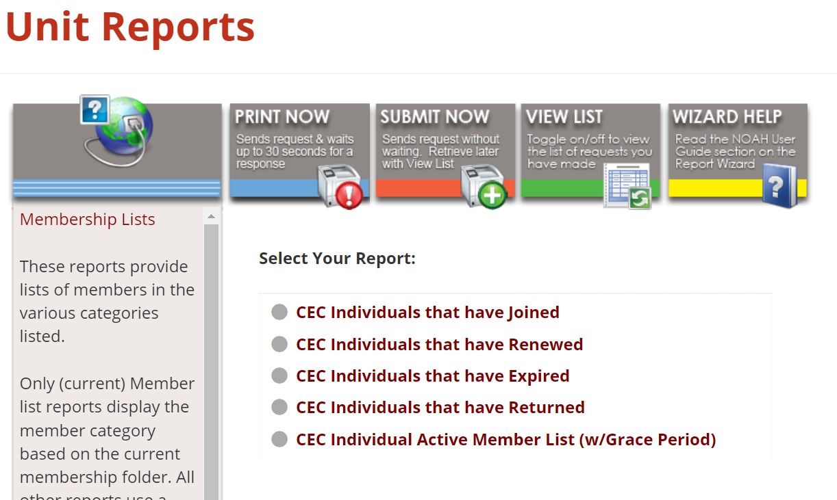
Membership
Pulling Member List
https://exceptionalchildren.org/engage/resources/units
Notes:
https://exceptionalchildren.org/engage/resources/units

Slide 9
Onboarding
Now that you know how to pull your membership list--- Lets share ways that we welcome new members?

Slide 10
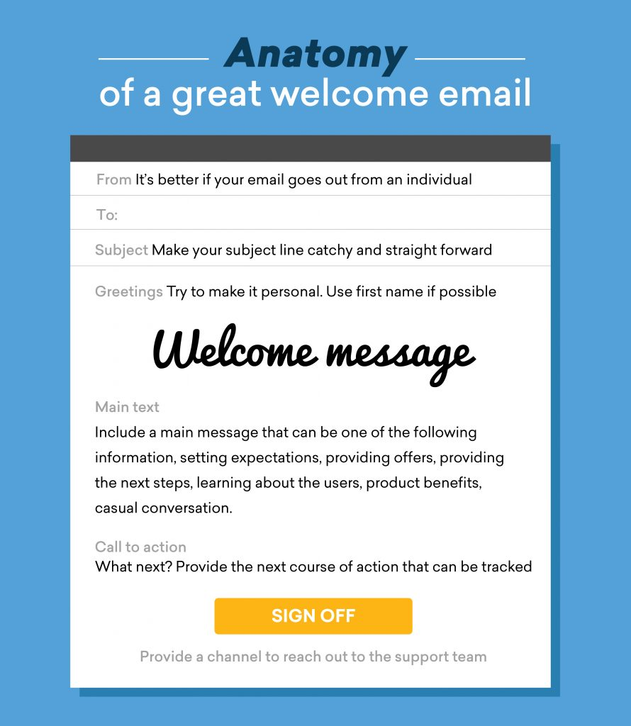
Onboarding
First Impressions Matter

Slide 11
Onboarding
Create a “welcome” email series that explains your association and its benefits.
Instead of including every possible bit of information in your new member welcome email, create multiple emails your new members will incrementally receive after they sign up.
These emails can include:
Information about your Unit
Explanation of Benefits
Helpful tips or recent Blogs
Anything that adds value for your new members
Send them to a member center on your website
Notes:
!

Slide 12
How Do New Members Find You?
Rely on your brand or your brand ambassadors (members)
If you have a strong brand or brand ambassadors, people get referred

Slide 13
Recruiting
How are you getting new members?

Slide 14
Volunteers
President
President Elect
Past President
Treasurer
Secretary
Membership Chair
Web Chair
Communications Chair
Professional Development Chair
Student Chair
Representative Assembly ( RA) Children and Youth Action Network Representative ( CAN )

Slide 15
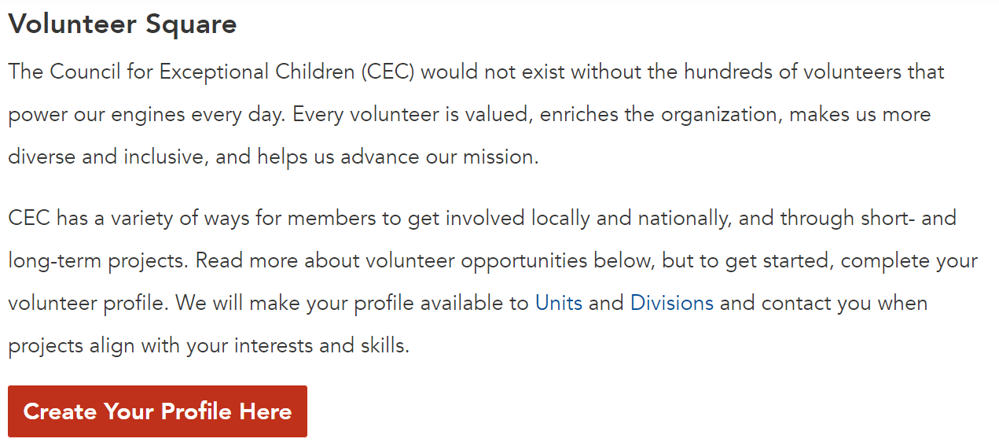
Volunteer Square
https://cec1785.wufoo.com/reports/volunteer-square/
PLEASE NOTE: You can post the link to Volunteer Square everywhere, but the list of those who have signed up is confidential to division and unit leaders only.
Notes:
https://cec1785.wufoo.com/reports/volunteer-square/

Slide 16
Communications
How often are you communicating with your members?
What ways are you communicating with your members?

Slide 17
Communications Best Practices
Instead of this...
Do this!
Send just one welcome email​
Leave your website unattended for more than thirty (30) days​
Over and/or under communicate with your members​
Leave your membership roster unattended for more than thirty (30) days
Have an onboarding campaign​
Use common language from CEC HQ’s website​
Communicate with your members on a regular basis (weekly/monthly) with new topics and resources​
Have a communications calendar​
Refer back to CEC HQ’s website when possible​

Slide 18
How To Repackage CEC Resources
Two-way communication
Are you communicating well with your members?
Do they communicate back with you?
Use CEC's benefits as your benefits when pitching to potential members
Use CEC's resources and guides as a reference
Email campaigns
Social media campaigns
Social Media Toolkit
Use the CEC website
USE SET
Article especially pertinent to your unit

Slide 19
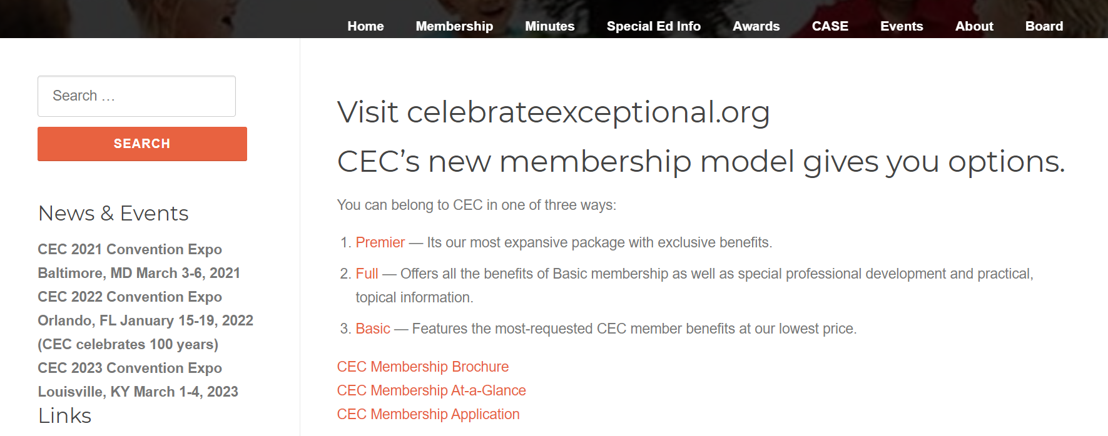
Is Your Website Up To Date?

Slide 20
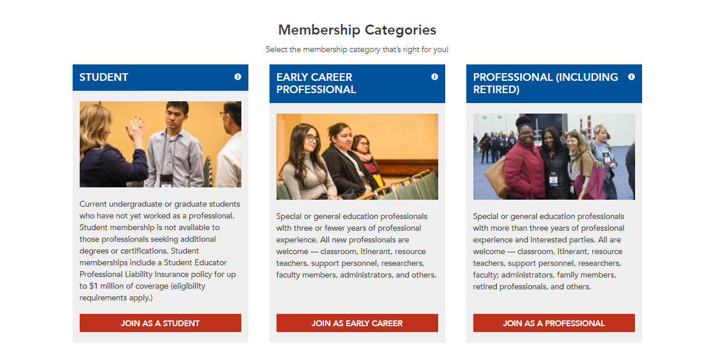
First Impressions Matter
Strategies: Make Sure You Have what Your Potential Members are Looking For
TARGET
VALUE
CTA

Slide 21
Tools and Resources
Meetings
Email Systems & Tools
Zoom
www.calendly.com/ceczoommeetings
www.calendly.com/ceczoomwebinars
Moosend (free and paid plans)
Mailchimp (free and paid plans)
Constant Contact (paid plans only)
Social Media Schedulers
Later (free and paid plans)
Hootsuite (free and paid plans)
Buffer (paid plans only)
Tweetdeck (free)

Slide 22
Save the Date
Leadership Institute July 8-10, Alexandria VA

Slide 23
Final Thoughts…
Any questions?
Any suggestions?

Slide 24
Next Steps….
Next Quarter we will focus more on Membership, we will delve deeper into what we discussed
Your homework :
Bring back your membership chair/ someone who is willing to be your units membership chair to next town hall

Slide 25
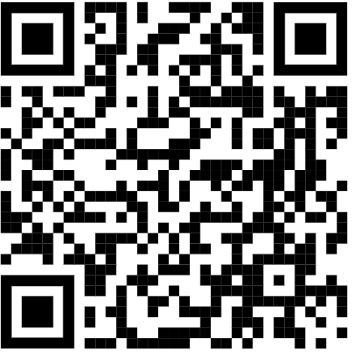
THANK YOU!
Thanks for all you do for CEC, Students, Staff, Family!
We are here to help
Brannan bmeyers@exceptionalchildren.org
Luann
luannpurcell@gmail.com
https://bit.ly/3Jh1MXB

