Slide 1
U.S. Units & Divisions
Financial, Operational & Legal
Overview

Slide 2
Presentation Outline
Unit & Division Dues: Collection & Distribution
Maintaining 501(c)(3) Status – U.S. Only
Form 990 - Annual Tax Returns – U.S. Only
Other Operations Planning – U.S. Only
Budgeting & Reserves
Contacts and Resources
CEC Financial Condition
CEC 2020 Major Initiatives

Slide 3
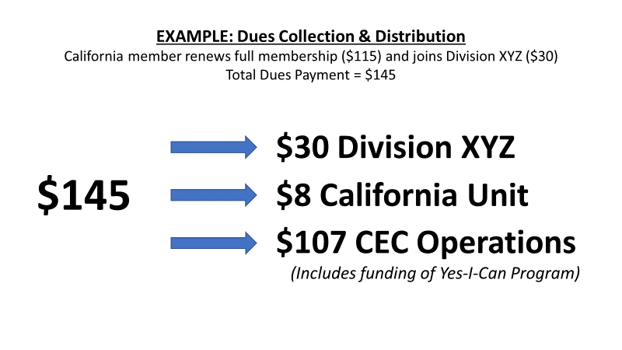
Unit & Division Dues
Collection & Distribution

Slide 4
Unit & Division Dues
Service Fees
CEC Provides Services to Units & Divisions Including:
Membership administrative support & data management
Direct mail and email reminders
Membership marketing
Promote events & announcements
Customer service (reply to inquires by phone, email and mail)
Collect and distribute unit and division dues
Advocacy efforts for the Special Education field
And more…. (see CEC website for details)
Service Fee for Units & Divisions
12.5% of dues collected

Slide 5
Unit & Division Dues
Collection & Distribution
Units and Divisions are Required to Submit Signed Annual Assurance Forms to be Eligible to Receive Dues:
    Contact Info for Current Officers & Directors
    Copy of Current Bylaws
    U.S. Units & Divisions – Most Recent 990 Tax Return
    Assurance that the Unit / Division provides required services to its members

Slide 6
Unit & Division Dues
Collection & Distribution
UNITS
Annual Report Provided Including Dues Paid by Member
Dues Collected (net of service fees) Sent by Check Once Per Year (March)
DIVISIONS
Monthly Financial Statements Provided to Each Division Including Dues Paid by Member
Division Dues Paid Monthly or Quarterly (Division’s Preference)
Service Fees Deducted Quarterly
Payment by ACH Available (Contact CEC)

Slide 7
Maintaining 501(c)(3) Status
(U.S. Only)
Units and Divisions are Separate Entities from CEC and Each Other; Each has Separate Articles of Incorporation and Separate Employer Identification Number (EIN)
What is My Employer Identification Number (EIN)?
Find an old “affirmation” or “determination” letter from IRS
Find a previous 990 Tax Return
Check with bank where account is held
Call the IRS (800) 829-4933

Slide 8
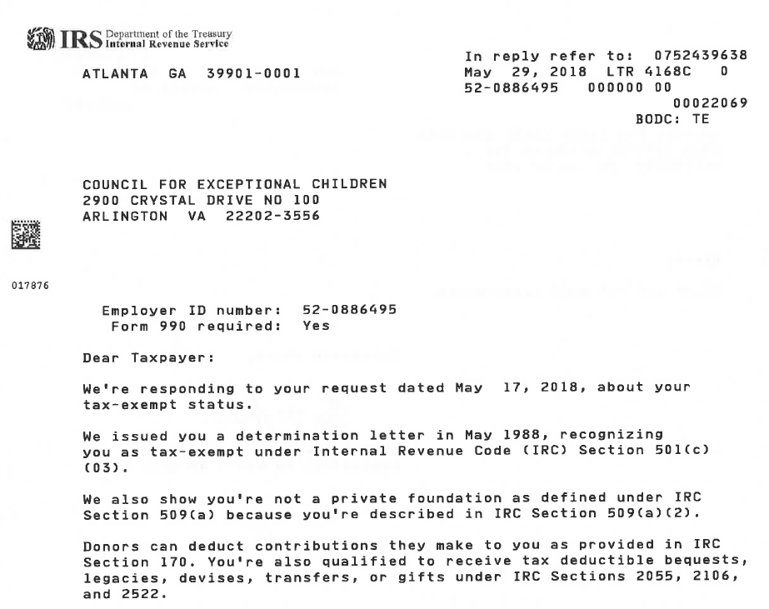
Maintaining 501(c)(3) Status
(U.S. Only)
Contact IRS (877) 829-5500 to request an
“affirmation letter” or “determination letter”

Slide 9
Maintaining 501(c)(3) Status
(U.S. Only)
File Annual 990 Tax Return
Make 990 available to public upon request
Cannot endorse or fund political candidate or organization
May lobby in limited amount if it furthers 501(c)(3) mission
Cannot generate excessive UBI (Unrelated Business Income)

Slide 10
Maintaining 501(c)(3) Status
(U.S. Only)
Keeping Orderly Records Allows for Transfer of Information to Future Unit & Division Leaders
Documents to Keep On File
Articles of Incorporation
Bylaws
990 Tax Returns (Minimum 3 Years)
IRS Determination Letter

Slide 11
Maintaining 501(c)(3) Status
Form 990 – Annual Tax Returns
(U.S. Only)
irs.gov/charities-non-profits/annual-filing-and-forms
Returns due 15th day of 5th month following close of tax year
Revenues > $200K OR Assets > $500K – File Full Form 990
Accountant Assistance Recommended
Revenues < $200K AND Assets < $500K – File Form 990EZ
Probably DIY
Revenues < $50K – File Form 990N
Definitely DIY – Basic Info on Postcard-Sized Form

Slide 12
Maintaining 501(c)(3) Status
(U.S. Only)
Failure to File 990 for Three Consecutive Years
= Automatic Loss of 501(c)(3) Status
Instructions for Reinstating 501(c)(3) Status
Instructions for Applying for New 501(c)(3) Status
irs.gov/charities-non-profits

Slide 13
Other Operational Planning
(U.S. Only)
Insurance
Forrest T. Jones & Company – Provides Insurance Options for CEC, Units & Divisions
Do not have to use FTJ – Can use any provider
Insurance Types to Consider
Directors & Officers
Commercial & Liability
Convention & Events
Errors & Omissions
Other

Slide 14
Other Operational Planning
(U.S. Only)
Annual Audit
Independent Agency Hired to Review Financial Reporting and Internal Controls
Is considered optional in most states for Non-Profits
Recommended even if not required; best business practice, especially for larger organizations or fundraising organizations

Slide 15
Other Operational Planning
(U.S. Only)
Miscellaneous
Internal Written Policies
  Whistleblower?
  Conflict of Interest?
  Confidentiality?
councilofnonprofits.org/tools-resources

Slide 16
Budgeting & Reserves
Budgeting
Budgeting IS a roadmap to financial goals
Budgeting IS NOT a crystal ball
Monitoring actuals vs. budget - where are we compared to where we wanted to go?
Pay particular attention to bottom line – make adjustments to reach bottom line budget
Drill down to individual line items to determine areas of necessary adjustment or success.

Slide 17
Budgeting & Reserves
EXAMPLE

Slide 18
Budgeting & Reserves
Reserves
Theoretically, how many months can operations be maintained with no additional cash coming in?
Liquid Assets (Cash / Investments)
Less: Short-Term Liabilities (bills due within 30 days)
Divided by Average Monthly Expenses
3 months is average reserve – 6 months is better
If reserves are 1 year or more (guideline), may be stockpiling money; need to expand programming / make donations

Slide 19
Contacts & Resources
CEC HQ Contacts
Craig Evans – CFO
craige@cec.sped.org (703) 264-9416
Division Monthly Statements / Division Dues Transfers
Tiffany Lewis – Sr. Accountant
tiffanyl@cec.sped.org (703) 264-9410
Assurance Forms / Unit Dues Transfers
Bryan Reynolds – Membership & Database Manager
bryanr@cec.sped.org (703) 264-9480

Slide 20
Contacts & Resources
(U.S. Only)
stayexempt.irs.org
Everything you need to know about obtaining and maintaining 501(c)(3) tax-exempt status
FAQs, Video Courses, Resources
irs.gov/charities-non-profits
Information on 990s and filings
Information on reinstatement of 501(c)(3) status
Educational resources and guidance

Slide 21

Contacts & Resources
www.cec.sped.org About Us CEC Leadership Unit and Division Leadership Resources
“Leadership Finance & Operations Guide 2019”
Dues Collection
990 Information
501(c)(3) Maintenance
Resource Contacts
More

Slide 22
CEC Financial Condition
Two Major Financial Challenges Over Past Several Years:
20-Year Lease Saga: 2010 – 2030 @ $1 million / year
Declining Membership & Dues Revenue
Challenge #1 Has Been Resolved:
Negotiated Early Termination of 20-Year Lease
Entered New Lease in New Location
New Lease Structure Saves CEC $6.5 million over 7 years
Challenge #2 Persists (Next Slide)

Slide 23
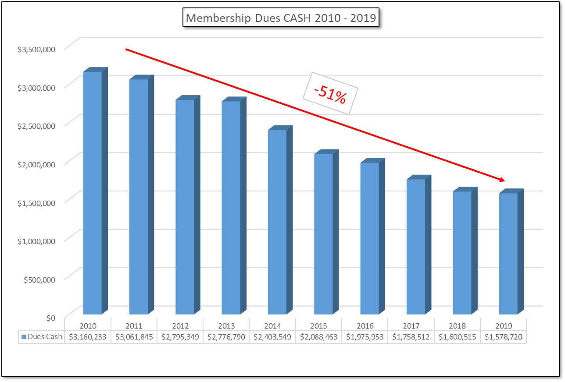
CEC Financial Condition
Declining Membership Dues
Although Financials will show a small increase on an accrual basis from 2018 to 2019, cash collected declined 2.3%

Slide 24
2020 Major Initiatives
Savings from Lease Allows for Expansion:
  Hire Professional Standards Director
  Hire Digital Content Manager
Membership Expansion:
  Upgraded Website
  State Initiatives
  Dues Structure Study (Early Career)
  Division Membership Marketing

